Slide 1
Closing Remarks: Take Action- Leverage Opportunities for Impact
Crystal FitzSimons

Slide 2
Meeting our Children’s Nutritional Needs
Child Nutrition Programs
School Breakfast Program
Summer Food Service Program
Afterschool Meals and Snacks
National School Lunch Program

Slide 3
Meeting our Children’s Nutritional Needs
Provides a morning meal, typically served before the start of the school day
Low-income students eligible for free or reduced price meals
Must meet USDA guidelines for healthy, nutritious meal
School Breakfast Program

Slide 4
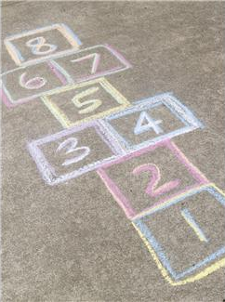
Improving Academic Achievement
School Breakfast:
Improved test scores
Less tardiness and absenteeism
Fewer disciplinary referrals
Less depression, anxiety, and hyper-activity
Notes:
Children who eat breakfast at school:
Increase their math and reading scores
Perform better on standardized tests
Improve their speed and memory in cognitive tests
Also has health benefits for school breakfast:
Decreases the risk of food insecurity, especially for low-income children.
A healthy breakfast each day helps prevent obesity.
Children who eat school breakfast eat more fruits, drink more milk, and eat a wider variety of foods.
Summer/Afterschool meals – fights obesity. Yet still these programs are limited!

Slide 5
Barriers to Breakfast Participation
School Breakfast
Late arrivals due school bus schedules/rushed morning schedules
30 cent co-payment for reduced-price breakfast burdensome
Cafeteria too small or students want to socialize or play outside;
Parents vaguely aware of the program
Program is stigmatized as being “for the poor kids.”

Slide 6
Strategies to Increase Participation
Offering Breakfast for Free (Community Eligibility/Provision 2)
Medicaid Direct Certification
Eliminating the reduced-price co-pay
Photo credit: Teach for America
Notes:
Takes away both monetary barriers as well as stigma.

Slide 7
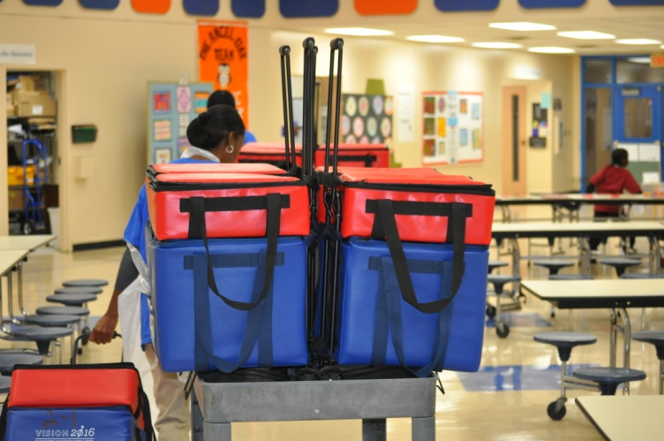
Strategies to Increase Participation
School Breakfast:
Alternative Breakfast Service Models: breakfast is served after the start of the school day and eaten in the classroom
Breakfast in the Classroom
Notes:
Breakfast in the Classroom usually takes about 10-15 minutes to serve, eat, and clean up.
Good time to take attendance, collect homework, do morning announcements.
Teachers critical to the sustainability and success of BIC

Slide 8
Improving Academic Achievement
Breakfast for Learning Education Alliance: AASA, NEA Healthy Futures, AFT, NAESP Foundation, NASSP, Ed Trust, National PTA, NASBE, FRAC
Partners for Breakfast in the Classroom: NAESP Foundation, NEA Healthy Futures, School Nutrition Foundation, FRAC
Notes:
Four out of

Slide 9
Breakfast in the Classroom
Principals Reports:
78% of elementary school principals surveyed would recommend an alternative model, with 17% neutral, and only 5% neutral
85% increased breakfast participation and 61% fewer reports of student hunger
40% fewer tardies
37% improved student attentiveness
And 34% improved school and 35% classroom environment
Notes:
Children who eat breakfast at school:
Increase their math and reading scores
Perform better on standardized tests
Improve their speed and memory in cognitive tests
Also has health benefits for school breakfast:
Decreases the risk of food insecurity, especially for low-income children.
A healthy breakfast each day helps prevent obesity.
Children who eat school breakfast eat more fruits, drink more milk, and eat a wider variety of foods.
Summer/Afterschool meals – fights obesity. Yet still these programs are limited!

Slide 10
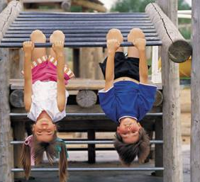
Importance of Summer
Children gain more weight during the summer
Children are more likely to be food insecure during the summer
Impact felt more in states with low Summer Food participation
Summer Learning Slide

Slide 11
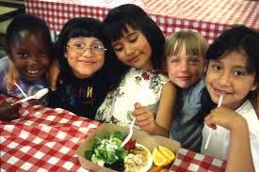
Meeting our Students’ Nutritional Needs
Provides free, nutritious meals to low-income children 18 and under
Operates when school is not in session
Qualify based on area eligibility
1 in 5 reached in CA
Summer Food Service Program

Slide 12
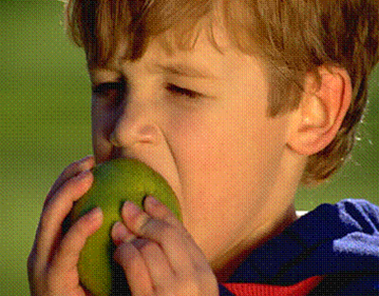
Strategies to Increase Participation
Programming and activities
Build community support
Provide interesting programming
Identify new opportunities for sites
WIC clinics, Farmers markets, Libraries, Churches

Slide 13
Meeting our Students Nutritional Needs
Provides up to a meal and a snack after school, on weekends, and school holidays
Serves low-income areas
Requires enrichment activity
Available through Child and Adult Care Food Program (CACFP)
Must meet state or local health and safety standards
Afterschool Meals and Snacks

Slide 14
Strategies to Increase Participation
What is enrichment?
Get the Athletes into the program
Build on existing transportation
Afterschool Meals and Snacks

Slide 15
Child Nutrition Reauthorization
Summer Meals Act
Summer EBT
CACFP snack
HAPPENING NOW!

Slide 16
FRAC.org
Crystal FitzSimons
202.640.1106 | cfitzsimons@frac.org
Connect With FRAC
@fractweets
@fracgram
Facebook.com/foodresearchandactioncenter
Linkedin.com/company/food-research-and-action-center

