Slide 1

The Safety Net: An Investment in Children

Slide 2

Overview of current economic context & recent academic research
Much of today’s talk drawn from Hamilton Project document I coauthored last year.

Slide 3
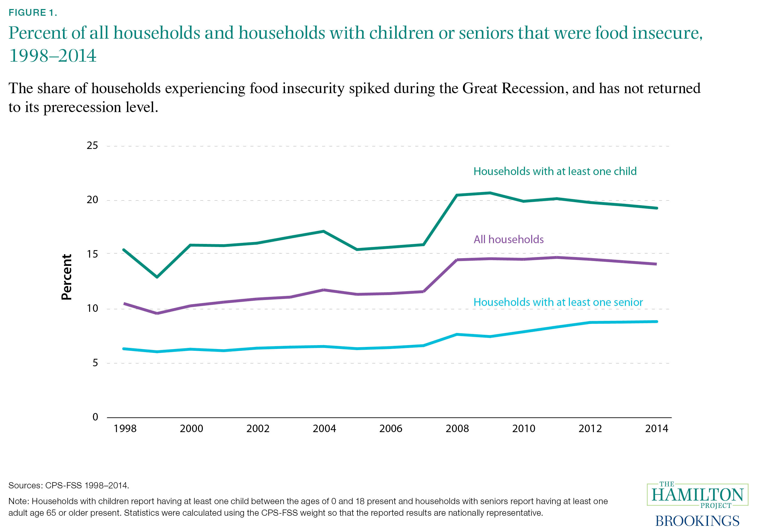
1.
In 2015 almost one in five households with children were food-insecure.

Slide 4
Food insecurity spiked, even conditional on income

Slide 5
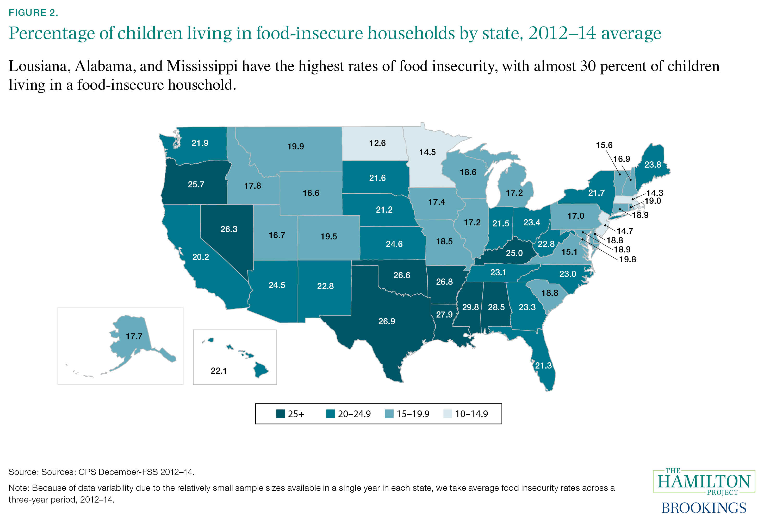
2.
In nine states, one in four children lives
in a food-insecure households

Slide 6
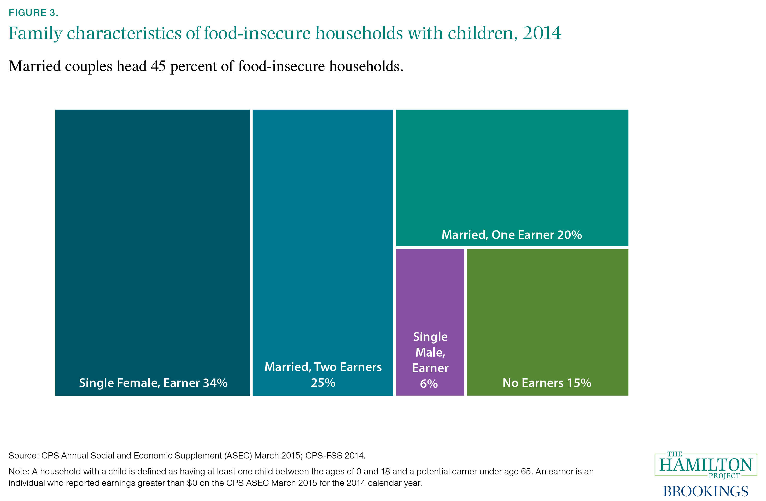
3.
About 85 percent of food-insecure households with children are headed by adults who work.

Slide 7
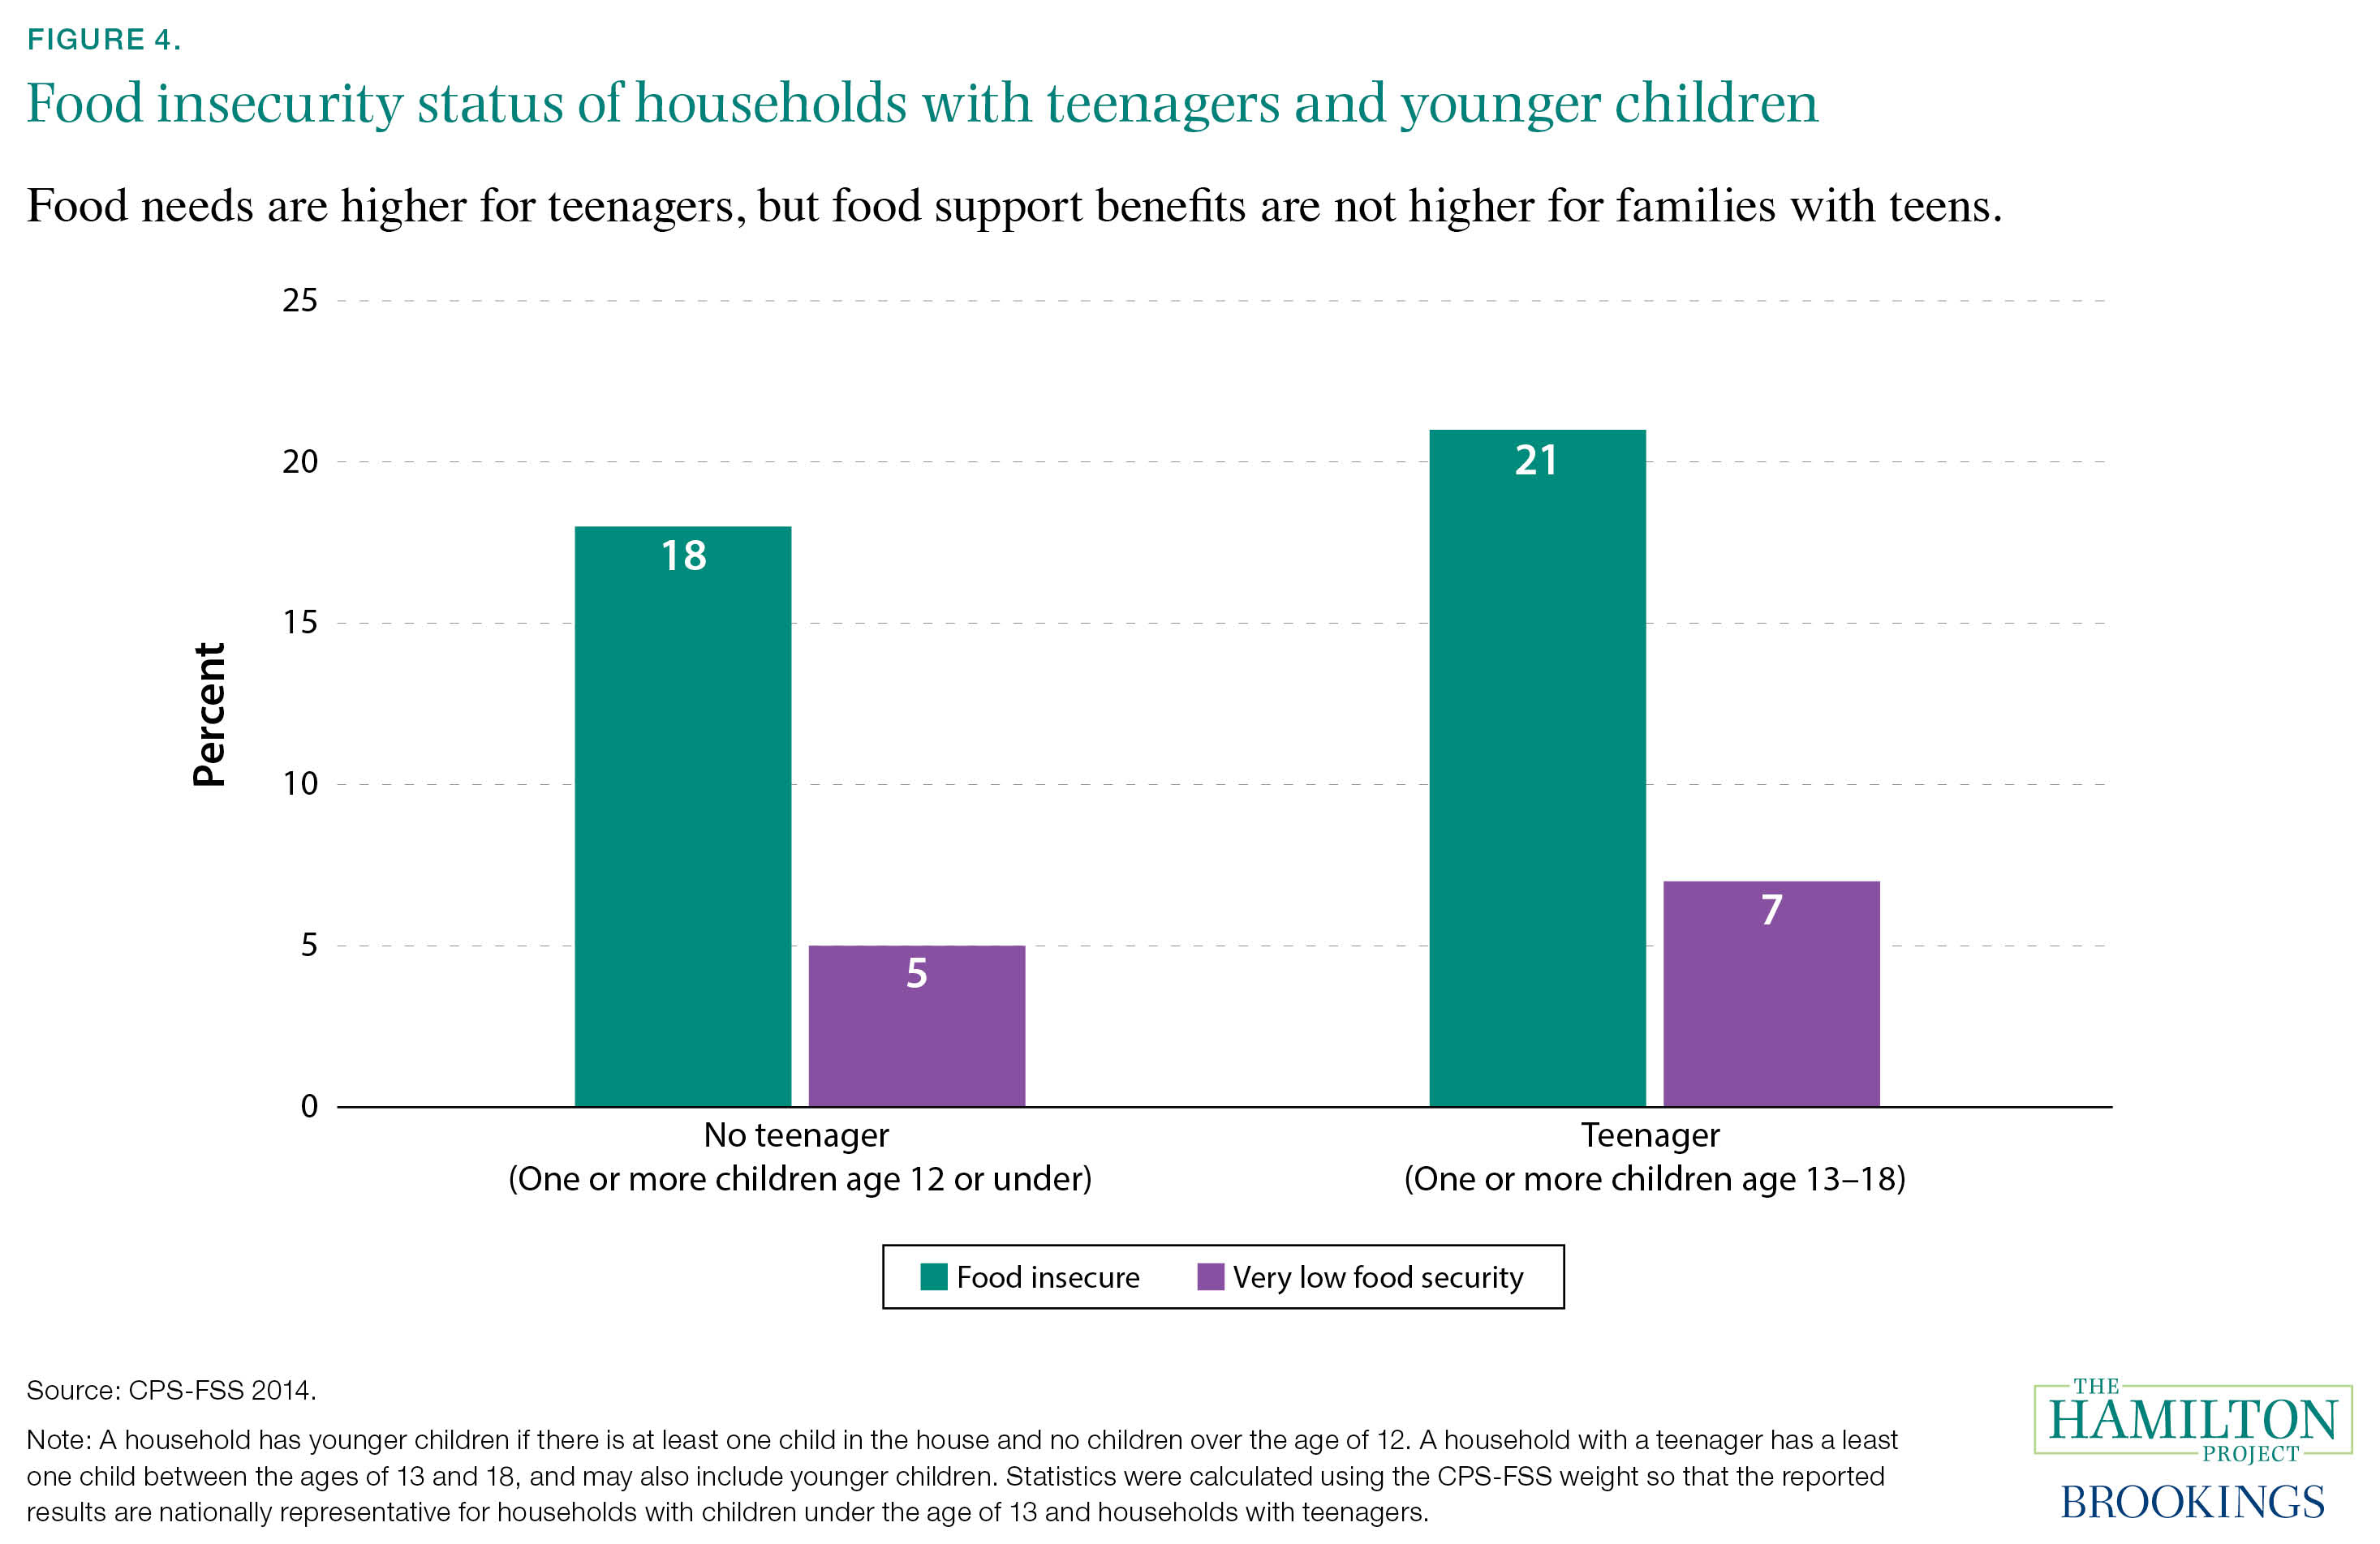
4.
Households with a teenager are more likely to experience very low food security.

Slide 8
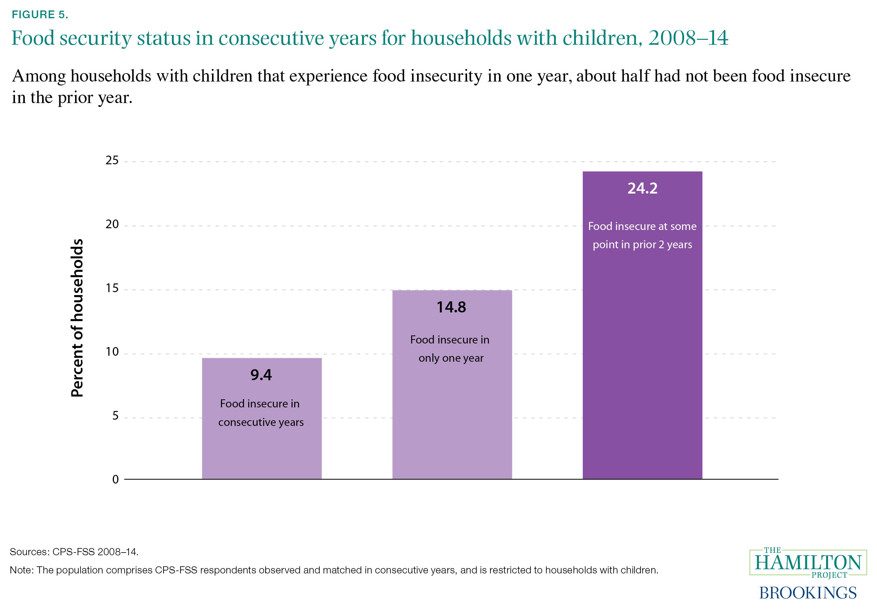
5.
Annual snapshots mask the extent of the food insecurity problem.

Slide 9
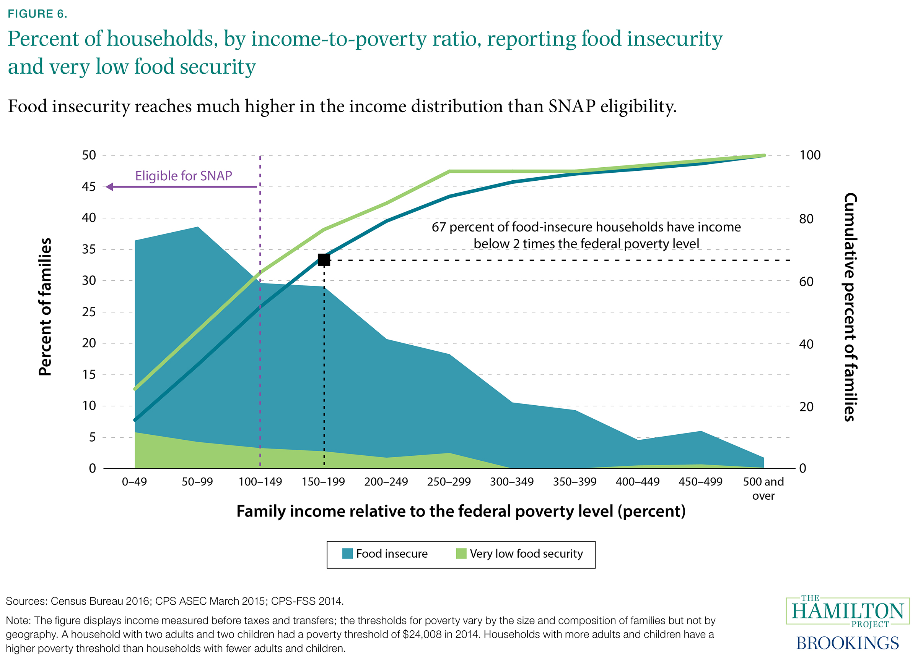
6.
One third of food-insecure households have annual incomes of at least two times the federal poverty level.

Slide 10
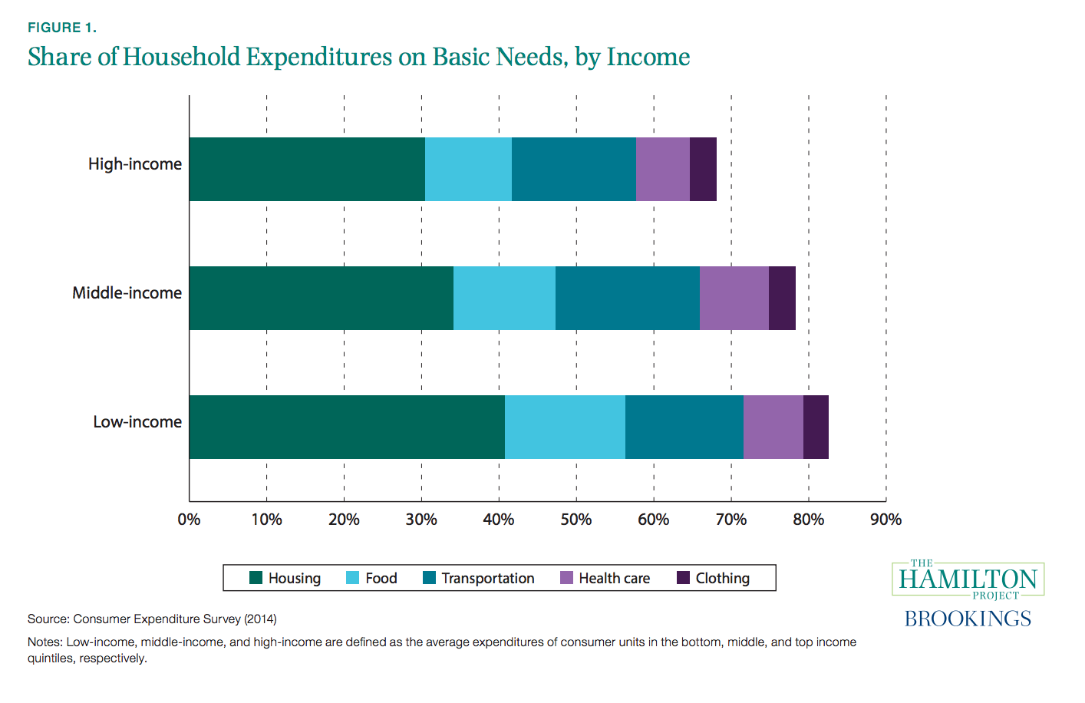
Lower-income have less slack in their budget

Slide 11
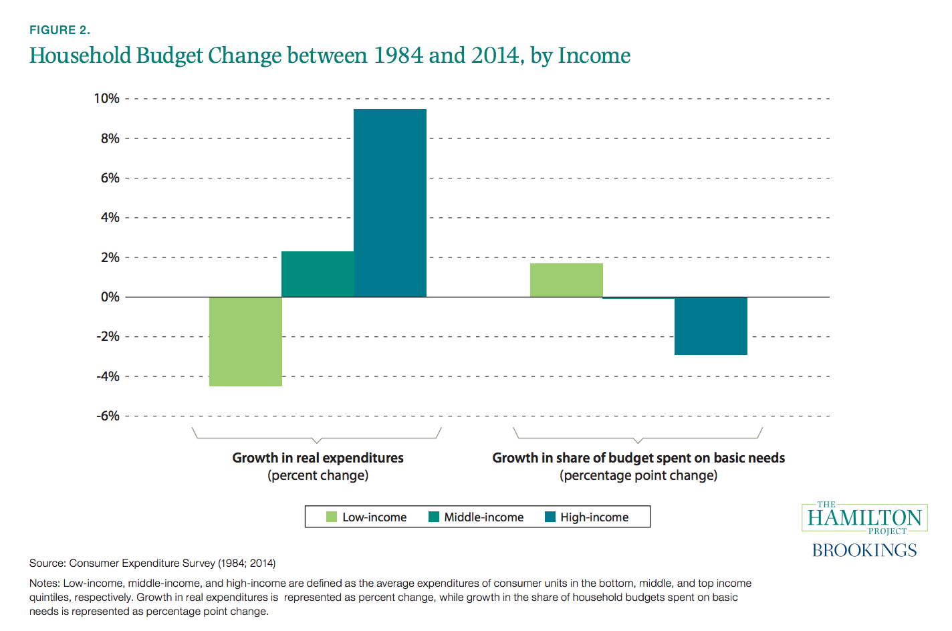
Lower-income have been losing ground

Slide 12
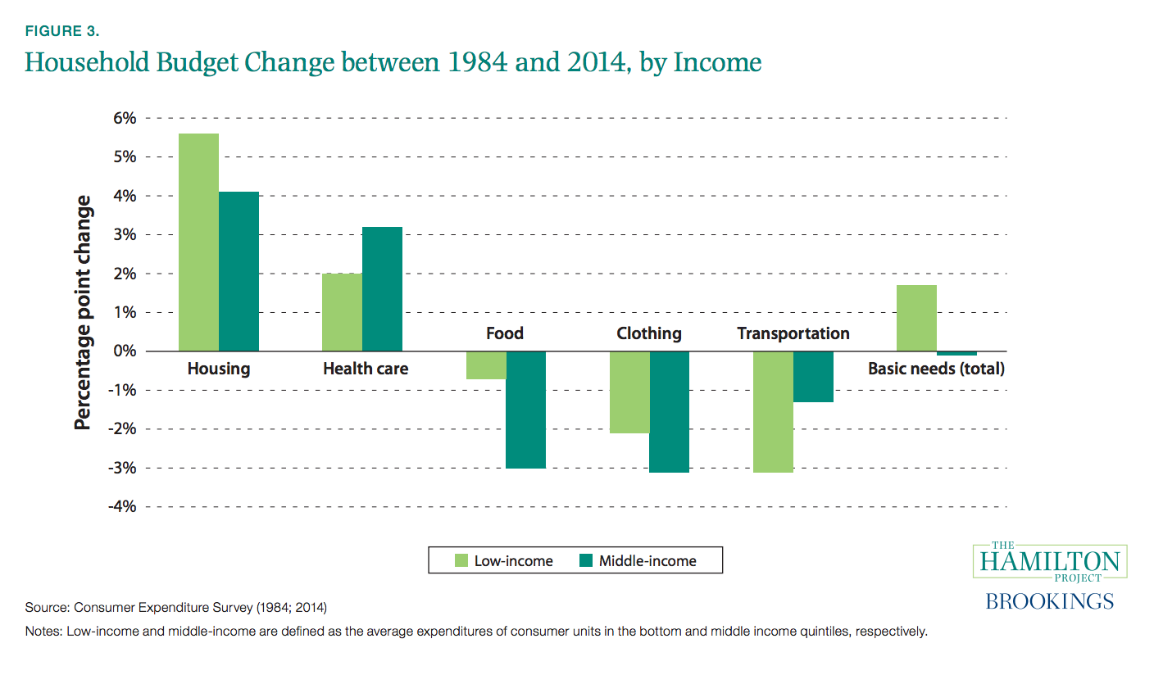
Lower-income spending more on basic needs over time

Slide 13
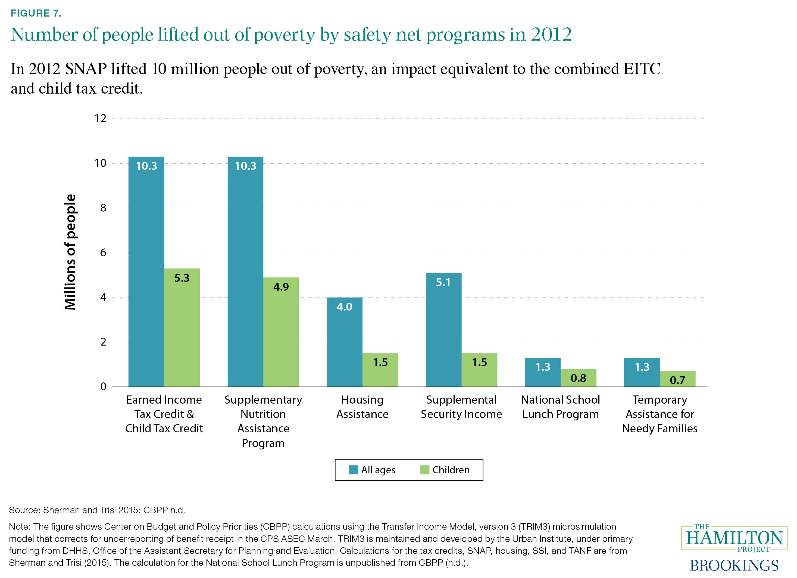
7.
The social safety net lifts tens of millions of people out of poverty.

Slide 14
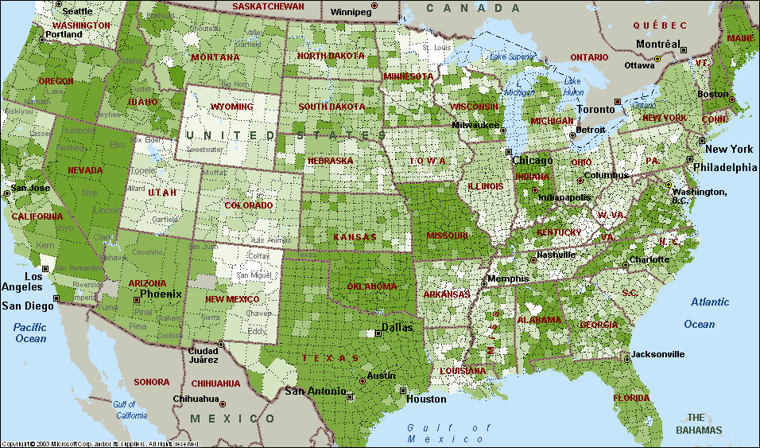
Long-Term Impacts of
Childhood Access to SNAP
Use initial rollout of the FSP (1961-1975) to examine effects of program
4 studies:
  Consumption
  Labor supply
  Birth outcomes
  Long-term impacts

Slide 15
Measuring Long-term Impacts

Slide 16
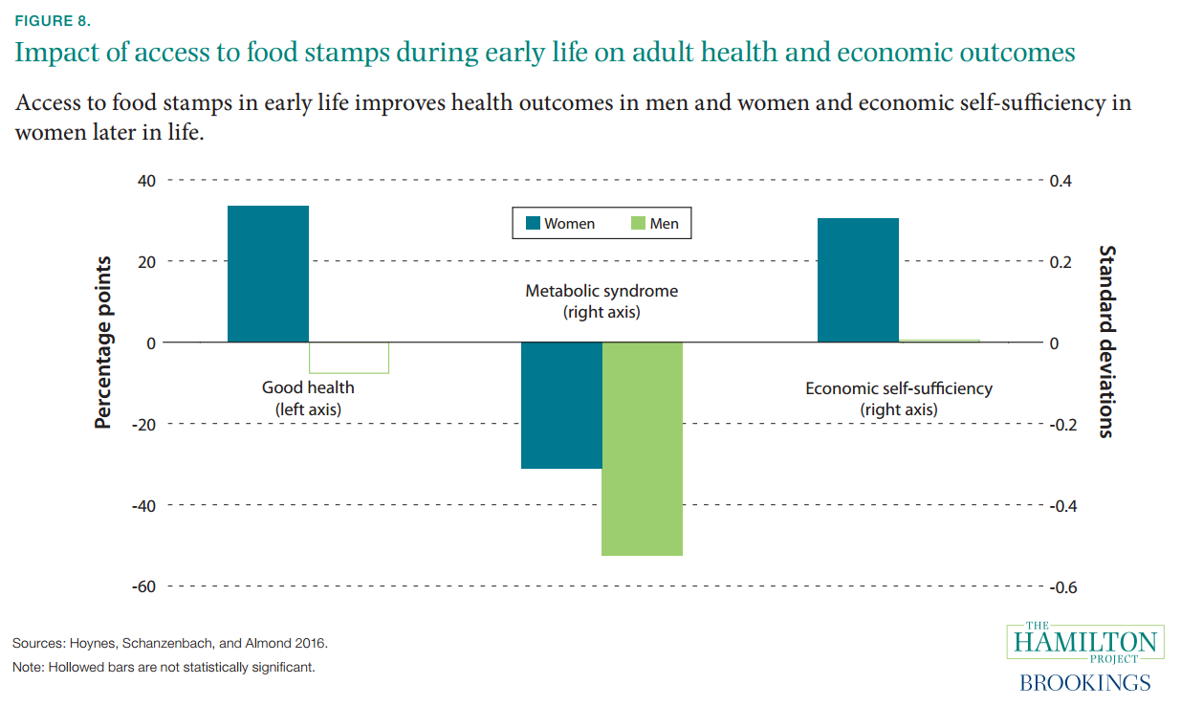
8.
SNAP investments have long-term payoffs.

Slide 17
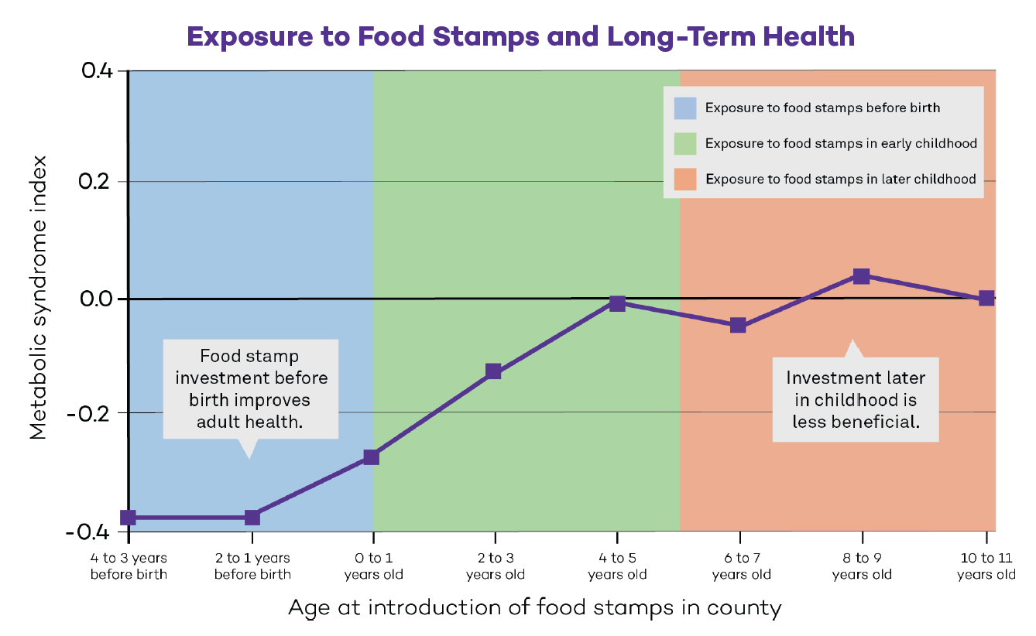
Timing matters: Early investments have larger payoff for health (only)

Slide 18
SNAP investments have shorter-term payoffs:
Variation from loss of immigrant access

Slide 19
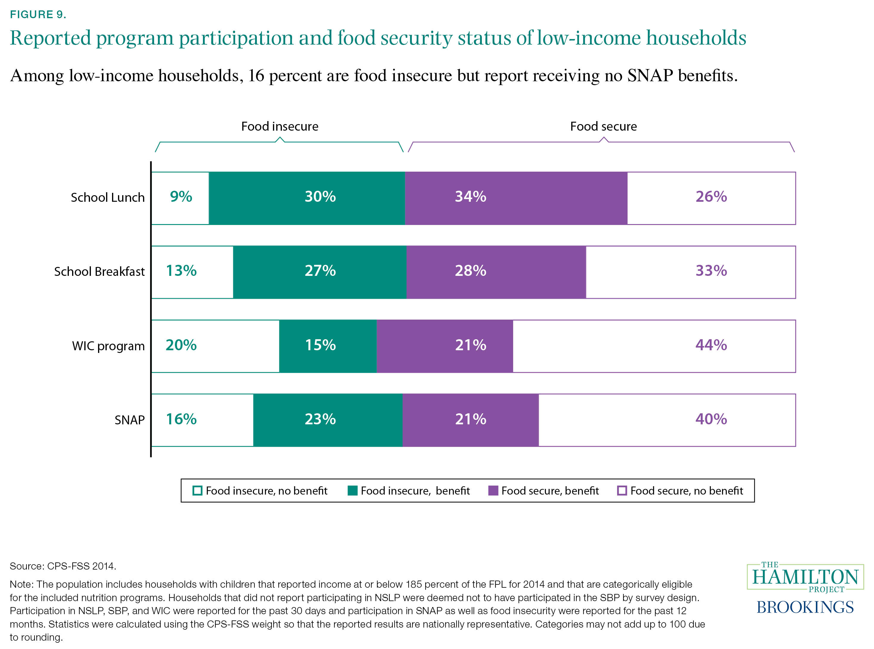
9.
Nutrition programs vary in their reach
to low-income households.

Slide 20
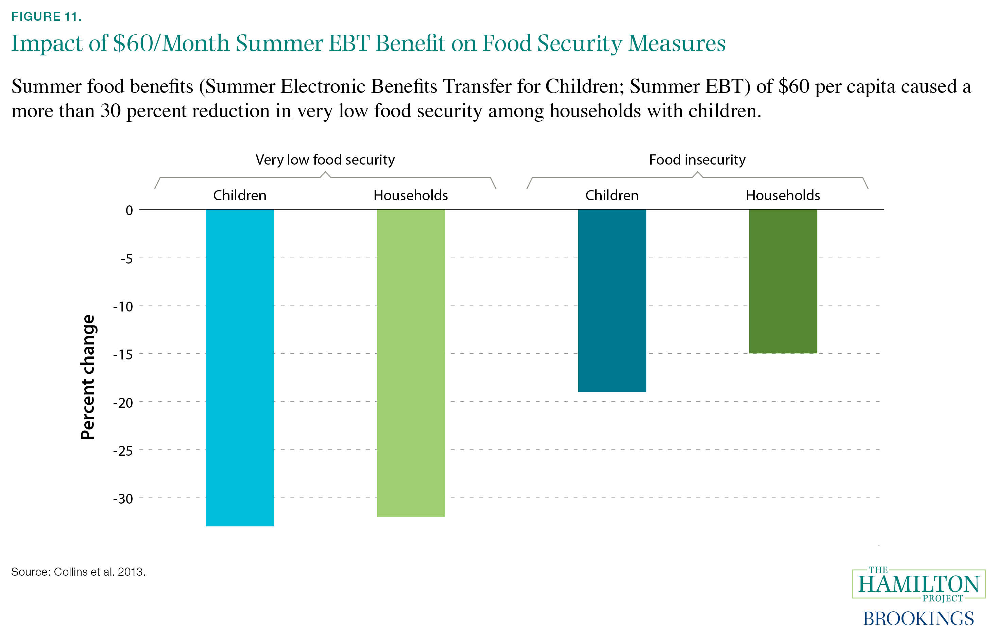
11.
Summer nutrition benefits can substantially reduce very low food security.

Slide 21
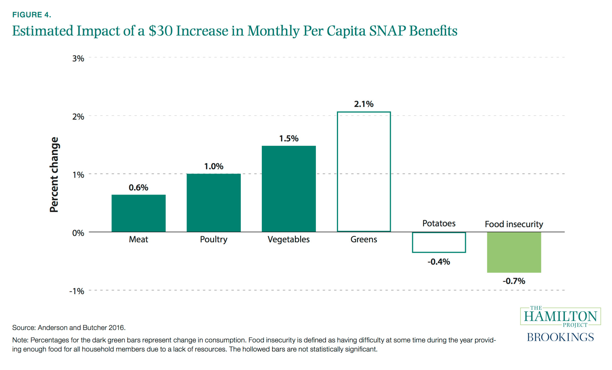
How would food consumption change with more resources?

Slide 22
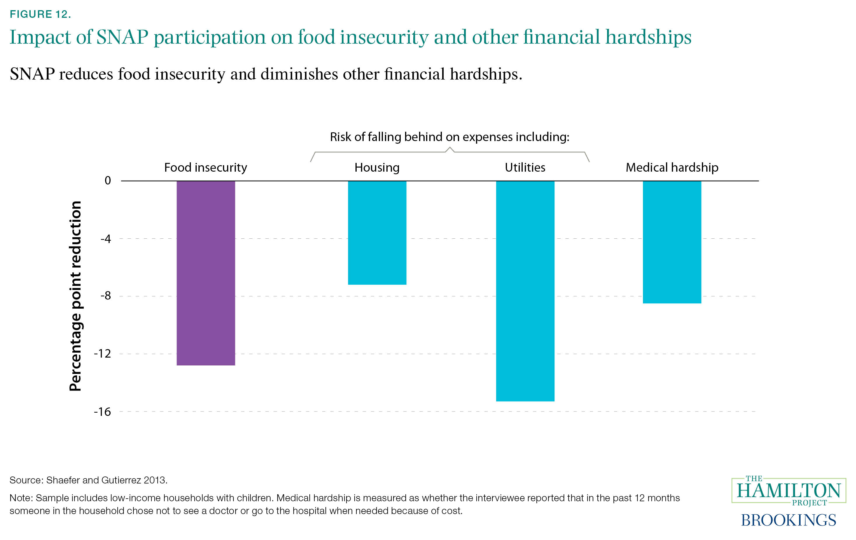
12.
Beyond food security, SNAP improves households’ financial well-being.

Slide 23
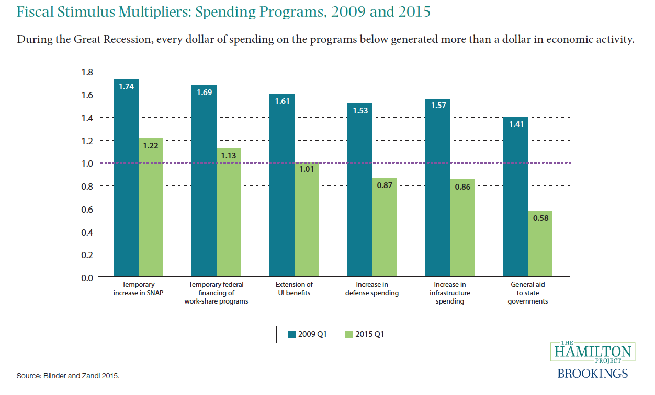
SNAP benefits are good for the macro economy
Block granting SNAP would undermine automatic fiscal stabilizer

