Slide 1
Healthy Food For Kids
Snack Tips
and
Nutrition Activities

Slide 2
What Is Healthy Food or Snacks For Kids?
My Plate- half the plate should be fruits and vegetables
Most U.S. youth do not meet the recommendations for eating 2½ cups to 6½ cups of fruits and vegetables each day*
56% of primary and 80% of secondary school students do not eat the recommended daily amount of vegetables.**
How do we get children to eat fruits and vegetables??
**An initiative of NSW Ministry of Health, NSW Department of Education and Communities and the Heart Foundation. Copyright 2014 Healthy Kids
*National Center for HIV/AIDS, Viral Hepatitis, STD, and TB Prevention, Division of Adolescent and School Health and National Center for Chronic Disease Prevention and Health Promotion,Division of Population Health
Notes:
Ask audience for suggestions regarding what they think are healthy snacks/food for kids?
Why do kids not eat enough fruits & vegetables? (ask audience)
The average 6 to 11 year-old eats only 3.5 servings of fruits and vegetables each day, achieving only half the recommended 7 servings per day for this age group.

Slide 3
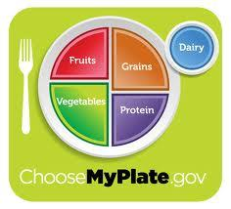
My Plate
Half your plate should be
fruits and vegetables
Eat whole grains
Eat lean meats such as
turkey, chicken and fish

Slide 4
What Are Some Key Things To Think About When Providing Snacks To Kids
Focus on low sugar items
Pick foods high in fiber-fruits and vegetables.
Stay away from processed foods=high in trans fats
Pick a rainbow of color
Think easy and mobile!!!!

Slide 5
Why Is It Important For Children To Eat Healthy?
Adolescence is an extremely important time for both physical and mental development
Bone Development-Approximately 30% of all mineral deposited in our bones throughout life, occurs during adolescence and 90% of our adult skeleton is formed by the age of 18 and even earlier in girls.
2. Brain Development-Next to infancy, adolescence is the most important time for the development of the brain
3. Long-term effects of not eating good as youth--increased risk for the development of major illness later in life
Notes:
3.Cancer, Diabetes, and heart disease

Slide 6
What Are Some Limitations To Eating Healthy Foods?
Convenience
Cost
Knowledge=Power
Notes:
Convenience-lack of grocery store, lack of transportation, lack of child care.
Give examples of snacks and food recipes for kids.
Cost-not everyone can afford healthy food. Where can they get it-food bank, grow their own food, shelters…
Knowledge-We need to provide information.
Bring up CR cooking classes.
Freeze foods
Whole foods are cheaper than people think
Teach the adult and the child- family learning-- CM classes for families and parents

Slide 7
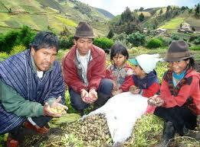
Helpful Hints To Getting Kids To Eat Better
Access
Consistency/Repeat exposure
Be a good example
No labeling
Provide structure
Notes:
A family that farms together stays together!
Takes a least 15 times before a child will sometimes try a food
Use positive feedback and don’t withhold foods
Children do what we do- Remember kids see what we have in our adult/teacher lounge areas.
Do not call a child a picky eater-increased taste buds
Kids need structure with eating just like other parts of their lives

Slide 8
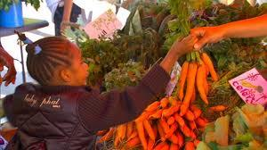
Helpful Hints To Getting Kids To Eat Better
Access:
Approach a local supermarket for donations
Get kids to write letters
Apply for grants-there are a
number of state grants that
help provide healthy snacks to kids
3. Ask local schools if they have
excess produce/snack foods

Slide 9
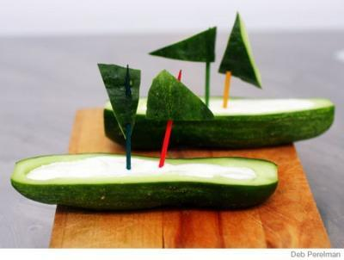
Make It Fun!!
Offer kids choices-children need to be empowered to make there own decisions
Offer a rainbow of colors (5 per plate)
Wrap up healthy food
Make food into art
5. Bike blenders are a hit
6. Taste testing
6. Teach kids where their food comes from-Farm to Table concept
Notes:
Given the opportunity, children will grab fruits & vegetables if left out (refer to #2)
Children are attracted to plates of food with multiple colors. Sell it as the Rainbow of colors! (Refer to #3)

Slide 10
Offer Kids Choices!
Offer children 2-3 choices for a snack option
Make sure all choices are related but there is still a variety
Cut food up into bite size pieces
Accomodate children’s needs if possible

Slide 11
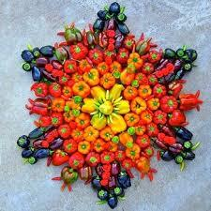
Offer A Rainbow Of Color!
Scientific research shows that
children are more likely to eat a
plate of food if there are at least
five colors on a plate
***Aesthetic appeal is not just
something to consider when feeding
adults!

Slide 12
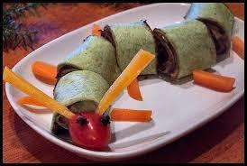
Wrap Up Healthy Food!
Wrapping food up makes it fun and portable
Kids love to make their own wraps
and are amazingly creative
at coming up with their
own fun combinations of food
*Source: www.nutritionforkids.com/‎

Slide 13
Wrap It Up!
Make it sweet or savory, but always healthy!
Wrap it up in a spinach tortilla, thin pita, a crape or maybe even a large kale leaf wrapper
Ideas:
Cooked apples, cinnamon and cream cheese
Grilled vegetables
Sunflower butter, banana slices and honey
Sauce with grated cheese and olives
Beans, rice and salsa
*Source: www.nutritionforkids.com/‎

Slide 14
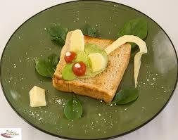
Make Food Into Art!
With a few simple supplies kids can be given the opportunity to be creative and eat a healthy and exciting snack!
Supplies:
Toothpicks
Fruits
Vegetables
Cheese
The list can go on and on…….

Slide 15
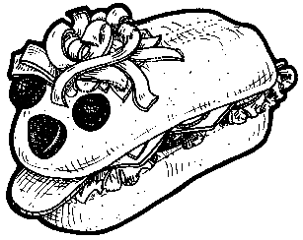
Make Food Into Art!
SANDWICH ART: Make a hoagie sandwich that looks back at you!
Source: How to Teach Nutrition to Kids | YOU WILL NEED: hoagie buns sliced low fat cheese lean luncheon or deli meat shredded carrots, lettuce, or sprouts olives cherry tomatoes miscellaneous condiments (mustard, reduced fat mayonnaise, etc) toothpicks (or broken spaghetti pieces) clean work surface and hands DIRECTIONS: Make hoagie sandwich, using desired ingredients. On one end of the sandwich, use toothpicks or broken spaghetti pieces to position olives for eyeballs and cherry tomato for nose. Arrange shredded carrots, lettuce, or sprouts on top for hair. If desired, stick a small piece of lunch meat out of the "mouth" for a tongue. NOTE: Be sure to remove all toothpicks before eating!

Slide 16
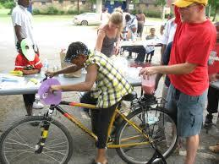
Bike Blenders Are A Hit!
It is amazing what you can make with a bike blender:
Smoothies
Hummus
Yogurt dip
And on and on…...

Slide 17
Taste Testing!
Expose children to new fruits and vegetables
Conduct a taste test:
Use pictures and symbols to help kids understand taste testing
Choose food items that are a bit unusual
Expose children to new things
Use “thumbs up” and “thumbs down” exercise
**Repeat exposure is key to kids eating foods over the long run!

Slide 18
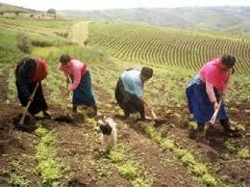
Teach Kids Where Their
Food Comes From!!
Provide healthy snacks to kids and provide them with the foods history !
Take the children on a field trip to a farm or a school garden
Develop your own school garden
Talk about where the food comes from…
does the vegetable come from the leaf, stem
or root of a plant. Bring in examples!

Slide 19
Check This Out
Great place to get recipes:
Nutrition for Kids: www.nutritionforkids.com/‎
All Recipes: http://allrecipes.com/recipes/healthy-recipes/healthy-snacks/
Great places to go for fun and exciting nutrition education games:
Nutrition for Kids: www.nutritionforkids.com/‎
USDA Website: http://www.fns.usda.gov/multimedia/games/blastoff/blastoff_game.html
Academy of Nutrition and Dietetics: http://www.eatright.org/nnm/games/#
Nourish Interactive: http://www.nourishinteractive.com/
Great places to go for creative ways to eat healthy snacks:
Nutrition for Kids: www.nutritionforkids.com/‎
Parenting Magazine: http://www.parenting.com/gallery/healthy-kids-snacks

Slide 20
Check It Out!
Great place to get information on taste testing:
USDA website: http://healthymeals.nal.usda.gov/recipes/taste-testing-and-evaluating-recipes
Great place to go for food art ideas:
Planet pals: http://www.planetpals.com/edible_food_art_crafts_kids.html

