Slide 1
Building Capacity: Redefining Food Banking & Those You Serve
May 13, 2016

Slide 2
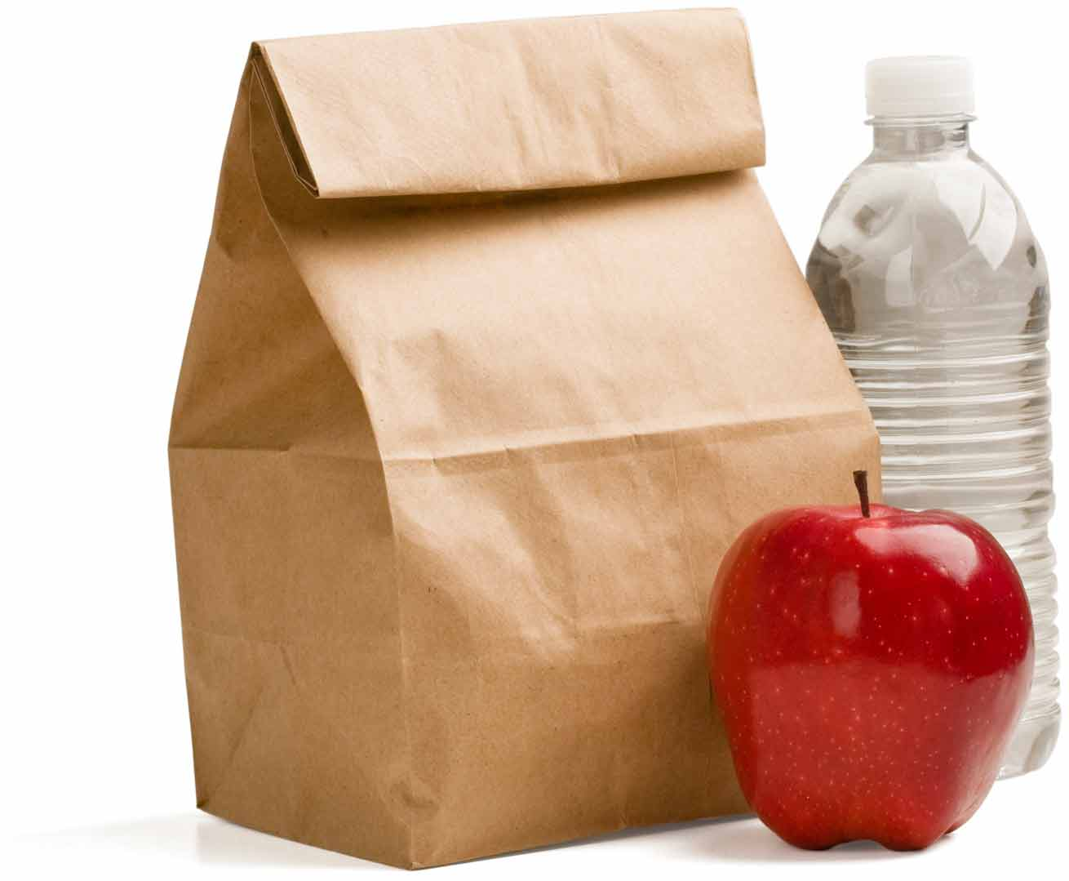
Who’s in the Room?
Does your agency prepare meals?
Does your agency provide bagged, ready-to-eat lunches to the homeless?
Does your agency provide food bags to the homeless?

Slide 3
What is Capacity Building?
Fundraising
Volunteers / Staff
Record Management (inventory, reports)
Distribution hours
Transportation
Storage—Dry and Cold

Slide 4
Opportunity for Growth
Capacity Building is improving and/or expanding on the food services you provide as a nonprofit organization

Slide 5
New Vision and Mission
Vision:
A Hunger-Free Community
Mission:
Lead our community to ensure that anyone who needs a healthy meal can get one

Slide 6
Strategic Plan
Grow number of people served by 100,000
From 250,000 to 350,000 Ave / Month
Start with 14,000 in FY2017
Incorporate Healthy Food
Make Food Accessible

Slide 7
Strategic Plan
We are in the business of handing out food
We need your help to get the food to the individuals that need it
What does this mean for you?
Evaluate your current program and see where you can do more
Budget for an expansion to your program

Slide 8
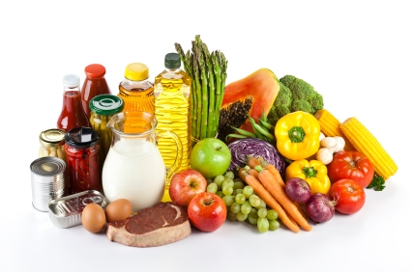
Food Mix
Produce
50+% of food distributed is fresh produce
Grocery Rescue is growing
Purchased and Donated
Dairy
Frozen

Slide 9
Storage and Transportation Capacity
Does your agency have sufficient storage?
Dedicated space for the pantry
Cold storage for only the pantry
Larger than household sized
Commercial grade
Newer than 2005

Slide 10
Storage and Transportation Capacity
Transportation
Large van or truck available to pick up food on regular basis
Requires registration, insurance, driver
Opportunities
Receiving additional food on regular basis
Grocery Rescue Program, Warehouse Shopping
Program expansion
Services to underserved locations (schools, medical clinics)

Slide 11
Distribution Capacity
When is your agency open to the public?
Can you be open more often?
Friday thru Sunday & Evenings
Is the time you are open
good for the population you serve?
Take surveys / Ask those you serve

Slide 12
Distribution Capacity
Can you serve more people?
Who are you missing?
How are you currently reaching people?
Word of mouth, fliers, Craig’s List
Food Connection, additional referrals
Open to public food pantries should have information in system

Slide 13
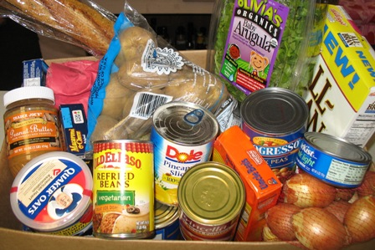
To Choose or Not to Choose?
Client Choice
What does it look like?
Respects dietary needs
Reduces waste
Empowers clients
Provide variety
Helps move those
“odd” items

Slide 14
Types of Choice
Grocery Store
Pantry is set up like a grocery store
Allow people to pick certain foods from shelves
Limits of items are set by category
Check List
People check the items they would like on a sheet and volunteers create the bags

Slide 15
Types of Choice
Table distribution
Set all food items available on tables with volunteers
Have people go through the line
Person has option to not take something
Half and Half
Pre-bag certain core items
Have shelving or tables with extra items
Bread and produce are most common

Slide 16
The Power of Choice
Agencies have control, flexibility, & influence
Place limits on items by family size or across the board
Only have certain items visible
Nudges – Setup the pantry that will promote new and certain foods!

Slide 17
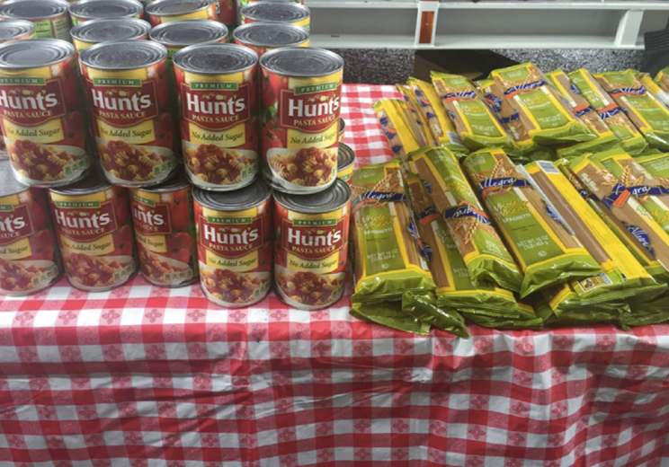
The Power of Choice
Nudge Interventions
Recipe/Poster Placement
Front & Center Placement
Tasting Sessions
Pair Items Together

Slide 18
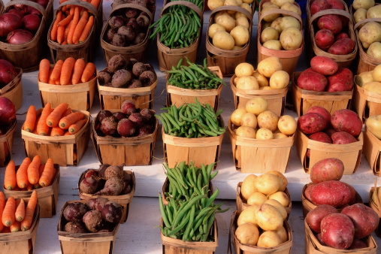
The Power of Choice
People respond to visible, attractive, and conveniently presented foods.

Slide 19
Food Nudges
Place produce in a prominent location where it is easily reached and seen
Place produce 1st in line
Place produce in two separate locations
Find ways to make healthy food more attractive

Slide 20
Food Nudges
Pair Items Together
Bundle foods together for convenience
Meal Programs
Add more vegetables or healthy protein
Pantries
Place recipes near staple items
Place items that go together next to each other in the line: pasta and sauce, rice and beans

Slide 21
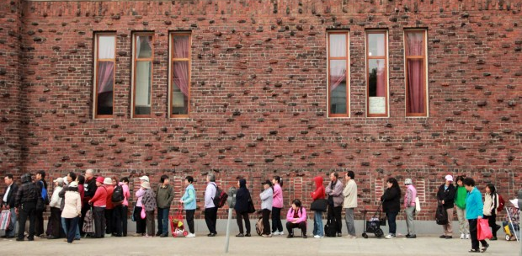
Putting People First
When Those You Serve Enter
Make them feel welcome – Wal-Mart Greeter concept
Serve them promptly or provide reason for waiting time
Have a comfortable place for clients to sit

Slide 22
Putting People First
Interview
Keep it friendly
Sitting next to them vs. across
Keep the tone positive
“I just need to get some information to help us do our job better”
Ask for necessary information
Don’t collect: SSNs or Driver’s License #s

Slide 23
Putting People First
Required Information
Count of number of people in household (children, adults, and seniors)
Do they fall under the income guidelines?
Self declaration is fine
Other questions to ask:
Have you heard of CalFresh and do you know if you are qualified?
Do you have children under the age of 5?
Are you receiving WIC benefits?

Slide 24
Thoughts for Food
Friendly, fun environments are contagious
Try something new, mix it up
Find time to take care of yourself and your volunteers along the way
Think outside the box—sometimes the craziest idea has the best results
Join our Facebook Group: SHFB Partner Agency Network

Slide 25
What’s your next Opportunity for Growth?

Slide 26
Thank you.

