Slide 1
The Clearer We See,
The Better We Serve
Unconscious Bias and Power Differentials
May 13, 2016
Notes:
Welcome. Thank you for choosing to spend the next hour in this workshop. Unconscious bias is a very difficult and important topic in our work and in our world and I request that we all agree to some ground rule for participating in this workshop. This is going to be a “work”shop, not a “play” shop or a “rest” shop, and I am going to offer for all of you to participate in some activities and do some real personal work. This might be easy for some of us and not easy for others. I know that this will be a great workshop for everyone if we get your full active participation. I ask that we are all respectful and take anything and everything shared by anyone as private and confidential and anything anyone might share or might come up doesn’t leave this room. This needs to be a safe space for sharing and growing. Can I see everyone’s hand if you can agree to make this next hour a safe, confidential place.

Slide 2
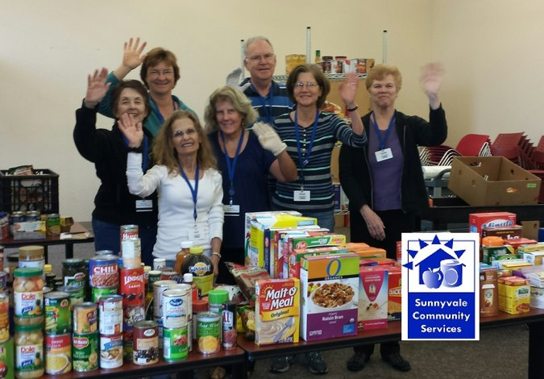
Background
Sunnyvale Community Services ▻ 1970
Financial Assistance ▻ Food Distribution ▻ 6,500 Clients/yr.
Clients demographics
Volunteer demographics
Improve understanding and communication
Improve customer service
Difficult Topics
Work and in the World

Slide 3
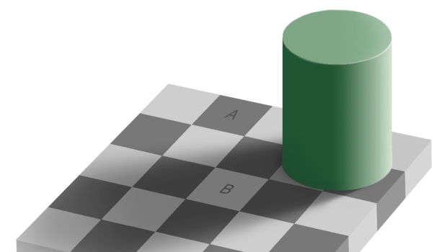
Unconscious Bias
Beyond our awareness
Happen automatically
Mostly beyond our control
Brains makes a lot of mistakes!

Slide 4
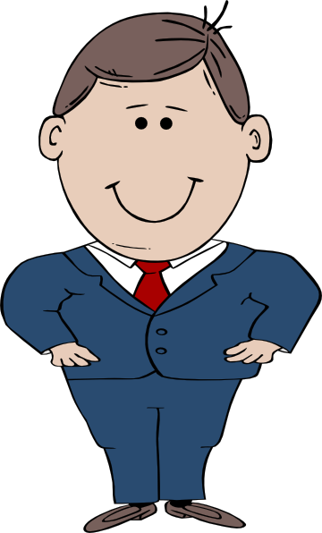
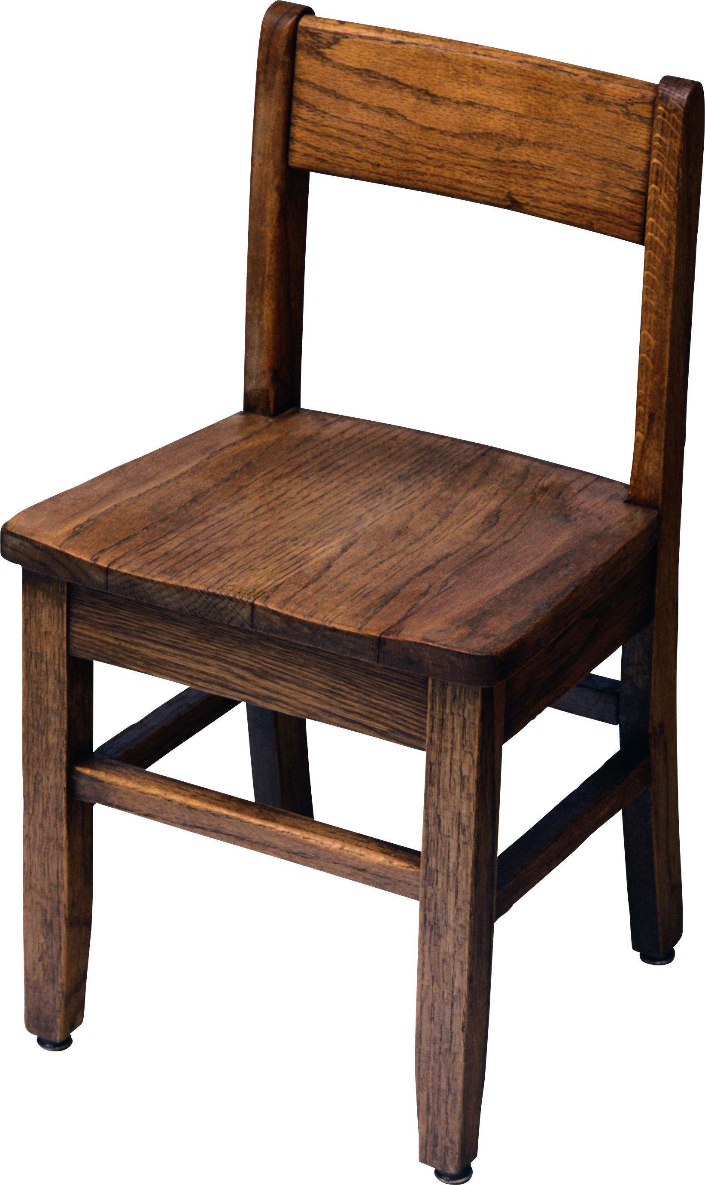
Personal Stage
Childhood Experiences
Family Beliefs
Religious Training
Community Norms
Books, Movies, TV
Influential People
Background is the context for
everything we experience!

Slide 5
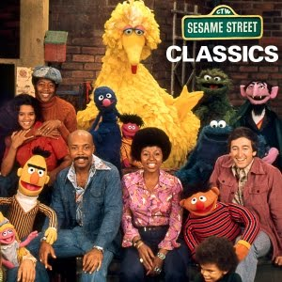
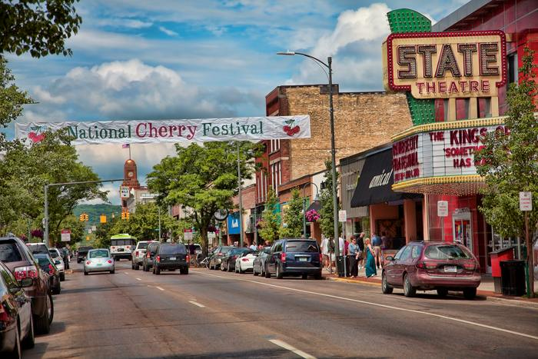
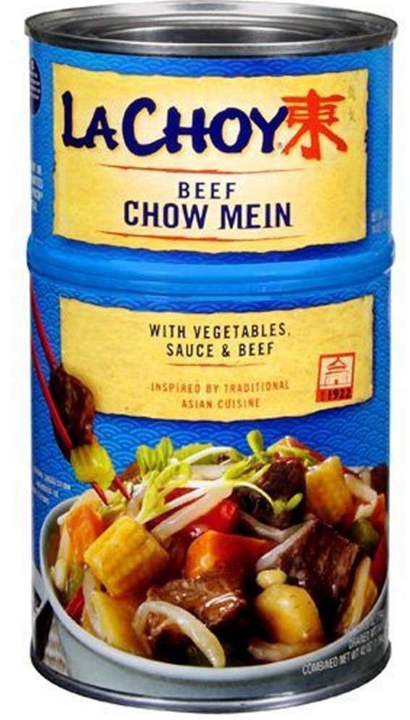
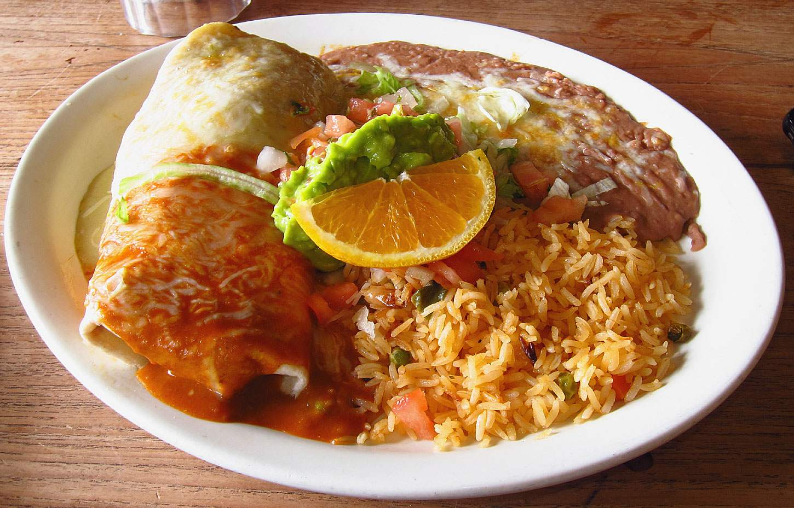
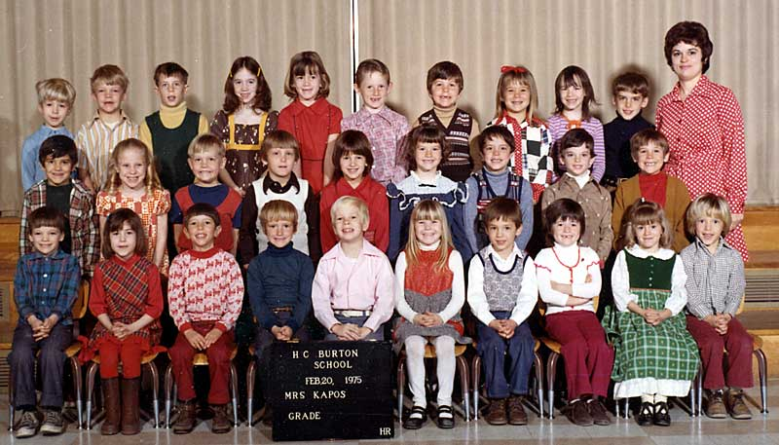
Early Years
Notes:
Traverse City. Economically diverse, racially homogeneous. Stories about African American adopted kids, Progressive middle class family. Parents supported me hanging out with the Mormon kids across the street and going to their church. They talked the talk, but only so much exposure you can give your kids in an all white community

Slide 6
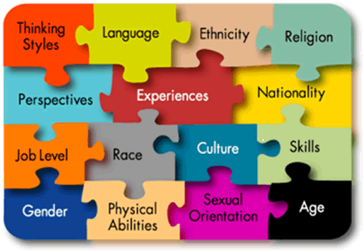
Your Personal Diversity Comfort Level
2 minute share with your neighbor
Diversity exposure growing up
Your overall diversity comfort level today
One area where you are least comfortable with those who are different than yourself.

Slide 7
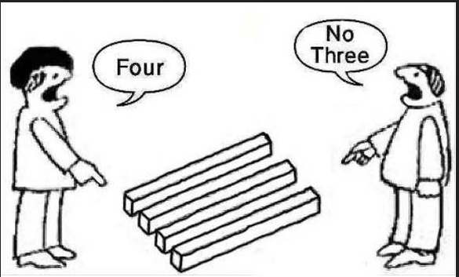
Personal Lens
Unique Views
Unique Feelings
Constant over time
Instantly change
OUR LENS feels like the TRUE LENS

Slide 8
What Do You See?
“This is my fifth time in prison. Every crime I’ve committed has come from my addiction. My seventeen-year-old daughter is in a home for teen moms. My twenty-one-year-old son is in jail. My eighteen-year-old daughter is doing OK. She’s got a job at FedEx and goes to college. (Federal Correctional Complex: Hazelton, West Virginia)
What is her life story?

Slide 9
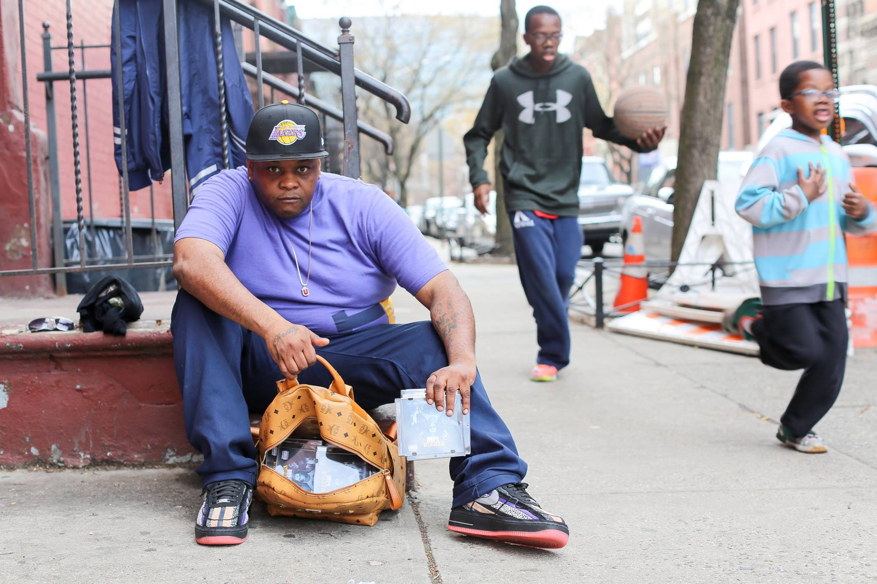
What Do You See?
“I drive a bus. I don’t want to do that for the rest of my life. I’ve got to wake up at 4 am everyday. That’s not working for me. So I’m trying to get my music off the ground. I’ve been handing out these CDs all day. But it’s tough. I’ve only sold three so far.”
What does this person look like?

Slide 10
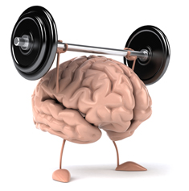
Retrain Your Brain
Take online implicit association tests
Expose yourself to counter-stereotyping imagery
Seek out counter-stereotype role models
Play counter-stereotype mind games
Unchallenged mind is not worth trusting!

Slide 11
Minds are Story Making Machines
Trustworthiness judgement formed in 1/10th of a second! ¹
3 Seconds
success
sexual preference
Religion
adventurous
social status
INTELLIGENCE
¹ Experiments by Princeton psychologists Janine Willis and Alexander Todorov

Slide 12
Real World Impacts of Unconscious Bias
Personal Level
Day to day interactions
Workplace decisions
Social circles
Societal Impact of Unconscious Bias

Slide 13
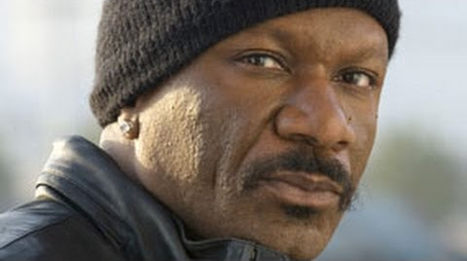
Choose Who to Sit Next To
1
2
3
What thoughts go into your decision?

Slide 14
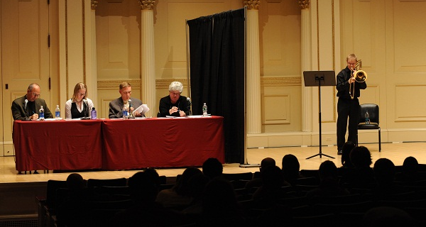
Orchestrating Impartiality
Blind auditions improved female advancement in symphonies by 50%

Slide 15
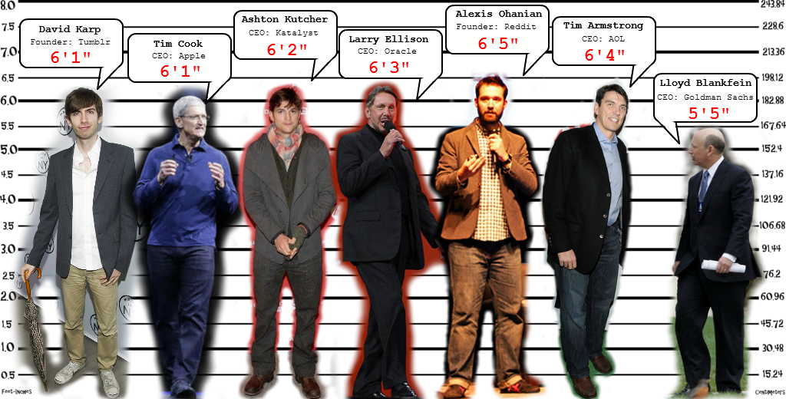
CEO Bias
30% of Fortune 500 CEOs are men 6’2” or taller
Only 3.9% of American men are 6’2” or taller

Slide 16
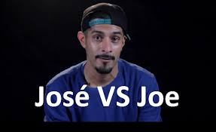
What’s in a Name?
Applicants with “typically white” names received 50 % more callbacks than applicants with “non-white” names.

Slide 17
Fitting In?
Similar
Different
Comfortable
Awkward
Alone
Understood
Scared
Known
Stupid
Safe
Community
Self conscious
Wrong
Normal
Right
Uncomfortable
Fitting in Feels Better!

Slide 18
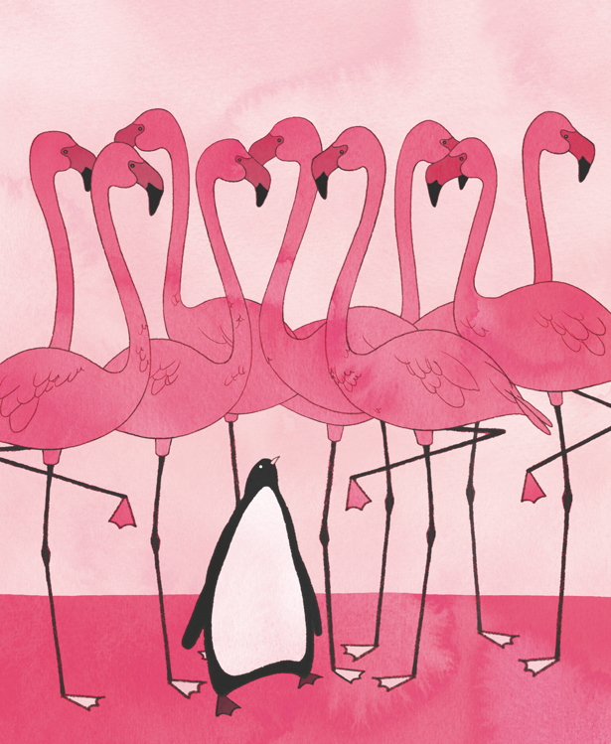
Affinity Bias
In-group - social group to which a person psychologically identifies as being a member ( race, culture, gender, age, religion, etc., etc., etc.)
Deep human need to be part of an “in-group”
Same brain neuropathways for ourselves and those in our “in-group”
Different neuropathways for those in our “out-group”
Increased indifference to the success or failure of people in our out-group
Much easier to express anger or irritation with people from our out-group

Slide 19
What’s Real?
Volunteers
Clients
Wealthy
Educated
Helpful
Judgmental
Lucky
…????
Unhealthy
Uneducated
Grateful
Lazy
Unlucky
….???
Notes:
Use the word Seem.

Slide 20
Know Very Little!
Volunteers
Clients
Health
Employment
Bank Account
Food
Mental State
Education
Their Story
Hard Work
Learning Challenges
Health
Employment
Bank Account History
Food
Mental State
Education
Their Story
Hard Work
Learning Challenges

Slide 21
The Walk of Privilege
ACTIVITY:
20 – 25 Volunteers on stage
Follow instructions!
What is your “gut reaction”
Are you surprised at where you are?
How does it feel to be where you are?
Did you come to any new realizations?

Slide 22
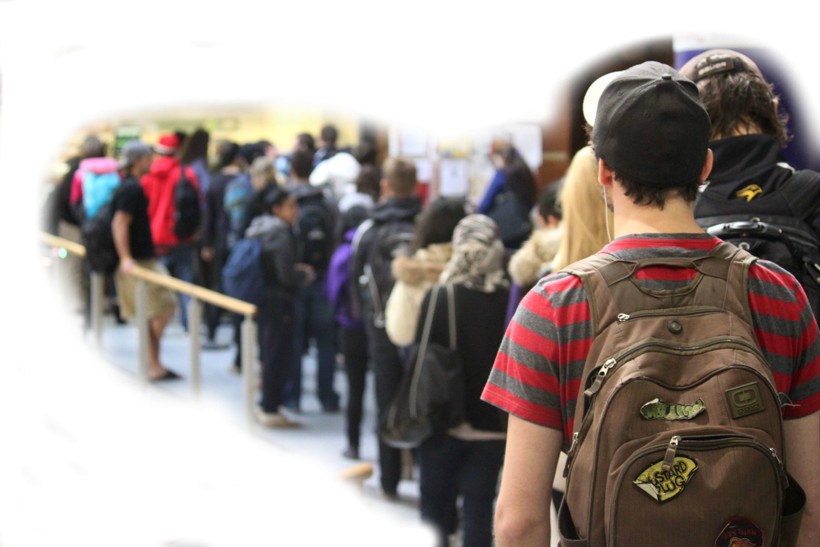
Client’s Situation
Agency = Government = Threat
Hurt pride
Frustrated
Many constraints
Immigration status insecurities
Desperate
In pain or hungry
Language barrier

Slide 23
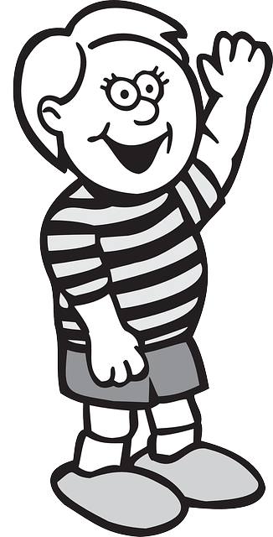
See Saw Dynamics
Rarely are the two sides balanced!
Power Partner
Dependent Partner
Build Trust
Lure of Fun
Hesitant
Difficult Job
Friendly
Vulnerable
Sensitive to other
Scary
Power Partner very responsible for positive outcome

Slide 24
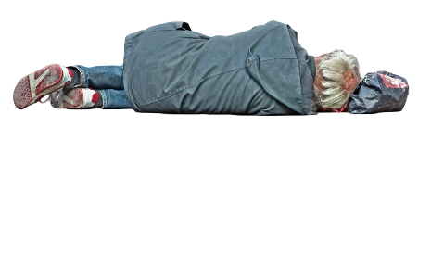
Volunteer Client See Saw
Knowledge
Resources
Reliant
Resource Limited

Slide 25
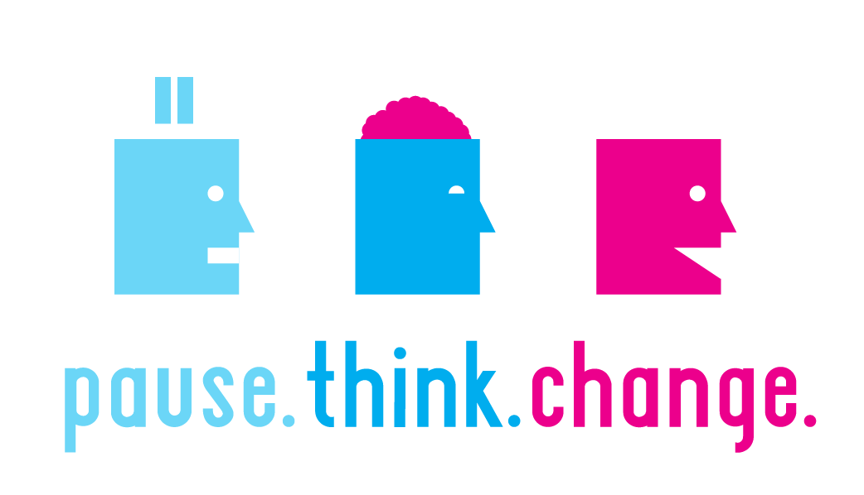
Overcoming Unconscious Bias & Power Differentials
Bias & power differentials awareness
Notice judgment words “should”, “wrong”, “bad”
Notice favoritism, inconsistent service and tone of voice
Notice differences in your comfort level with different clients
Shift from “wrong or bad” to “that is interesting….”

Slide 26
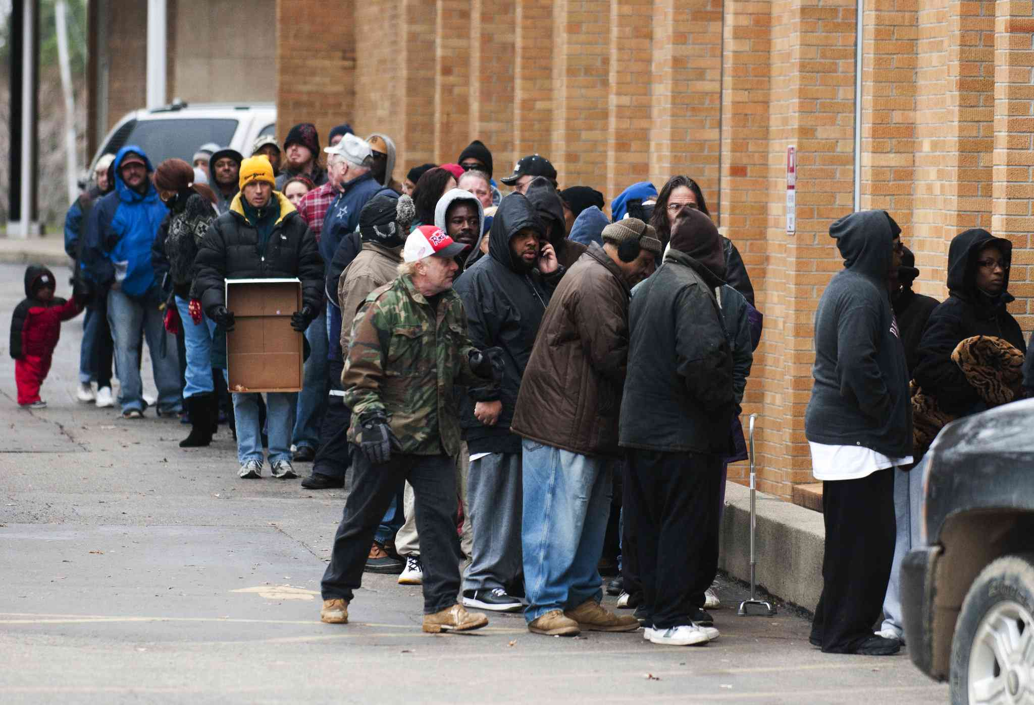
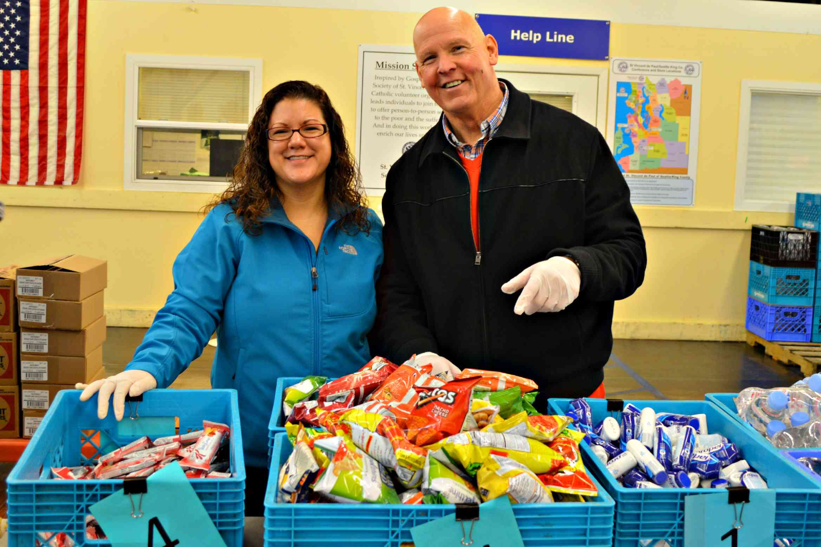
Volunteer Interaction Fully Loaded
Meets…..

Slide 27
“Clients Should Learn English”
Assumptions:
They’re not trying
Speak, understand and write equally well
Time and resources
They’re lazy
Agency is a safe place!
Suggestions:
Ask for preferred language
Find someone to help
Client experience first
Learn a few phrases
Awareness:
Speaking louder
Using teacher voice
Repeating yourself
Client reaction
Tourist at hotel or tourist at a police station

Slide 28
“Clients Look Well Off”
Nice car, nice clothing, why should I help them?
Assumptions:
Must have money
Wasting money
Want free stuff
Wrong Priorities
Suggestions:
Unknown story
Task focused
Client experience first
Benefit of the doubt
Awareness:
Turning away client
Consistent treatment
Probing questions
Client reaction
ASS….U…Me

Slide 29
“Clients Are So Pushy”
Why can’t they just wait in line nicely?
Assumptions:
Selfish
Break rules
Rude
Know the expectations
Suggestions:
Learn cultural norms - personal space, line etiquette & scarcity
Publish easy rules
Client experience first
Stay calm
Awareness
Speaking louder
Showing frustration
Using teacher voice
Repeating yourself
Client reaction
Keep Calm and Carry On!

Slide 30
Unintentional Impacts of Actions
Action
Tapping on car | Domestic violence survivor or war veteran frightened so much they do not return.
Raising your voice and speaking in a parent or teacher voice | Client is embarrassed and confused. Does not return for fear of further humiliation.
Pointing out they did something wrong | Client feels stupid. They leave angry and confused.
Repeating what you say, raising your voice and speaking slowly | Client is angry that they are being treated like a child and they tell others not to come.
Impact

Slide 31
Helpful Hints Unbiased Service
Greeting - Genuine smile, maintain eye contact, pleasant tone of voice.
Culturally sensitive body language – mirror client.
Professional conduct – hand papers and cards with both hands.
Keep questions relevant to service provided.
Use simple communication. Limit euphemisms, metaphors and jokes.
Ask “how can I help you?”, or “good afternoon” instead of “how are you doing?”
Limit use of negative judgement words “should, don’t, can’t, no, stop”.
Nature has given us two ears and two eyes but only one tongue,
so we should hear and see more than we speak.
— Greek proverb

Slide 32
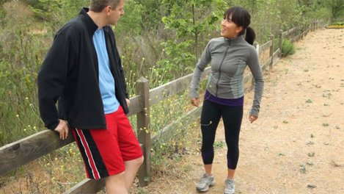
Where Are You From?

Slide 33
Other Bias and Privilege Resources
Harvard Implicit Bias Test - Hidden Bias Tests measure unconscious, or automatic, biases. Your willingness to examine your own possible biases is an important step in understanding the roots of stereotypes and prejudice in our society.
Blind spot: Hidden Biases of Good by Mahzarin R. Banaji (Author), Anthony G. Greenwald (Author)
Ted Talks
Unconscious Bias – Helen Turnbull
Overcoming Bias – Verna Myers
White Privilege – Cameron Russell

