Slide 1
Food is Foundational to a Better Community
Cat Cvengros,
VP of Development and Marketing,
Second Harvest Food Bank

Slide 2
Why kids need food
What is the Silicon Valley Hunger Paradox
How to partner to end hunger
What’s to come

Slide 3
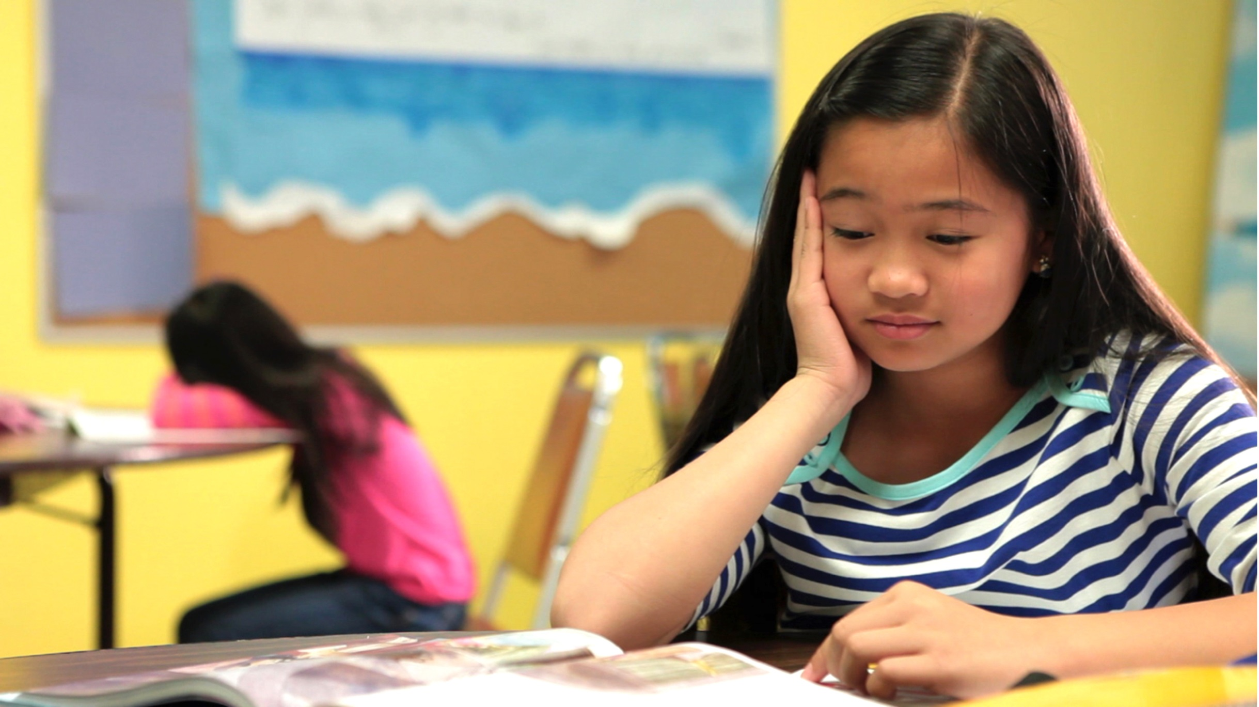
Eating Breakfast =
17.5% HIGHER SCORES ON MATH TESTS
Eating breakfast
=
17.5% higher scores
on math tests

Slide 4
Tech boom
=
Housing crisis
=
Food crisis
That is the hunger paradox.

Slide 5
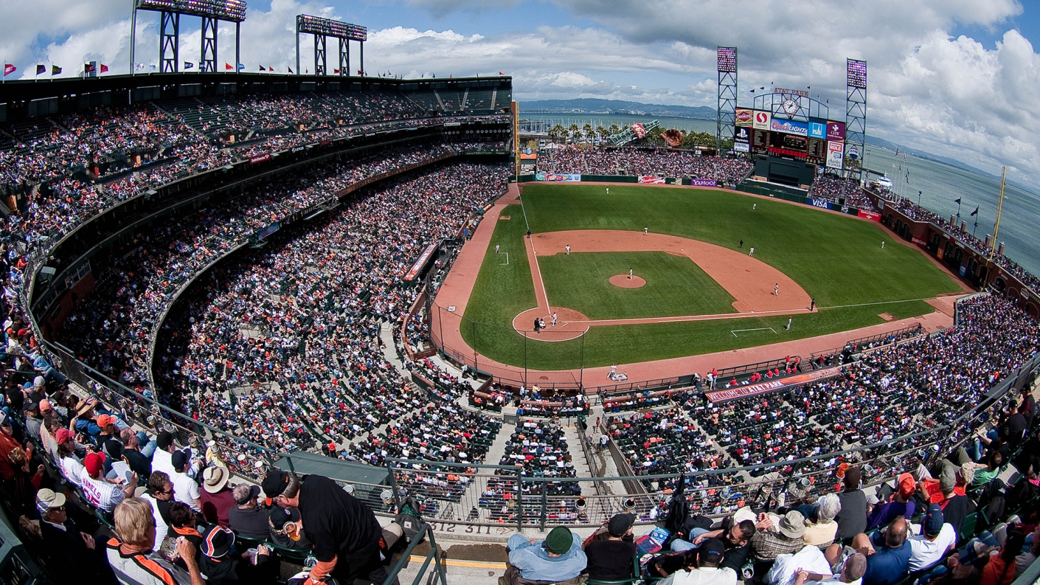
TOO MANY KIDS
ARE HUNGRY IN Silicon Valley

Slide 6
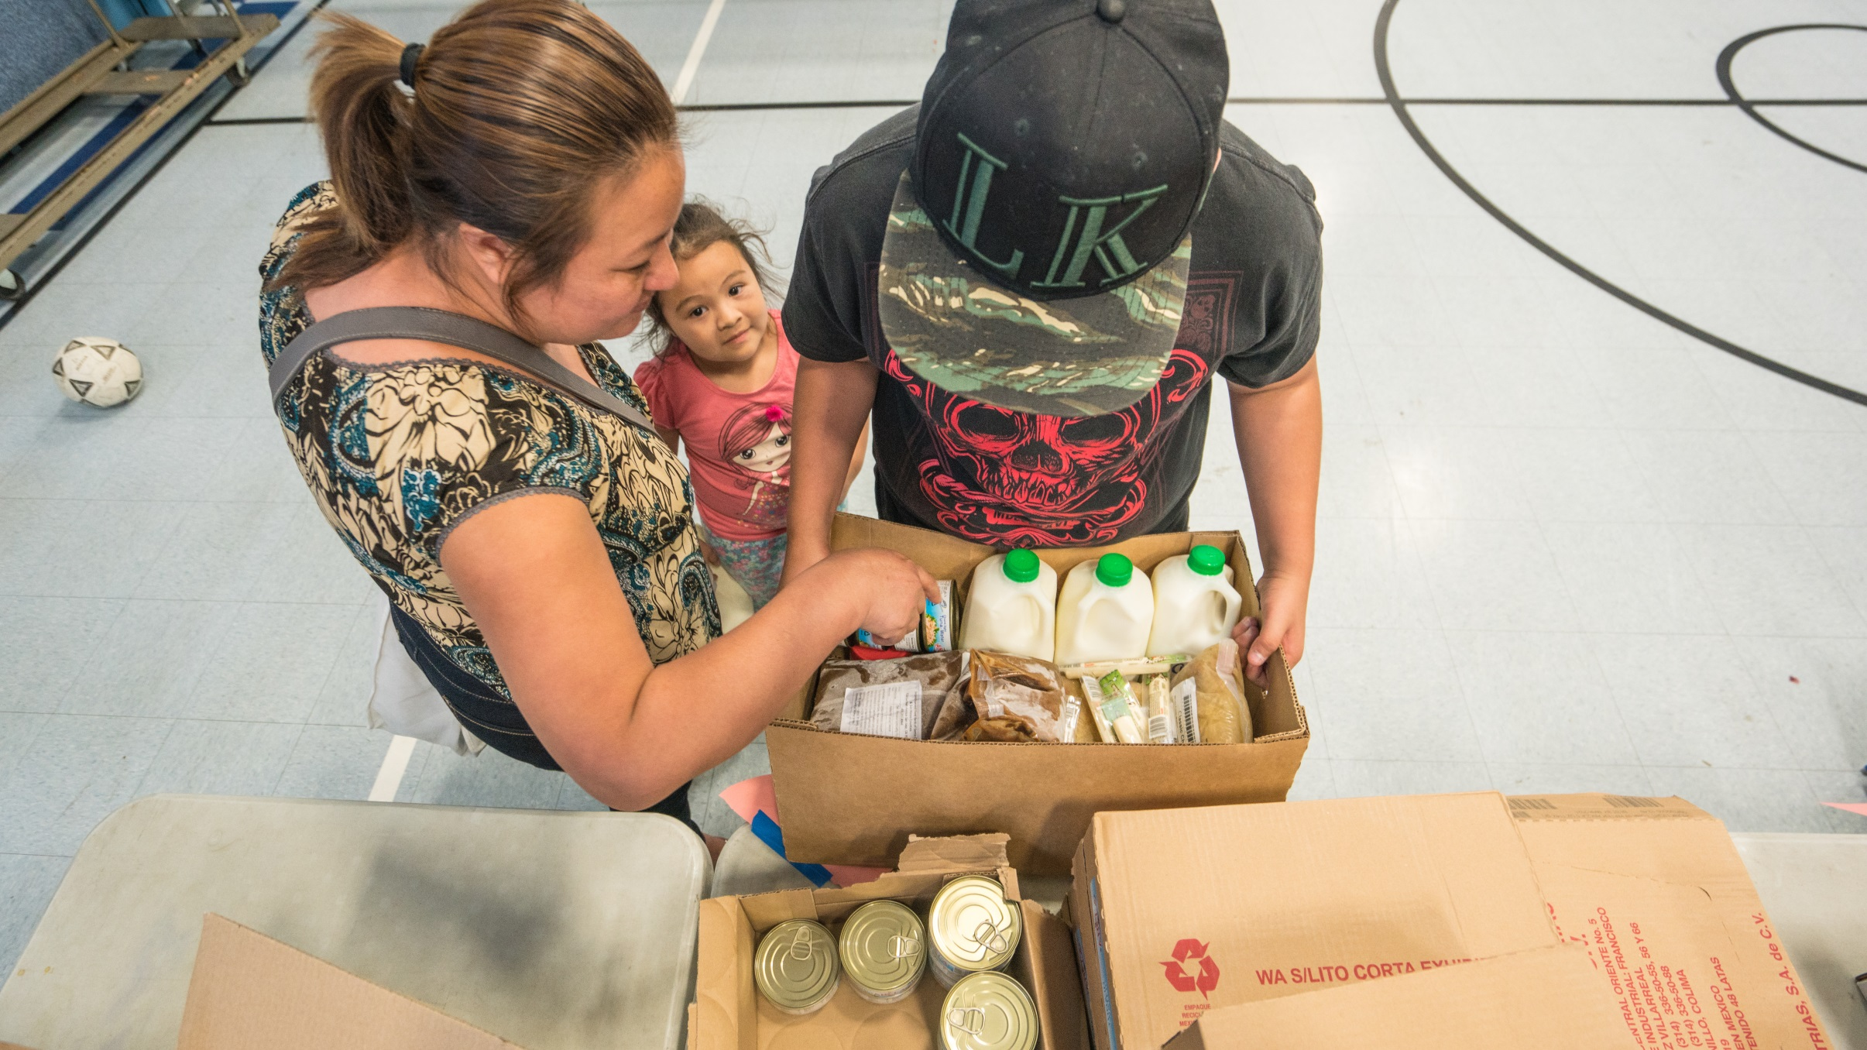
Anyone in our community who needs a healthy meal can get one,
NO QUESTIONS ASKED

Slide 7
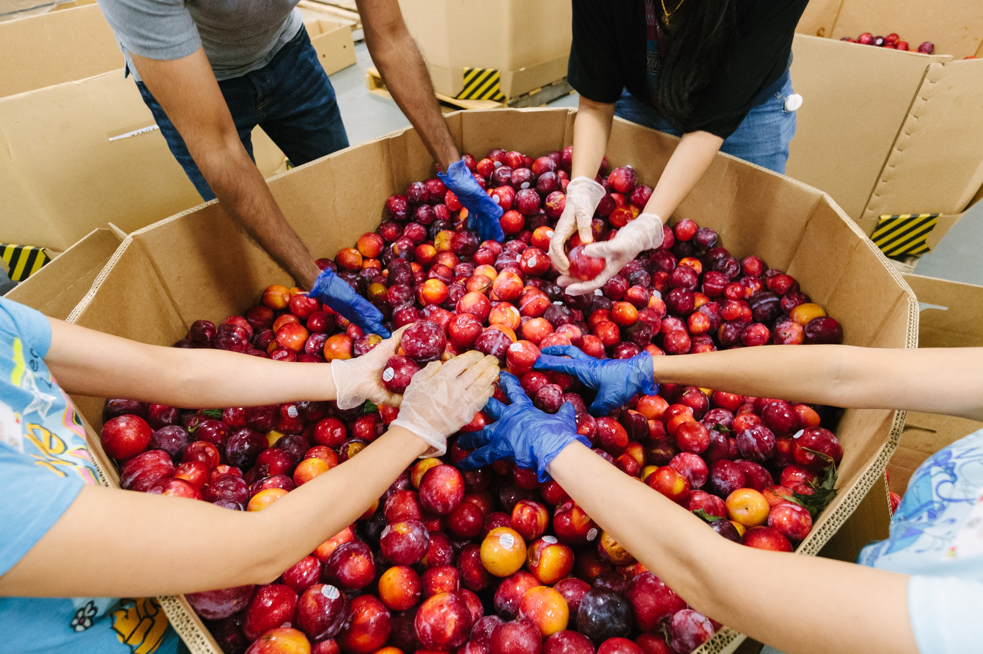
We’re all in this
TOGETHER
We are all in this together.

Slide 8
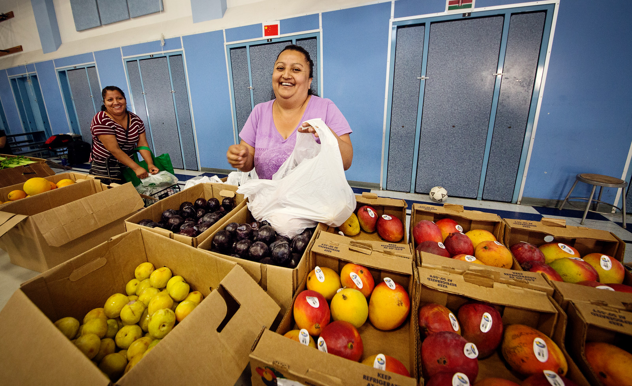
EVERYONE
has a role to play

Slide 9
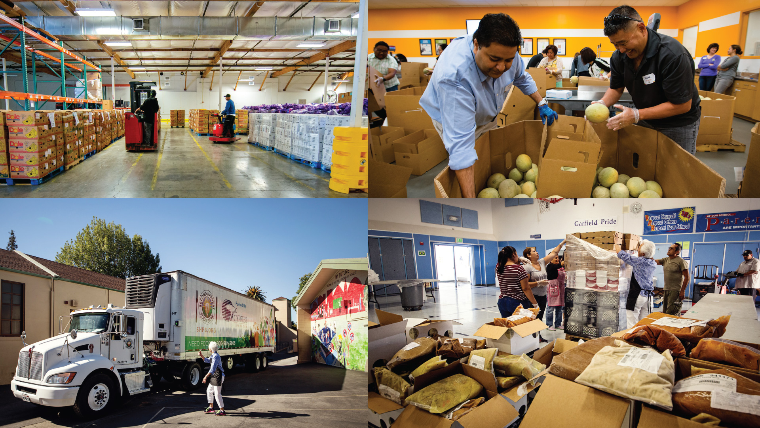
TOGETHER we can ensure that anybody in our community who needs a healthy meal can get one

