Slide 1
Magnitude and Complexity of the Hunger Problem
Bruno Pillet
Second Harvest Food Bank
Vice President, Programs and Services

Slide 2
Objectives
What is the size of the hunger problem in Santa Clara and San Mateo counties?
How can at-risk members of the community be segmented so that Second Harvest can mobilize the community to eliminate hunger?

Slide 3
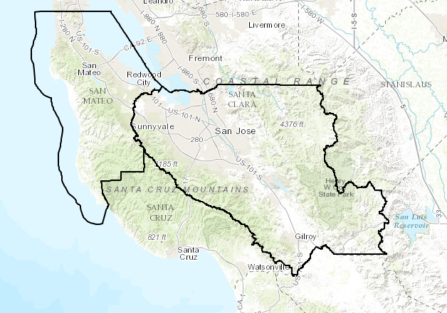
Interview Methodology
750 in-person interviews throughout San Mateo and Santa Clara counties
April through July 2016
500 interviews conducted at 30 Second Harvest Food Bank sites
250 interviews conducted at sites, such as parks, discount grocery stores, recycling centers and low-income clinics
Santa Clara

Slide 4
Methodology: Sizing Food Insecurity
Use nine questions to identify food insecurity
Apply predictors to Census data
Estimate the size of food insecure population
Derive key predictors (income, family status, etc.)

Slide 5
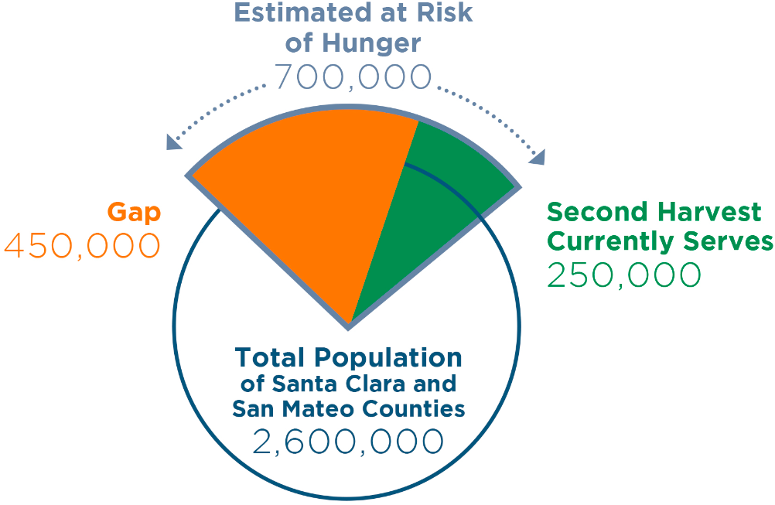
Key Findings

Slide 6
What Led to Their Food Insecurity?
It is first an income problem, but rising cost of living is close behind

Slide 7
Attitudinal Differences Between Recipients and Non-Recipients?

Slide 8
Segments: What Did We Learn?
Retired
● Do we qualify?
● Need info
● Limited mobility
● Word of mouth
● Friends / family
● Place of worship
Strivers
● Do we qualify?
● Need info
● Worry what people will think
● Word of mouth
● Friends / family
● Place of worship
Immigration Concerns
● Need info
● Do we qualify?
● Don’t know how to get help
● Worry about citizenship
● Word of mouth
● Friends / family
● Place of worship
Homeless
B A R R I E R S
● Limited mobility
● Transportation
● Need info
● No place to cook
C O M M U N I C A T I O N
● Word of mouth
● Friends / family
● Place of worship

Slide 9
What Will the Food Bank Do?
Robust marketing to food-insecure families
Adjust services to facilitate access
Expand partnerships with:
Schools: families with children
Low-income housing service providers: seniors and families
Clinics: all
Colleges: young adults
Increase focus on client experience

