Slide 1
The Power of De-stressing: How compassion and mindfulness can help you relate better to your clients
Presenters: Lineth Jezek, MBA
Founder and CEO of Yoga Initiatives Certified Yoga Instructor Diana Garcia
Nutrition Education Coordinator SHFB Certified Yoga Instructor

Slide 2
Agenda
What is stress and how it affects us and our ability to relate to our clients
Stress Reduction Techniques
Compassion, empathy and compassion fatigue
Mindfulness Practice

Slide 3
What is Stress
Stress is any change in the environment that requires your body to react and adjust in response. The body reacts to these changes with physical, mental, and emotional responses.

Slide 5
How Stress Affects Us and Our Ability to Relate to Our Clients
Working with vulnerable populations
Sometimes working with minimal resources
Trying to find work-life balance (relevant to all cases, and it is different for every person).
Compassion Fatigue

Slide 6
Stress Reduction Techniques
Compassion and Kindness
Physical Activity (yoga, dancing, running, walking, swimming, etc.)
Mindfulness: the art of being present (meditation, prayer, mindful breathing)
Reading and writing

Slide 7
Compassion “Concern to enhance the welfare of another who suffers or is in need." Motivation to act: to do something about it.
Empathy “Mirroring or understanding of another's emotion." Empathy is feeling; compassion is action.
Compassion Fatigue A state of mind in which we become less and less able to help others, for fear of being hurt ourselves.
Symptoms
Depression, anxiety, combativeness, the sensation of being on fast- forward, an inability to concentrate; some describe greater and greater difficulty in processing their emotions.
Charles Garfield, advisor to Greater Good magazine and expert on compassion and compassion fatigue

Slide 8
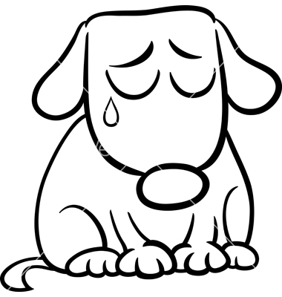
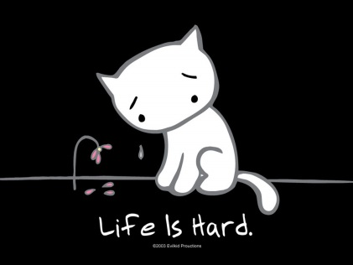
What happens when you confront pain and distress on a daily basis? ~ Emotions ~ Capacity to connect and care
Awareness: We can cultivate the ability to calm the mind, so we can recognize stress, suffering and others emotions
Compassion and empathy are natural processes being put to use over and over again in highly repetitive situations.

Slide 9
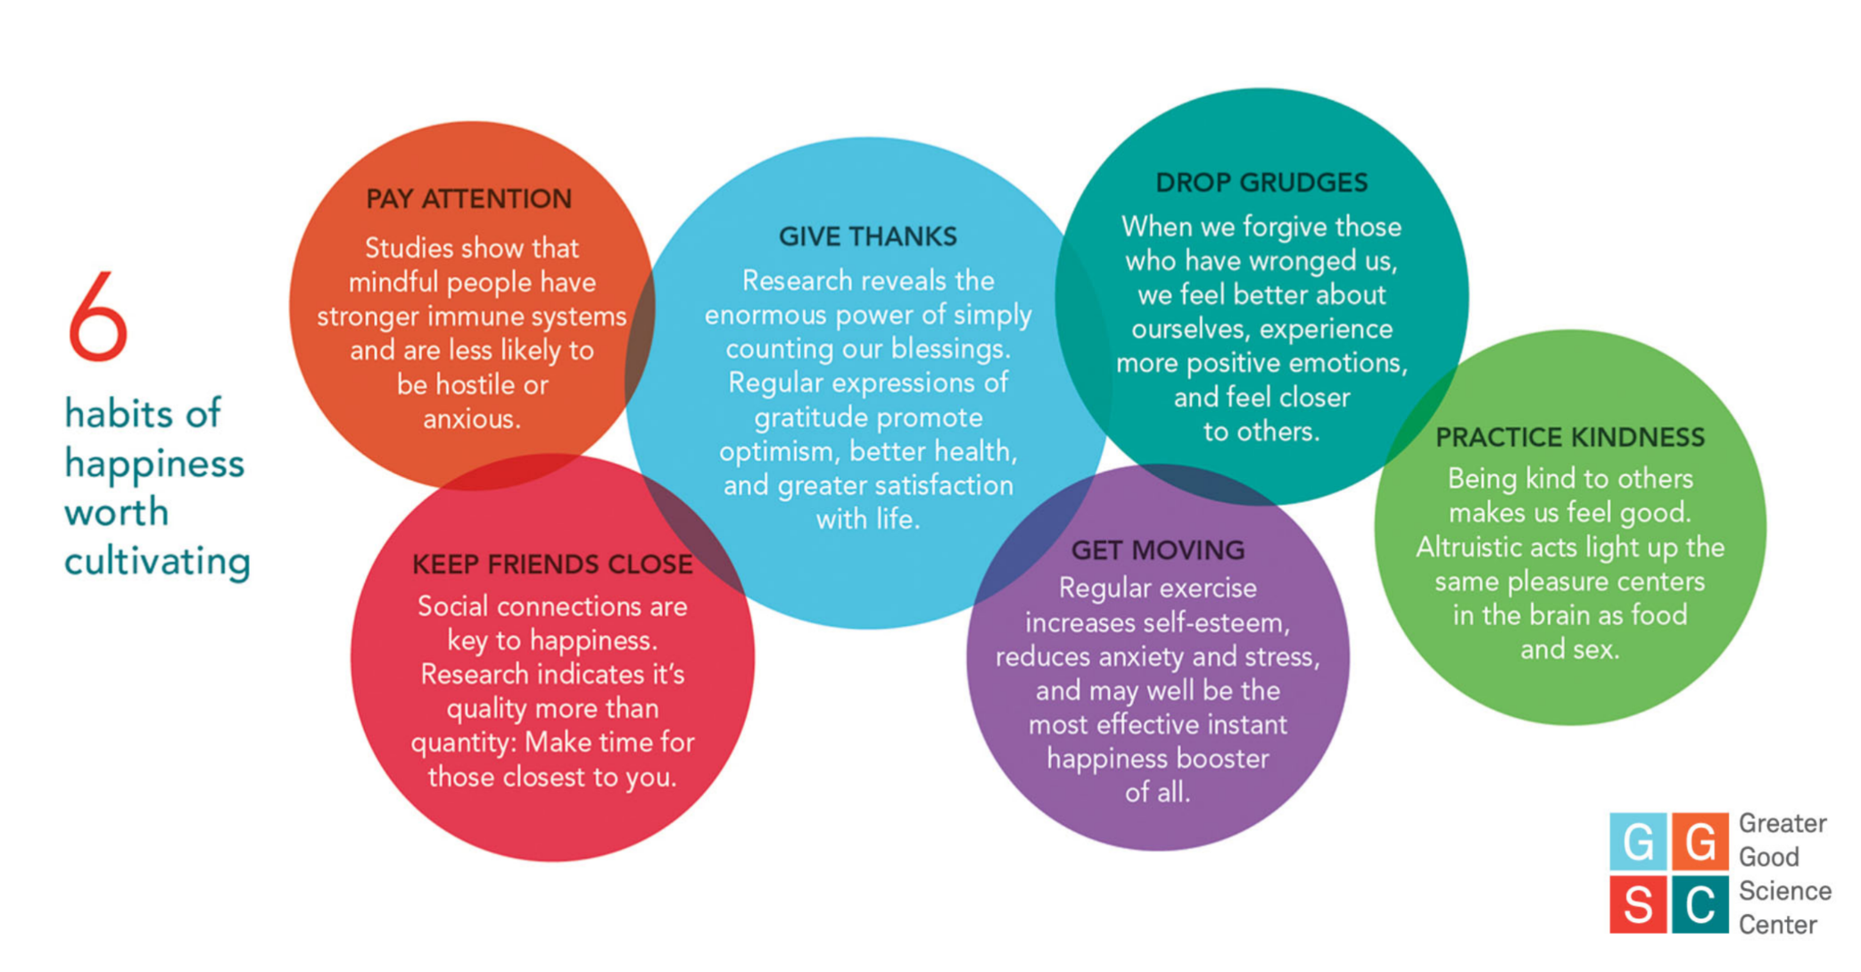

Slide 10
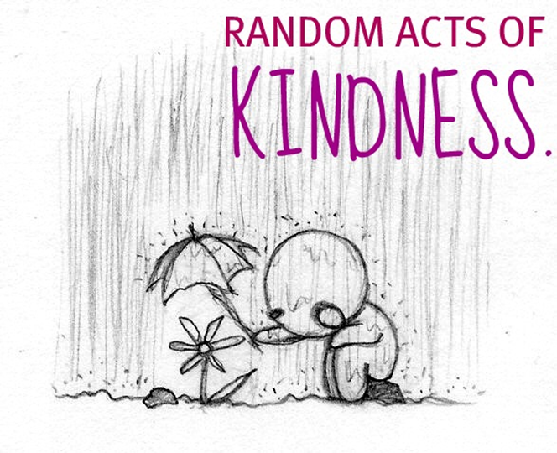
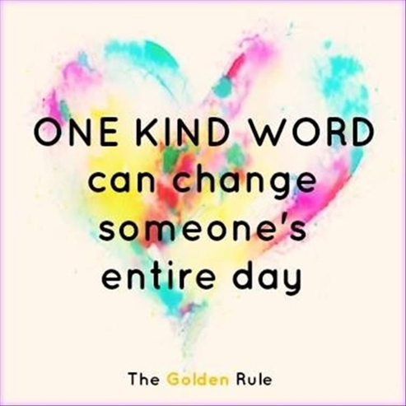
Mention daily common acts of kindness
Next time you observe someone being kind, see if you can notice how you react
Do your eyes light up?
Does your heart feel lifted?
Does your mouth shape itself into a gentle smile?

Slide 11
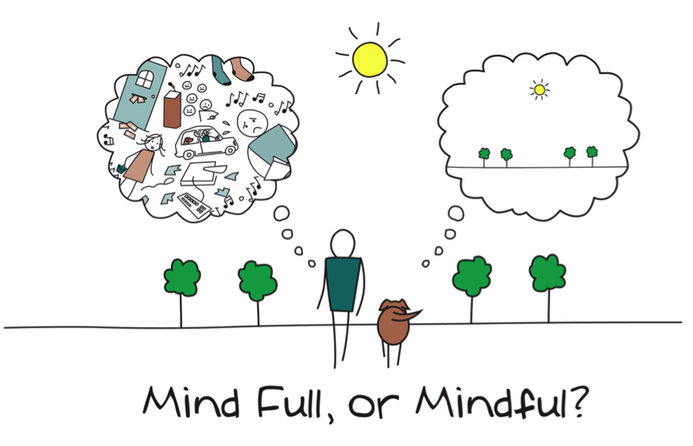
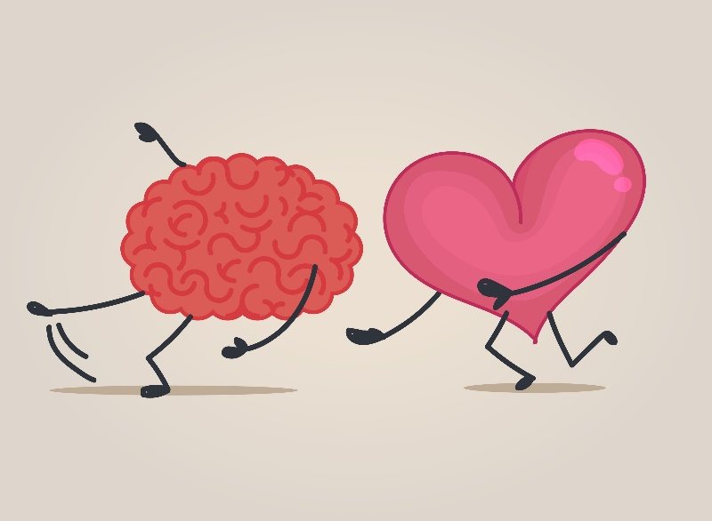
Mindfulness Practice for the Mind and Heart
Reduces stress
Increases happiness
Creates awareness
Improves social relationships
Effectiveness at work

Slide 12
Questions?
Thank you!

