Slide 1
Welcome
Tiffany Tedesco
Regional Program Manager

Slide 2
Conference Overview & Basic Logistics
Emergency Exits and Rallying Point
Workshop Locations
Program Schedule
Oracle Wi-Fi Password
Don’t forget to claim your Aunt Bertha page: staff is here to help!
Questions—see staff in logo wear
Thanks to planning committee: Sharon Kelleher, Amandine Aubin, Diana Garcia, Nancy Nagel,
Susan Takalo, Tiffany Tedesco
and Second Harvest Staff

Slide 3
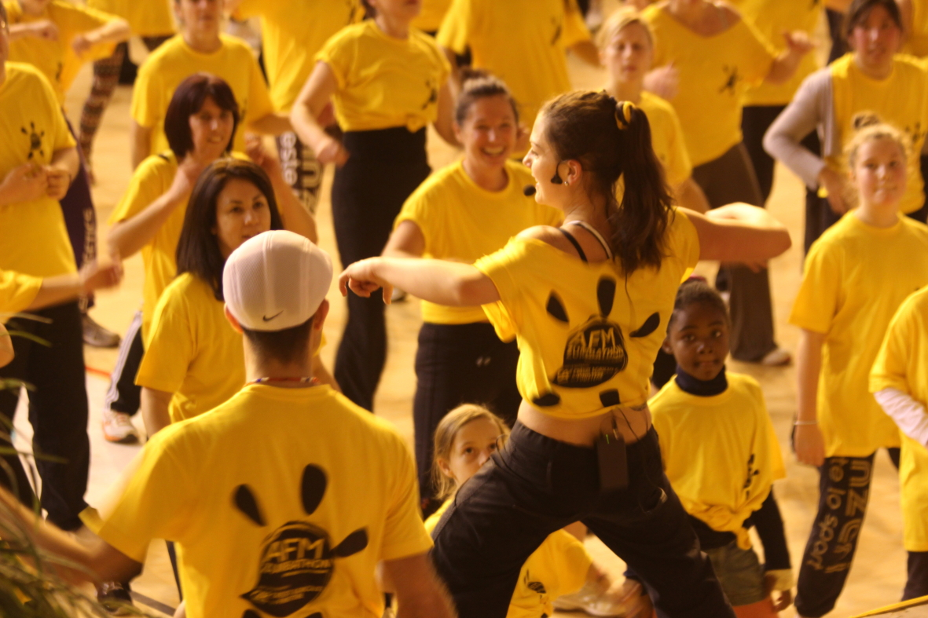
Let’s Zumba
Vicky Avila-Mendrano

Slide 4
State of the Food Bank May 11, 2018
Leslie Bacho CEO

Slide 5
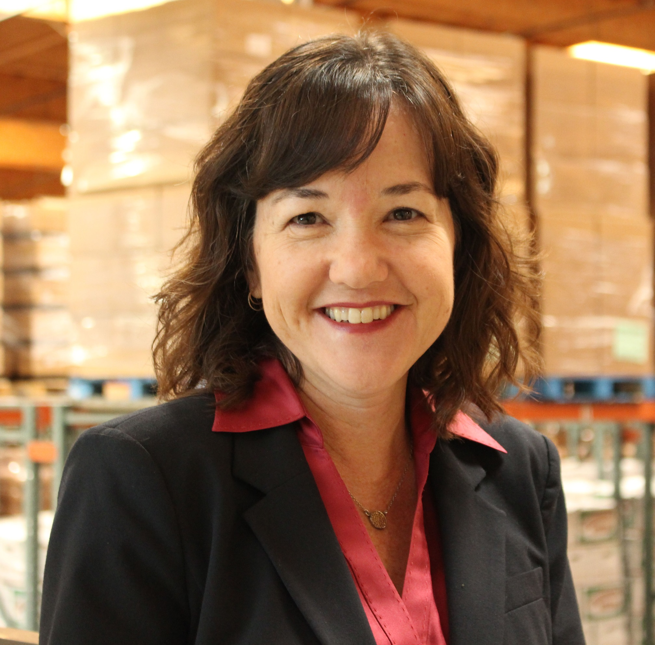
A little bit about me . . .

Slide 6
Keys to our future success
Community wired toward innovation and problem solving
Community willing to invest in solutions
Strong network of creative, committed partners

Slide 7
What I heard from you
Lots of positive feedback
Opportunities to improve our customer service
Resource challenges
Shared concern for clients having to move out of our community and how to best reach clients who remain
Impact of immigration fears
Shared concern for threats to the social safety net

Slide 8
Where we’re headed: Making our services more welcoming
Client-centered innovation – what do our clients want and need
Improving the end-to-end client experience
Marketing to clients – how to reach new people

Slide 9
Where we’re headed: Increasing Access
Expand access at our direct service sites
Better coordination with our partners
Mobilize all willing and able partners beyond our traditional partners (e.g. medical organizations, supportive housing service organizations, schools)
Expand nutrition education
Grow school and summer meals

Slide 10
Where we’re headed: Protecting and Improving CalFresh
Advocate to prevent cuts to SNAP/CalFresh in the Farm Bill
Continue CalFresh outreach
Work closely with counties to soften the impact of potential cuts

Slide 12
Partnership Awards
Tometrius Paxton
Senior Manager of Community Partnerships

Slide 13
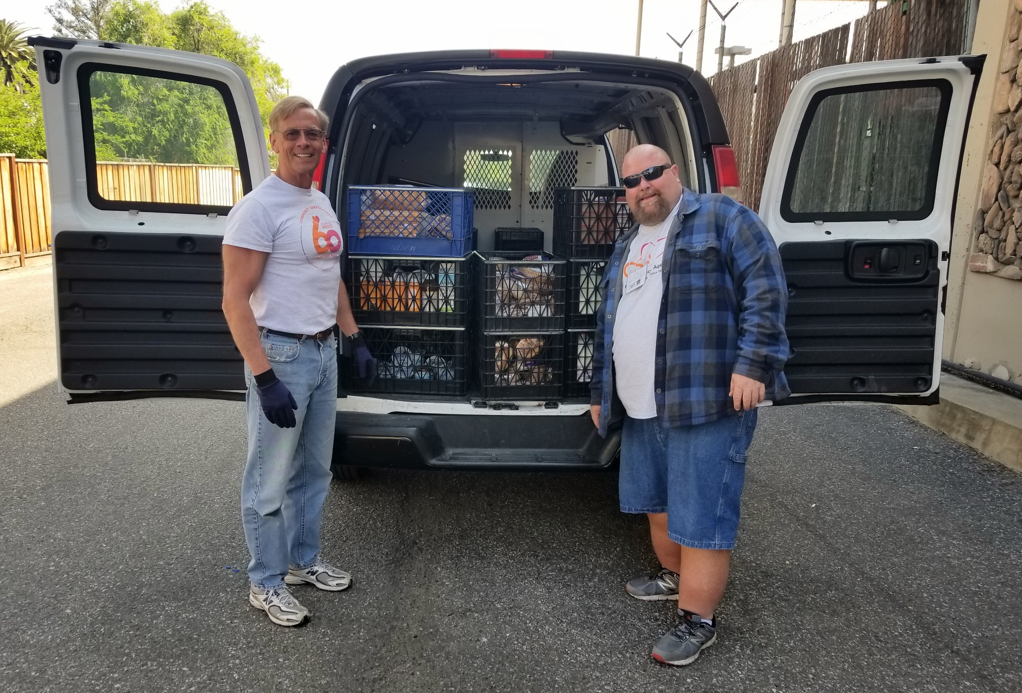
Outstanding Grocery Rescue Partner

Slide 14
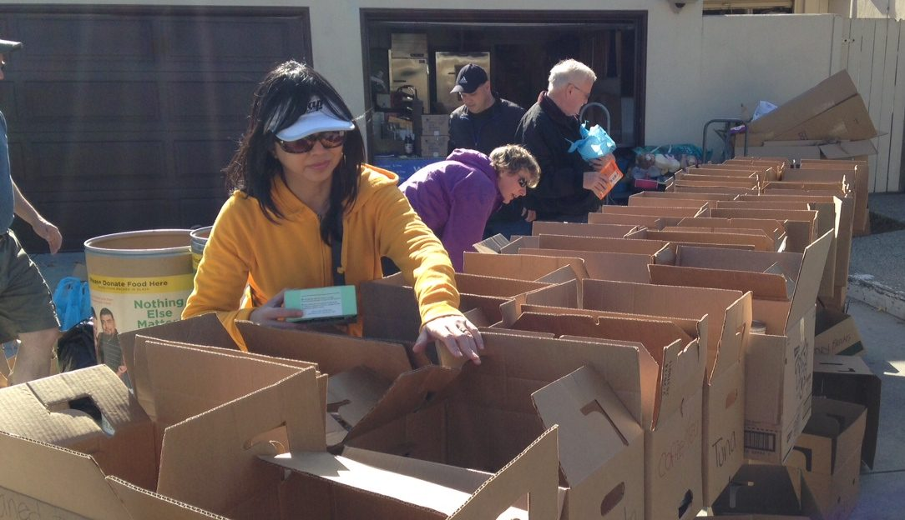
Ultimate Food Connector Award

Slide 15
Breakout Session 1
10:00-11:00 a.m.
Begin

