Slide 1

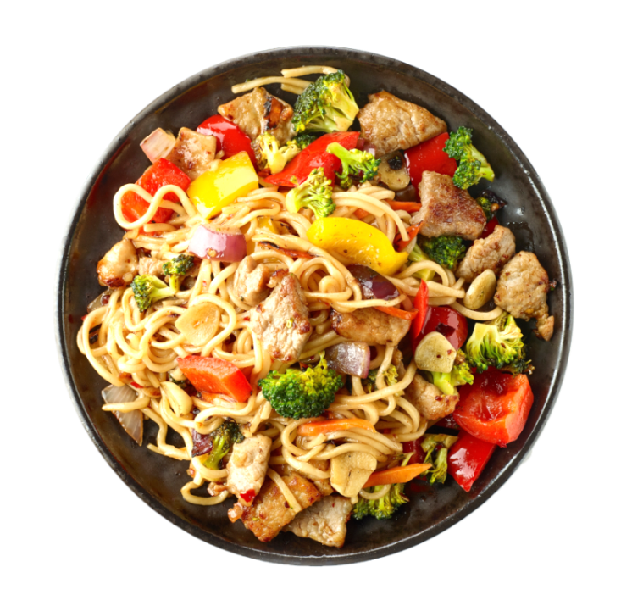


WELCOME
Expanding CalFresh to People Receiving SSI
Santa Clara County

Slide 2

REGULATION CHANGE
JUNE 1, 2019
people who receive SSI benefits will be ELIGIBLE TO APPLY for & receive CalFresh benefits
if otherwise eligible

Slide 3

REGULATION CHANGE
This historic change will increase nutrition and health while reducing hunger and poverty

Slide 4

What is CalFresh?
REGULATION CHANGE
There will be
NO CHANGE or REDUCTION to SSI/SSP benefit

Slide 5
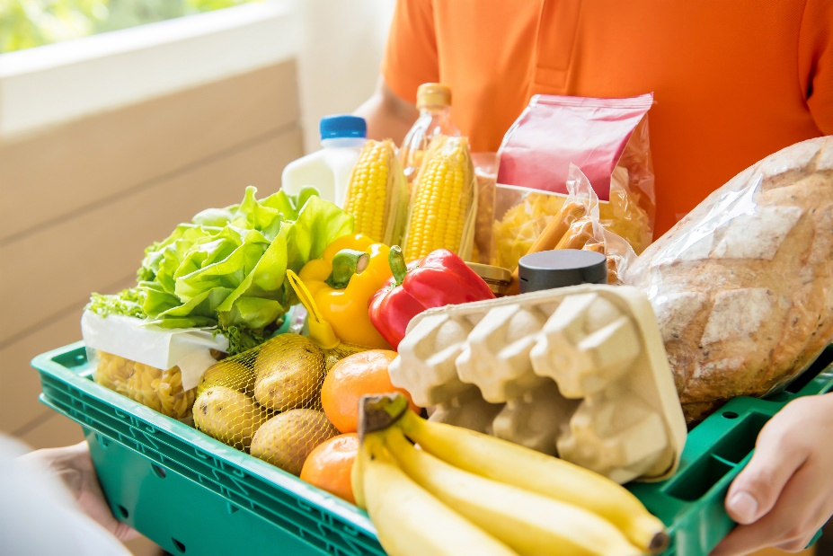
What is CalFresh?
CalFresh is a nutrition program that can help households
buy healthy foods.

Slide 6

Used to be known as the Food Stamps
In California, known as CalFresh
Nationally, the program is called SNAP

Slide 7

It is funded by the
FEDERAL GOVERNMENT
BENEFIT AMOUNT
Ranges from: $15-$192
Average: $105-$110
For older adults &
people with disabilities

Slide 8
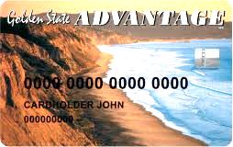
CalFresh benefits are issued on an EBT card that:
Benefits of
CalFresh Program
Works like a debit card
Can be used at most grocery stores
Many farmers markets to purchase food

Slide 9

Market Match
EBT Cards Accepted at Most Farmers’ Markets
Green Star Markets Accepts EBT
Orange Star Markets Accepts EBT & Doubles Your Money up to $10 free per day
WEBSITE:
https://www.sccgov.org/sites/phd/hi/ heal/harvest/Documents/market.pdf
Benefits of
CalFresh Program

Slide 10

Double Up Food Bucks
Use EBT Card to Buy California Grown Fruits & Vegetables
For Every $1 Spent, Earn $1 Free Double Up Food Bucks
Spend Double Up Food Bucks on Any Fruits & Vegetables Next Trip
WEBSITE:
http://www.doubleupca.org

Slide 11

Restaurant Meals Program
Application
Process
Use EBT Card at Participating Restaurants
Must Be Homeless, Disabled or Elderly (age 60 & over) to Qualify
Ask CalFresh Worker to Code EBT Card
WEBSITE:
https://www.sccgov.org/sites/ssa/debs/ Documents/scd207_english.pdf

Slide 12

Simplified Process
Application
Process
If Everyone in the Household is 60+ and/or Disabled, and Have ONLY Un-Earned Income
Application interview can be done by phone or in person
Complete 2 page form once a year
Recertification every 3-years with NO interview

Slide 13

Regular Process
Verifications Needed
If Household members are under 60 and
are Not Disabled, and/or Have Earned Income
Application interview can be done by phone or in person
Complete 2 page form every 6 months
Recertification every year with interview

Slide 14

E-Verified by County
Verifications
Needed
Verification only requested if questionable
Identify
Residency
SSI and/or RSDI Payment

Slide 15

Self Declared Verifications
Verification only requested if questionable
Shelter Costs Deduction
  Rent or Mortgage
  Utilities and Phone

Slide 16

Self Declared Verifications
CalFresh Household means:
  Who do you purchase, and
  Prepare Food with?

Slide 17

Paper Verifications
Earned Income
  Pay Stub or Letter from Employer
  Self Employed - Tax Return/Profit & Loss Statement
Other Income
  Award Letter or Current Benefit Check
  Rental Income, Etc.

Slide 18

Paper Verifications
Medical Deductions Examples
Health Insurance Premium (i.e. Medicare, Dental)
Co-payments for Appointments or Prescriptions
Acupuncture, Chiropractic or Herbal Treatments
Maintaining Care Attendants Due to Age, Infirmity or Illness
Over the Counter Medications Recommended by Doctor

Slide 19
Paper Verifications
5 Ways to Apply
Medical Deductions Examples
Eyeglasses, contacts, lens solutions; hearing aids, batteries; dental care, dentures; incontinence products
Cost of transportation to health care appointments or pharmacy
Outstanding medical bills
Maintenance cost for service animals

Slide 20
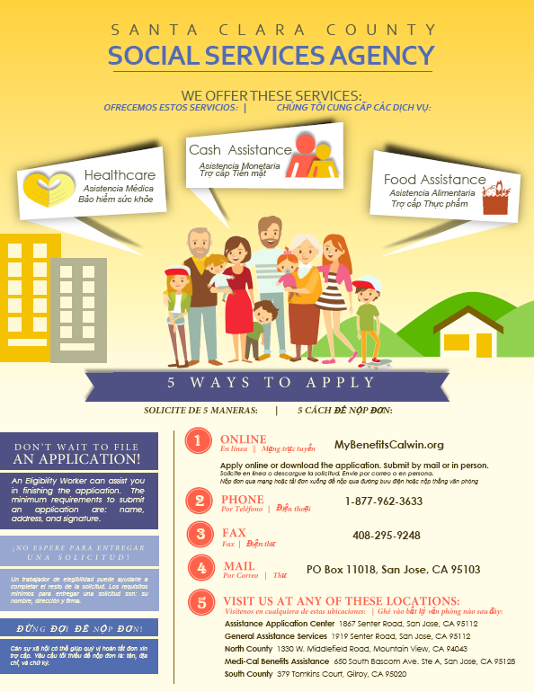
1
ONLINE
MyBenefitsCalwin.org
Apply online or download the application. Submit by mail or in person.
5 Ways to Apply
2
PHONE
1-877-962-3633
3
FAX
408-295-9248
4
MAIL
PO Box 11018, San Jose, CA 95103
5
MAIN LOCATIONS:
Benefits Assistance Center 1867 Senter Road, San Jose, CA 95112
North County 1330 W. Middlefield Road, Mountain View, CA 94043
South County 379 Tomkins Court, Gilroy, CA 95020

Slide 21

How Can You Help?

Slide 22

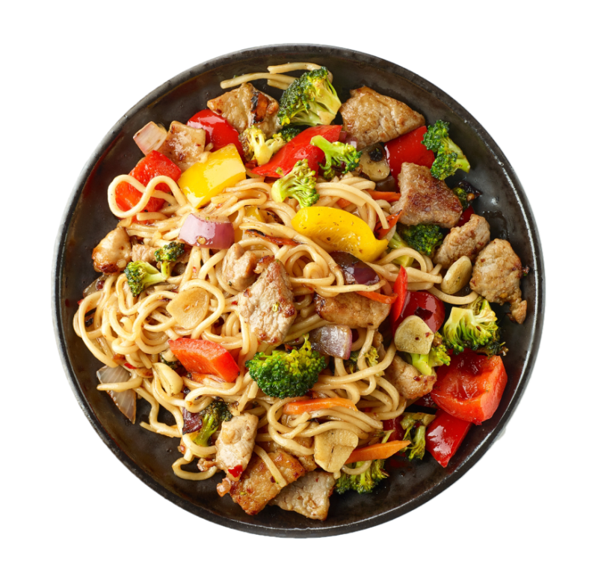

Inform SSI Recipients They Can GET CALFRESH FOOD & KEEP SSI BENEFITS

Slide 23
INFORM CLIENTS
About this historic regulation change
Explain how easy it is to get CalFresh benefits and maintain benefits
Encourage including deductions because they may increase benefit amount

Slide 24

WHAT YOUR AGENCY CAN DO
Give brochures to clients
Assist clients in applying
Invite us to give a presentation to your staff

Slide 25


questions
?
Roseann.Berthron-Arechiga@ssa.sccgov.org
408-755-7545

Slide 26



THANK YOU

Slide 27

Second Harvest Food Bank of Santa Clara and San Mateo Counties

Slide 28
Food Program Agenda
Overview of food bank programs
Food bank program application assistance and referrals
How to refer clients to other programs

Slide 29
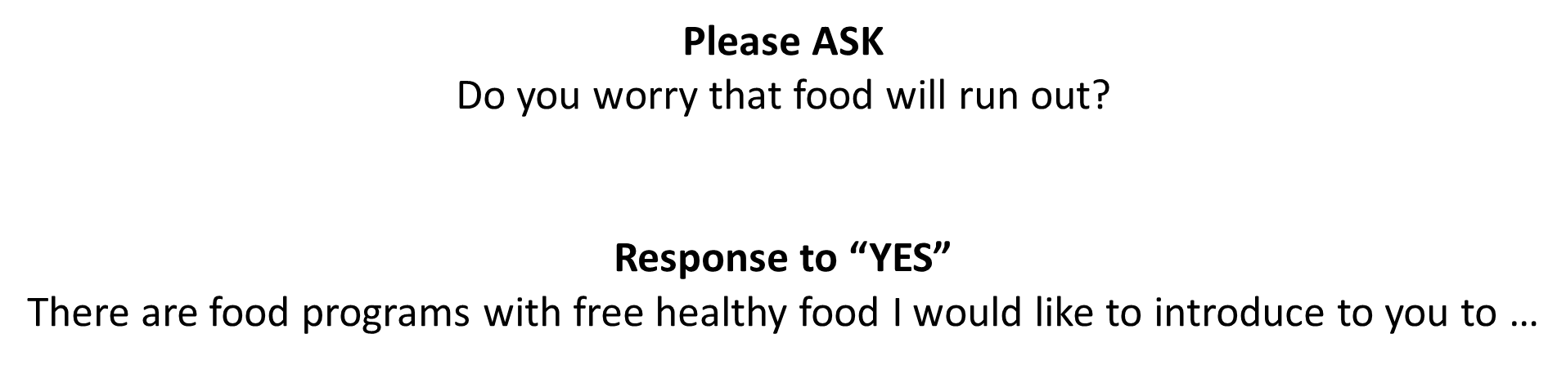
How Can You Help?

Slide 30


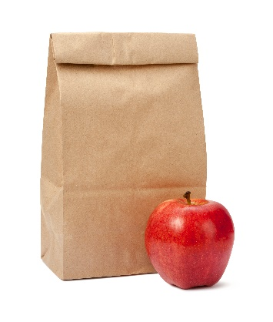
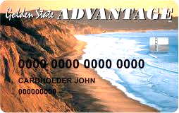
Different Ways to get Food…
GROCERIES
CALFRESH
PREPARED MEALS
SCHOOL MEALS

Slide 31
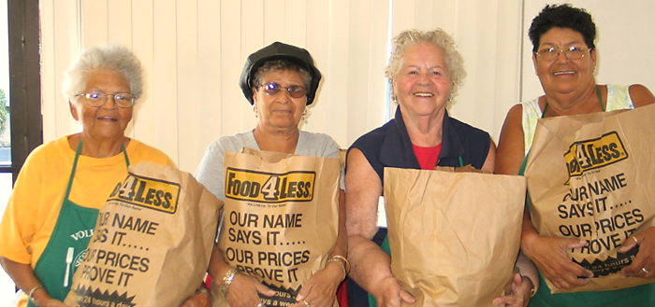
BROWN BAG
Twice monthly groceries to low-income senior (60+) and disabled (55+) households
Households receive about 60 pounds of food each month: fresh produce, eggs, chicken, grains and more

Slide 32
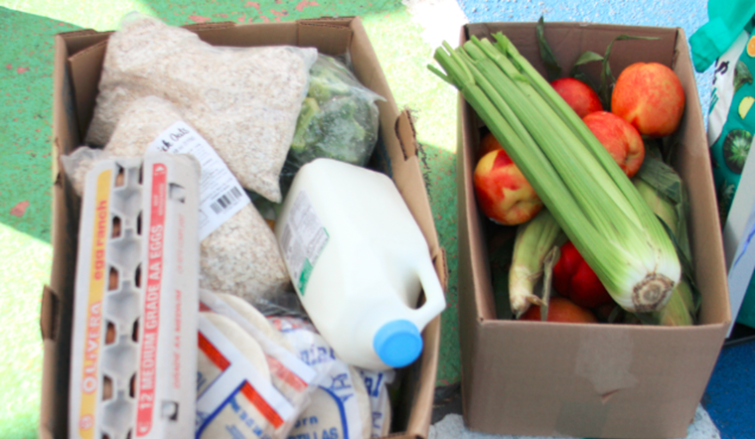
Pantries
Free groceries are available in convenient locations for anyone who needs healthy food

Slide 33

FAMILY HARVEST
Monthly groceries to low-income households with children under age 26 living at home
Families receive about 110 pounds of food per month: fresh produce, milk, chicken, eggs, peanut butter, grains and much more

Slide 34
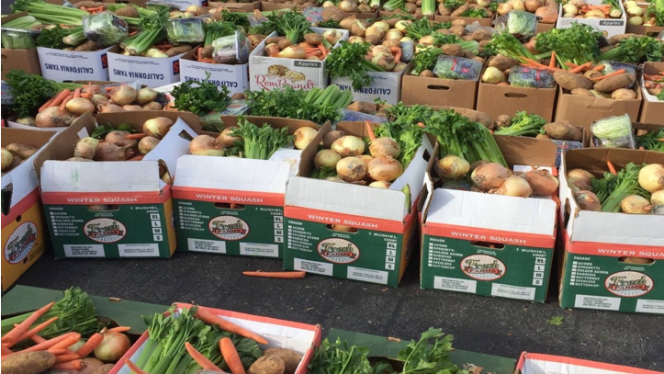
PRODUCE MOBILE
Provides fresh fruits and vegetables
Individuals get about 14 pounds of food per month

Slide 35
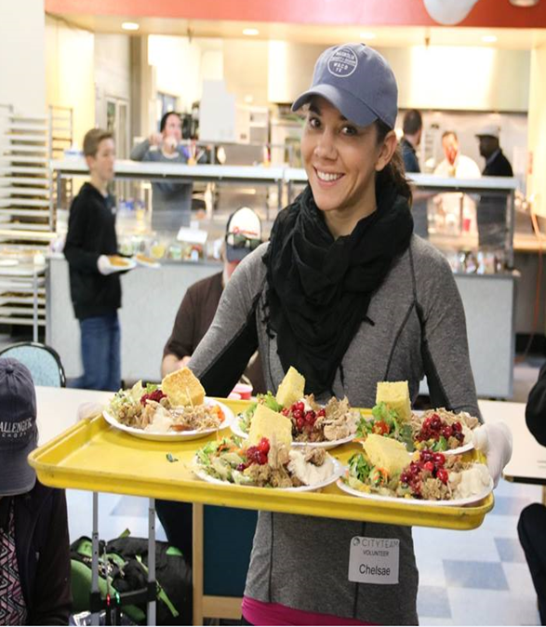
PREPARED MEALS
Many of our partners provide prepared meals
No questions asked – anyone can eat
Variety of meal times and days

Slide 36
Partner Options…
Host Site:
Schedule a food connection specialist at your site to screen for all programs including CalFresh!
Referral Partner:
Send referrals to food connection and we will screen for all programs!
FCAAP PARTNERS:
Train your staff to screen and submit CalFresh Applications!

Slide 37
Train to become an FCAAP Partner
4 – 5 hour training on CalFresh Application Submission Assistance
Food Referral Program Training included
Assistance to clients that we might be missing….

Slide 38
Overview of Application Process
Step by Step Process
Outreach for CalFresh
Prescreening & verifications compiled
Application submission on GetCalFresh
County processes and contacts Family
Approval or denial of benefits within 30 days

Slide 39
Making a Referral
Two Options
1. Email/fax a Food Assistance Referral Form to the Food Connection team
2. Call the Food Connection team with the client at 1800 984 3663

Slide 40
1. Making a Referral
Complete the Food Assistance Referral Form
Fax 408-266-9042, or email food@shfb.org to Food Connection Team
Client will be contacted within 24-48 hours

Slide 41
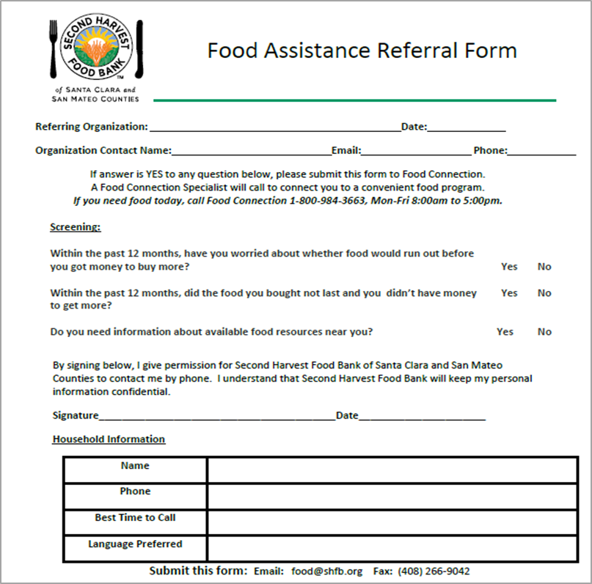
1. Food Assistance Referral Form
Fax or email:
(408) 266-9042 or food@shfb.org
Client will be contacted within 24-48 hours

Slide 42
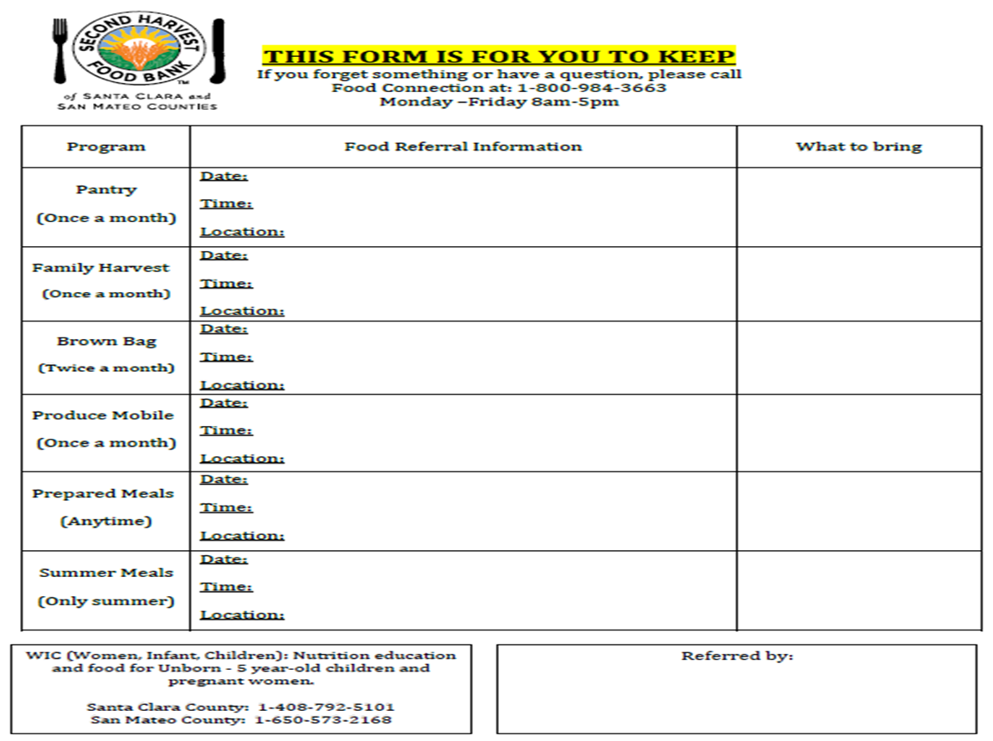
2. Client Referral Form

Slide 43
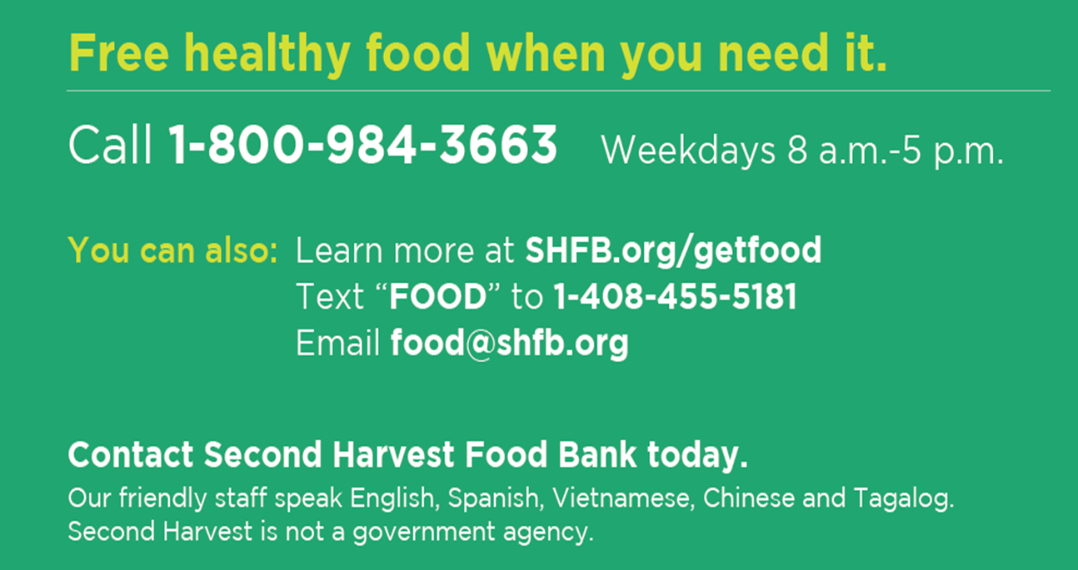
We’re here to help!

Slide 44

THANK YOU!
We look forward to working with you!

