Slide 1
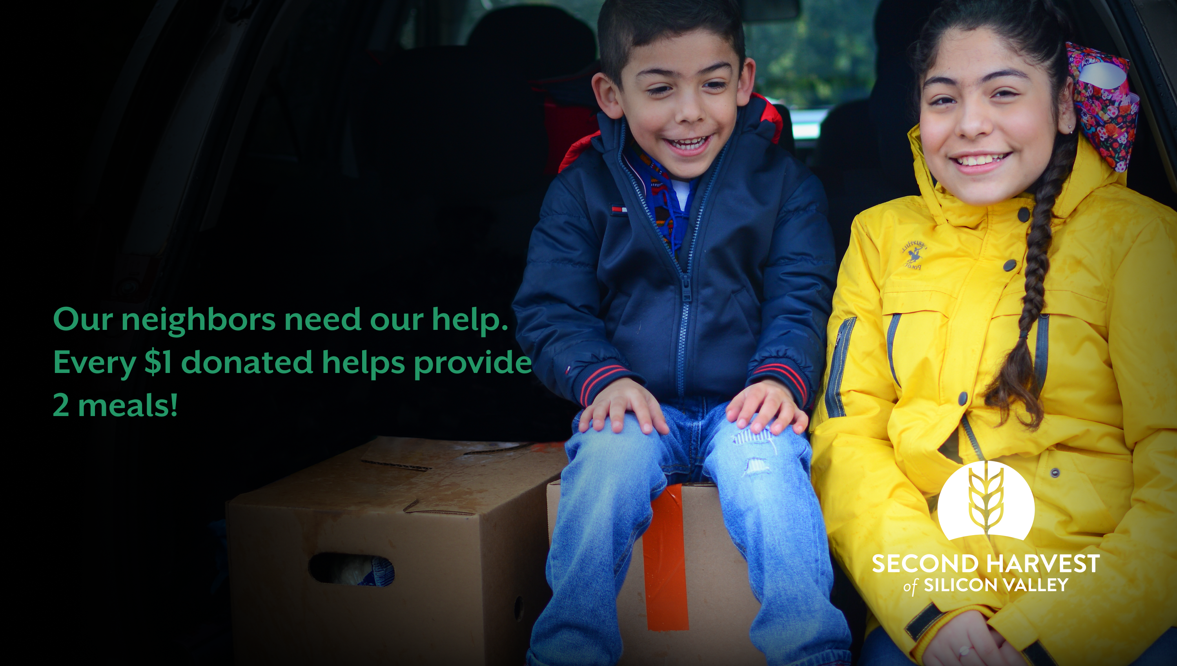
Help <Insert your organization name here> provide food to families in need by donating to our fundraiser for Second Harvest of Silicon Valley.
Visit shfb.org/fundraiser and search for <insert your page name here> and donate today.

