Slide 1
USDA Overview and Training + rules during covid 19
2022

Slide 2
*During covid 19
During covid 19, there are some interim flexibility to the rules. Until further notice, those waivers and guidance are provided to assist in the prevention of the spread of covid 19 by limiting exposure to staff/volunteers and clients.
Those interim rule slides are titled with: *during covid 19 (like above) in this presentation.

Slide 3
Program Overview
USDA = TEFAP/EFAP (The Emergency Food Assistance Program)
Administered by the California Department of Social Services
EFAP provides low income individuals and households with commodities provided by USDA
Established to supplement the nutritional needs and not to satisfy all hunger needs or nutritional requirements of individuals/households

Slide 4
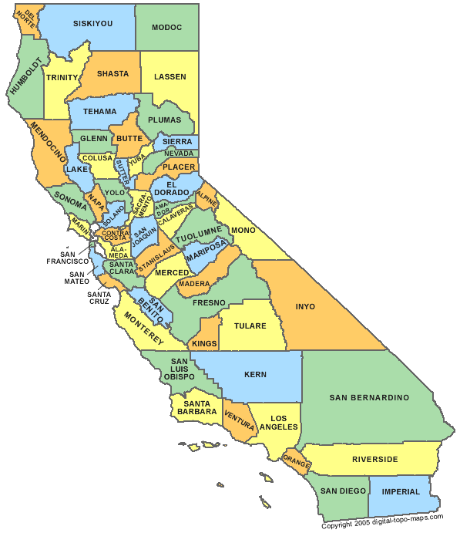
California Dept of Social Services (CDSS)
Oversees at State level
48 Food Banks/58 Counties
1.1+ million people served monthly in California

Slide 5
USDA Agreement
Must have signed agreement before starting program
Outlines all requirements and procedures
Each and every rule and procedure must be followed
Second Harvest will lose contract for non-compliance

Slide 6
Distribution Types
Two categories of distribution
Household: provides groceries for home consumption (ex: pantries)
Congregate meal: provides prepared meals on-site (ex: soup kitchens)

Slide 7
Distribution Guidelines
As with all Second Harvest products, commodities cannot be sold or used as barter for services
Distributing partner is accountable for any lost or damaged product. Report to your Second Harvest program manager immediately
Report any misuse of commodities or any other pertinent information to your program manager. We may have to report to USDA
Do not dispose of any USDA commodity without directions from a Second Harvest staff

Slide 8
Distribution Guidelines for Households
Can serve unhoused clients. Use address of where they are staying or where car is parked
Recipients must sign certification of eligilbity (EFA-7) each and every time
Commodities are for home distribution only
Submit USDA monthly report for unduplicated individuals and households served in that month

Slide 9
Distribution Guidelines for Congregate Meals
Partners that provide meals to needy and/or unhoused individuals on a regular basis in a congregate setting
Commodities are for congregate feeding only and cannot be given to participants to take from the premises. Please only order what is needed for the meal
Submit USDA monthly report for unduplicated individuals and meals served in that month

Slide 10
Distribution Location and Schedule
Must let Second Harvest know if you change distribution location or schedule
Must have a posted schedule of distribution days and times at your site
If all food is distributed before the advertised end time, a site representative must remain on site to inform recipients of their options (e.g. Provide Food Connection cards or let them know when to return again)

Slide 11
Storage Requirements
All commodities must be stored 4-6 inches off of the floor and 4-6 inches away from the wall
Frozen/refrigerated food must not be kept out for more than 2 hours at room temperature
Food safety rule is within 4 hours. Food needs to return to the refrigerator or freezer or be prepared within that timeline.
Food that is out for more than 4+ hours cannot be consumed safely

Slide 12
Verifying Eligibility
Recipients’ income level must fall within 235% of the Federal poverty level
Recipients are only required to self certify their income through their signature on the EFA-7 form
Recipients may not be asked to supply proof of income

Slide 13
Calculating Monthly Reports
Report the number of households that receive USDA food in addition to the regular reporting you already do
Household participation numbers must reflect unduplicated individuals and households including those for distribution sites conducting more than one distribution per month. If your site conducts more than one distribution per month, any individual counts as one whether they get food once or multiple times in that month
Congregate meal numbers must separately reflect the number of people and meals served. If one person has two meals, the report would reflect 1 person, 2 meals
Report through our online link by the 7th of the month, every month
All records must be kept for 3 years and the current year at your site and need to be available at your monitoring visits

Slide 14
Compliance Reviews/Audits
USDA conducts compliance reviews of Second Harvest and distributing partners, on-site
These compliance reviews may be unannounced
Second Harvest will conduct our own compliance review of partners during monitoring visits
USDA audits may include:
Inspection of inventory and storage of commodities
Audit of records and reports
Review of procedures and methodologies

Slide 15
OMB and Audit Requirements
Any organizations receiving USDA will need to fill out an OMB (Office of Management and Budget) Uniform Guidance Form at the end of the fiscal year
Second Harvest will send that along with the annual valuation letter
Any organization receiving $750,000 or more annually in Federal funds or food, either directly and/or as pass through (ie. from Second Harvest), must submit an audit report

Slide 16
Databases and electronic registration
USDA is allowing partners to use any electronic database or tracking system of their choosing. This will still need to be approved by USDA but we can help advise and preview your selection.
Your selection will need to have the information that is currently asked on the EFA-7 and able to replicate an electronic report.
For Second Harvest-run grocery programs, we are currently capturing client info in Salesforce.

Slide 17
Mandatory Forms and Posted Information
2021

Slide 18
Required Signage at Sites
Must be posted in clear view of all recipients at each distribution:
Income guidelines
EFA-7 sign in sheet
“And Justice for All Poster”
For religious organizations, “The Emergency Food Assistance Program (TEFAP) Written Notice of Beneficiary Rights”

Slide 19
Income Guidelines
Income must be within the 235% poverty level guidelines (for complete chart, see handout)
Household Size | Annual Income | Monthly Income
1 | $31,937 | $2,661
2 | $43,029 | $3,586
3 | $54,121 | $4,510
4 | $65,213 | $3,434

Slide 20
Sign In Sheet (EFA-7)
All participants must sign the form and answer all questions on form
Exempt for congregate meal programs
Anyone unable to write their name, may mark the letter “X” on the signature line. A distribution volunteer must then initial their own name and print the recipient’s name next to the “X”
Site must collect and maintain forms for 3 years plus current year
Second Harvest and USDA auditors may ask to see originals

Slide 21
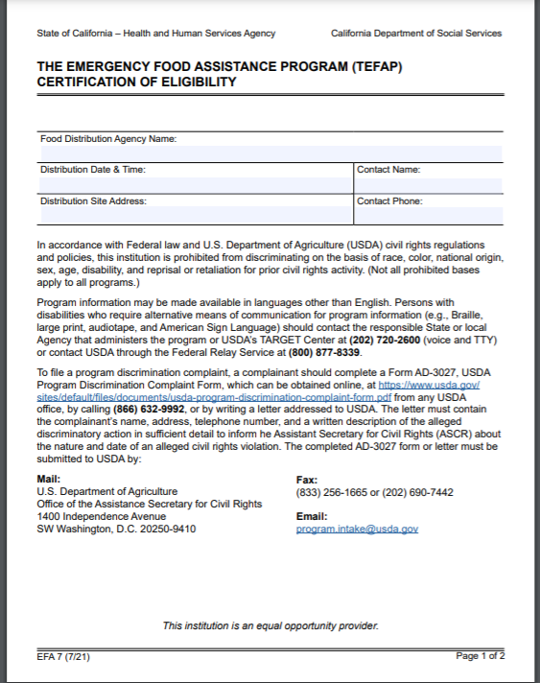
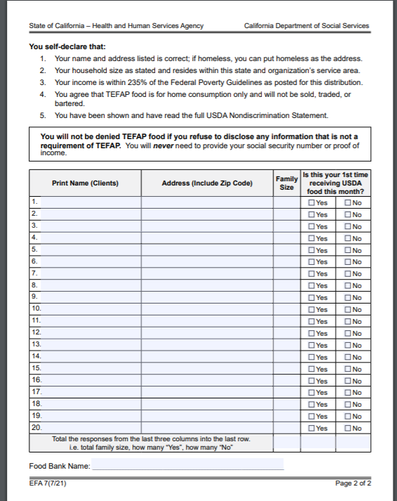
Sample EFA-7 Form

Slide 22
*During covid 19
USDA sites still need to use the EFA7 sign in sheets, however…
Site volunteer or staff may sign for the client and note “covid 19” in the signature box
Site volunteer/staff would put a check mark on the EFA7 for client in address
Allow client to see their name and address has been checked off
See sample on next slide

Slide 23
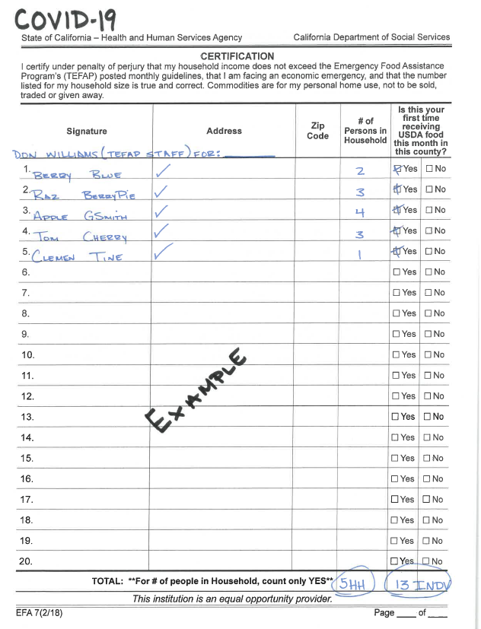
*During covid 19

Slide 24
Alternate Pick Up Forms
An alternate person may pick up commodities for a recipient in their absence
Alternate must bring with them an “Alternate Pick Up form” signed by the eligible recipient to an authorized pick up the first time and then be certified annually
The alternate must write the recipient’s name as well as their own name on the EFA-7
If an alternate does not bring the Alternate Pick Up form to the site, a note from the recipient authorizing the pick up will suffice
Alternate pick up forms and notes must be maintained on file and recertified or a new one filled out, annually
It is recommended the alternate pick ups be trackable (ie. The person that came for pick up is recorded or a list of eligible alternates be readily available for verification)
Limit of 5 alternate pick up forms may be presented at one time by one alternate chosen to pick up commodities (translation: only one person can pick up for five)

Slide 25
Alternate Pick Up note
The note must include:
Date
Statement authorizing the pick up by the alternate
Alternate’s name
Statement that the recipient is income eligible
Recipient’s signature, address, and household size

Slide 26
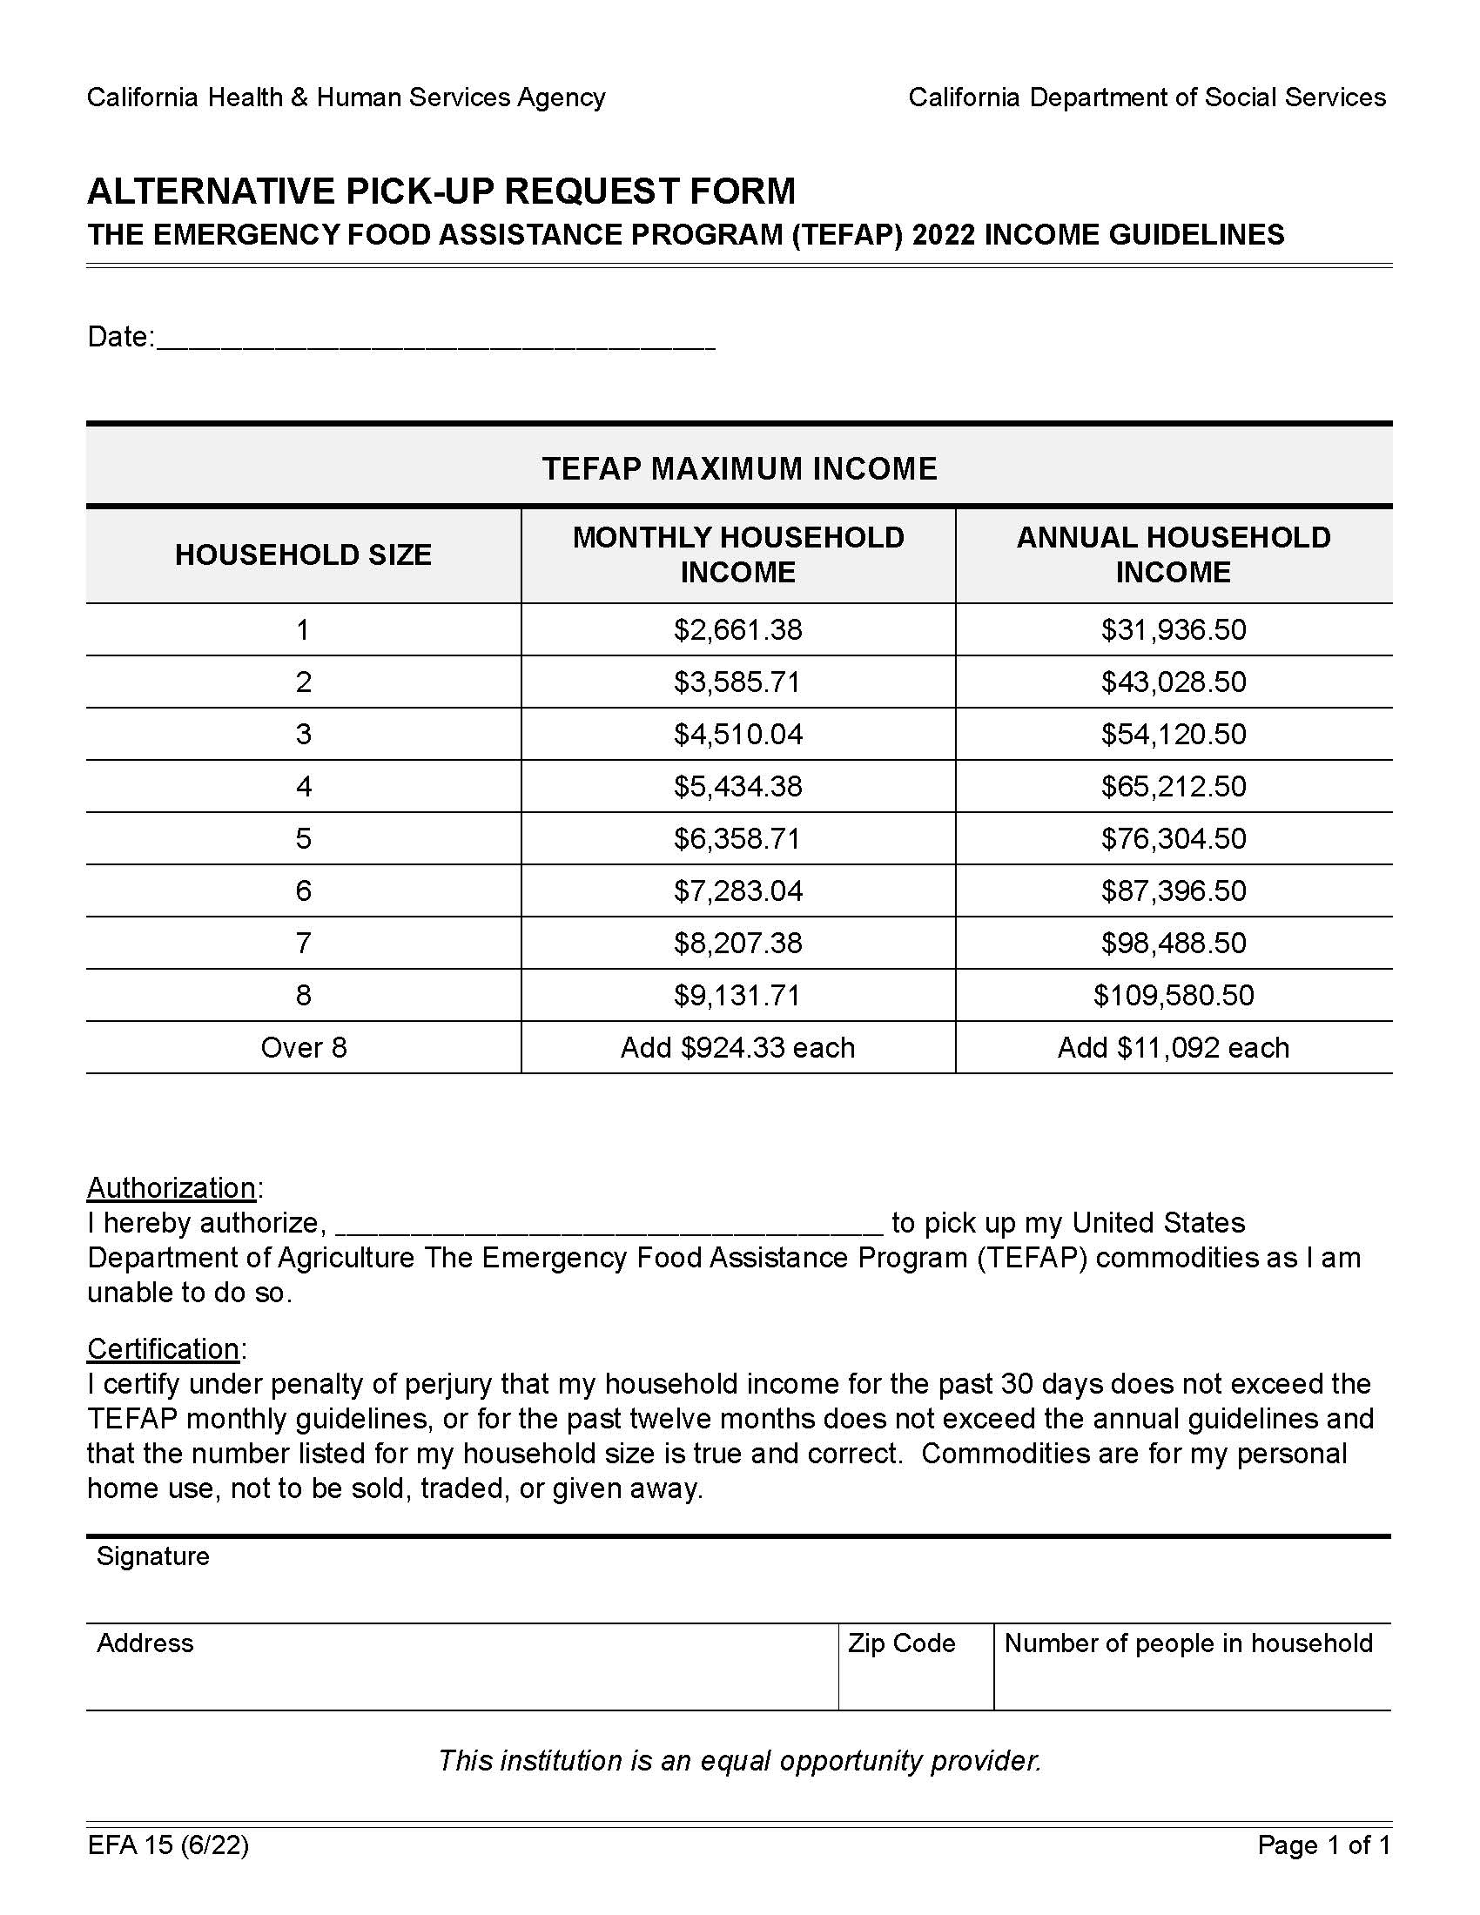
Sample Alternate Pick Up Form

Slide 27
*During covid 19
Removed the requirement for a new alternate pick up note for each distribution
Have one note for each alternate on file is enough, don’t need to bring a new form each time
Removed limitation of 5 alternate pick up forms being presented at one time
One alternate can pick up for as many people as needed

Slide 28
*During covid 19
Alternate pick up sites may be used as necessary
Site must contact and receive permission from client for this alternate service
Alternate may then sign on behalf of client and write “covid 19”

Slide 29
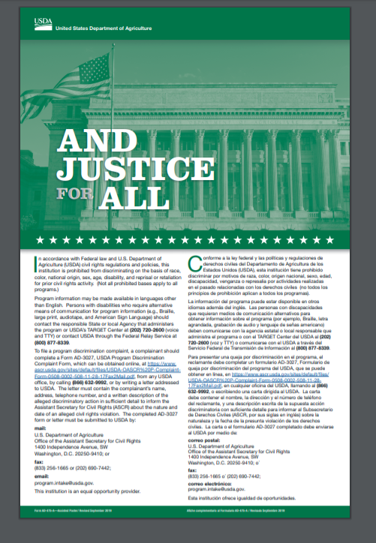
And Justice for All Poster
This will inform recipients of their civil rights, and right to file or make a verbal complaint including an anonymous complaint

Slide 30
Religious Organizations
“The Emergency Food Assistance Program (TEFAP) Written Notice of Beneficiary Rights” must be posted
Provides written notice to recipients of the right to be referred to an alternate provider when available

Slide 31
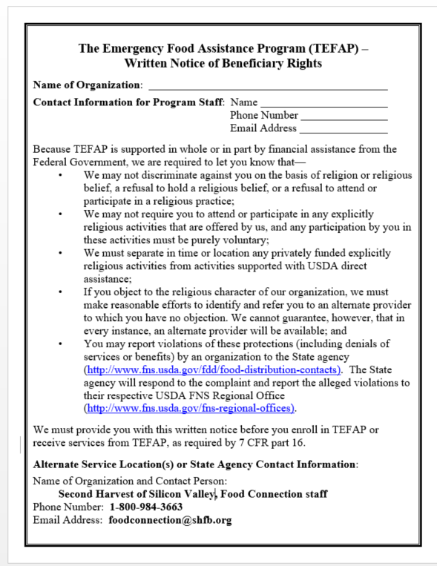
Sample Notice

Slide 32
Forms and Resources
Forms and resources can be found here:
General forms--all
EFA7 sign in sheet
Alternate pick up form
Income guidelines
Bookmark these links!

Slide 33
Civil Rights
2022

Slide 34
What are Civil Rights?
Civil Rights are the rights of an individual to receive equal treatment (and to be free from unfair treatment or discrimination) based on certain legally protected classes

Slide 35
Civil Rights Training
In accordance with the Federal law and USDA policy, there must be no discrimination in the distribution of USDA commodities under this part because of race, color, national origin, sex, age, or handicap
All distributing partners must take an annual civil rights training for all staff delivering services
All distributing partners must provide an annual civil rights training for all volunteers
Training must first occur at orientation prior to any contact with clients or their personal information
Copy of the checklist (FDU 113) must be kept on file as proof of completion for three years plus the current year

Slide 36
Who needs training?
Program management staff at any distribution site
Lead program/site volunteers or staff
Individuals who interact with clients, determine eligilbity, handle confidential client information

Slide 37
Instructions for Civil Rights Training
Level 1 – Training Checklist (FDU 113)
Program management staff at any location and lead program volunteers. This includes all individuals who interact with clients, determine eligibility, or handle confidential client information.
Level 2 –Civil Rights Presentation; in addition to the checklist
The following individuals must also complete a second level of training which shall be completed by viewing the FDU Civil Rights Presentation.
Program management staff at any location and lead program volunteers.
**Program management staff and lead program volunteers will need to do both levels. **

Slide 38
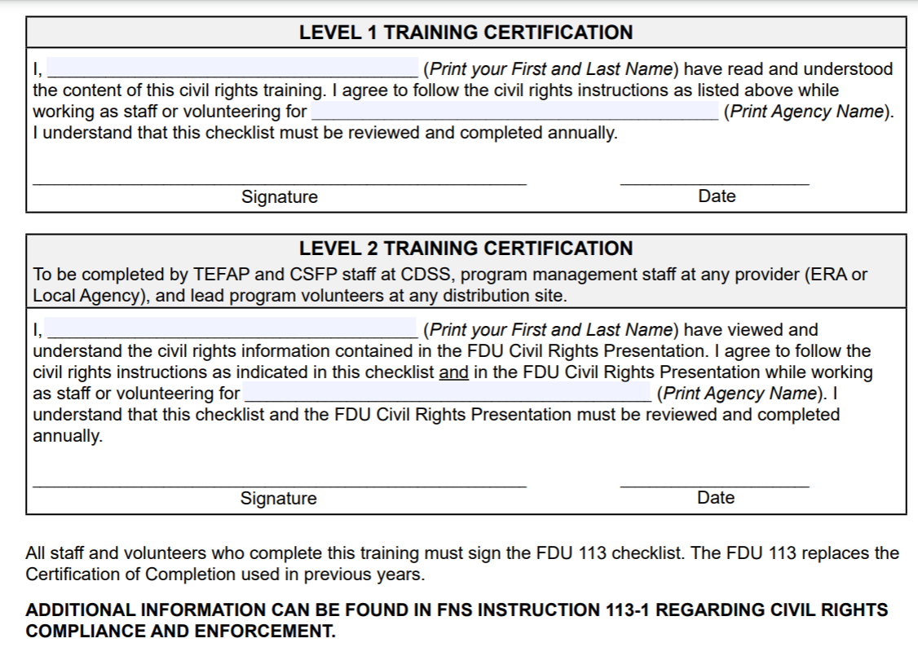
Certification sample

Slide 39
Civil Rights Training Tools
Civil rights annual training checklist (FDU 113)
Civil rights annual training checklist (FDU 113) Spanish
Civil rights training PPT presentation
Civil rights general resources
Civil rights complaint form

Slide 40
Summary of Next Steps
To qualify for USDA, we need from you:
USDA agreement
Take/view civil rights training
Provide civil rights training to staff/volunteers

Slide 41
Contact compliance team
Luz Ayala, Compliance Manager
layala@shfb.org
408 266-8866 ext 267
Ed Aldeo, Compliance Coordinator
ealdeo@shfb.org
408 266-8866 ext 253

