Slide 1
Legislative Gathering
2024

Slide 2
Welcome
Tracy Weatherby
Vice President of Strategy and Advocacy

Slide 3
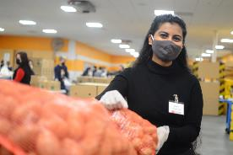
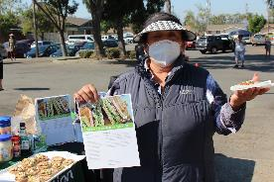
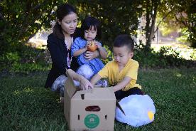
Food Bank Trivia
How many people are at risk of food insecurity in San Mateo and Santa Clara Counties?
When CalFresh Emergency Allotments ended in Feb. 2023, how much $ was lost in our local economy?
What % of our clients have less than $100 in savings?

Slide 4
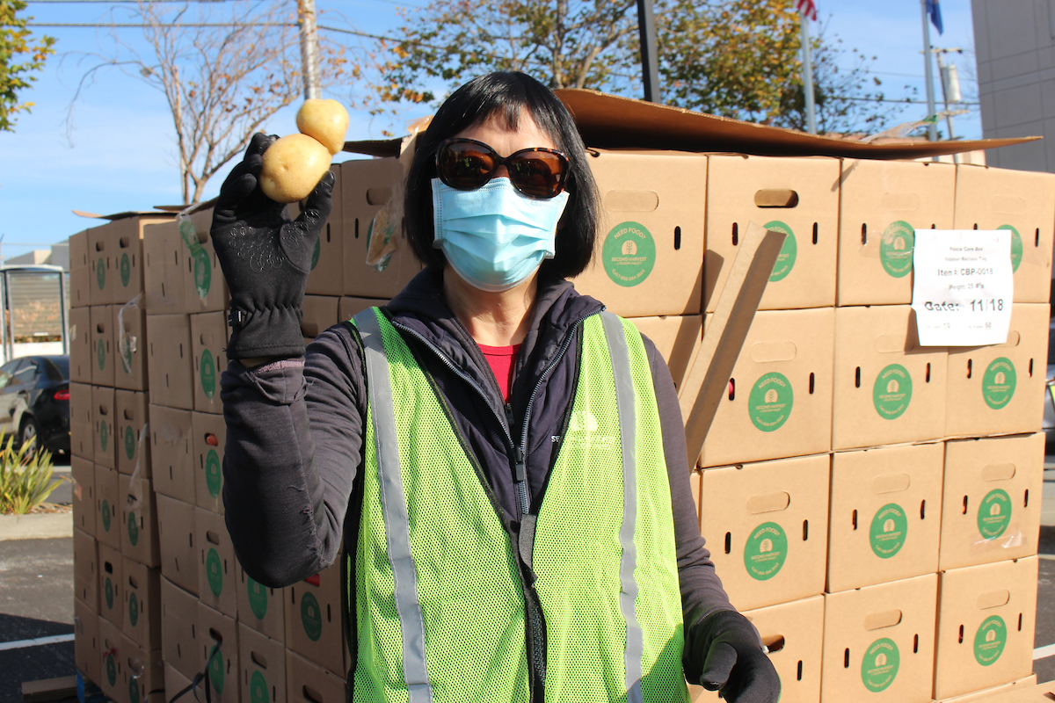
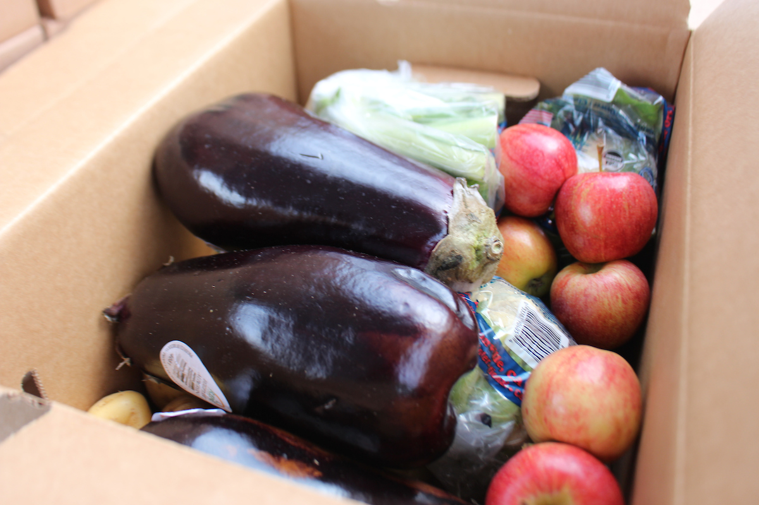
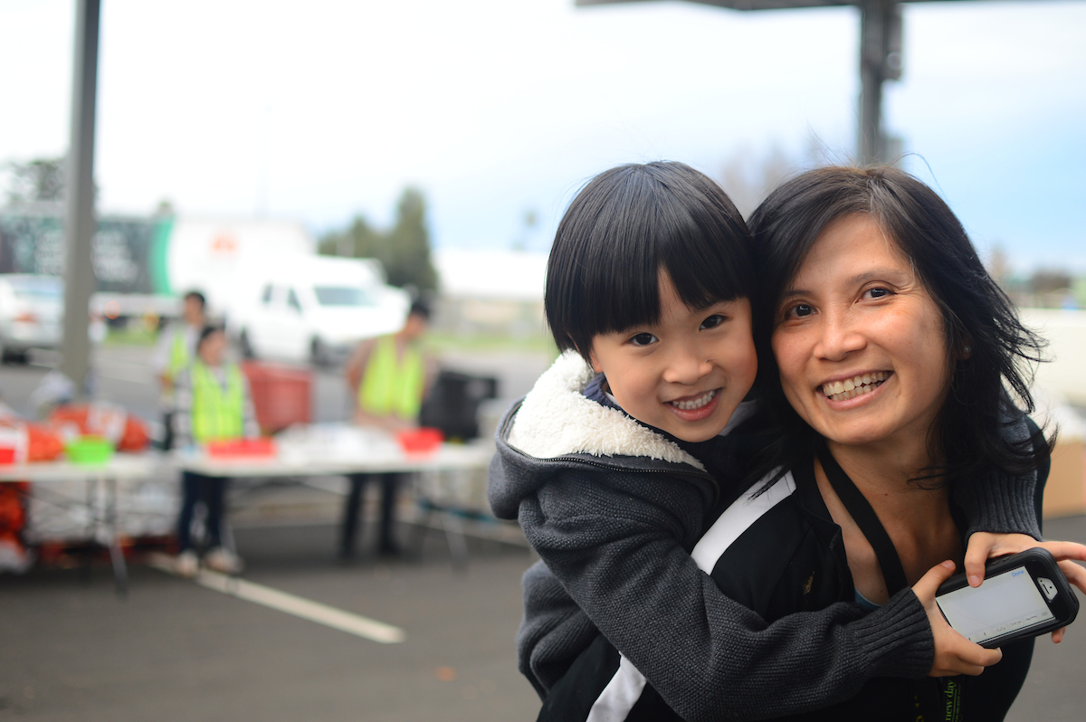
Trivia Answers
Nearly 60% of our clients reported having less than $100 in savings (Jan. 2024 survey).
1 in 4 residents of SMC and SCC is at risk of food insecurity.
In SMC and SCC, 93,000 households lost $16M in monthly grocery benefits when CalFresh Emergency Allotments ended.

Slide 5
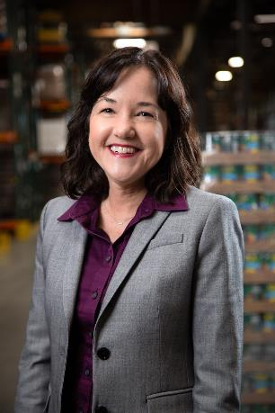
State of Second Harvest
Leslie Bacho
Chief Executive Officer

Slide 6
In Silicon Valley, almost any food that makes its way to people who need it within in the charitable food system begins with Second Harvest.

Slide 7
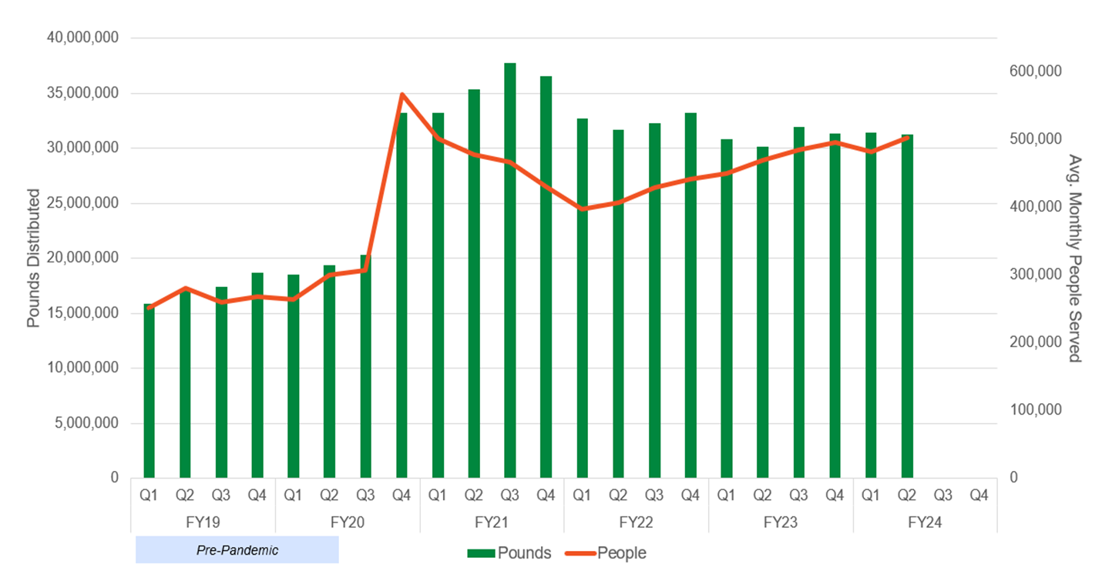
People Served Average people served continues to rise even after most of the pandemic-era impact is behind us

Slide 8
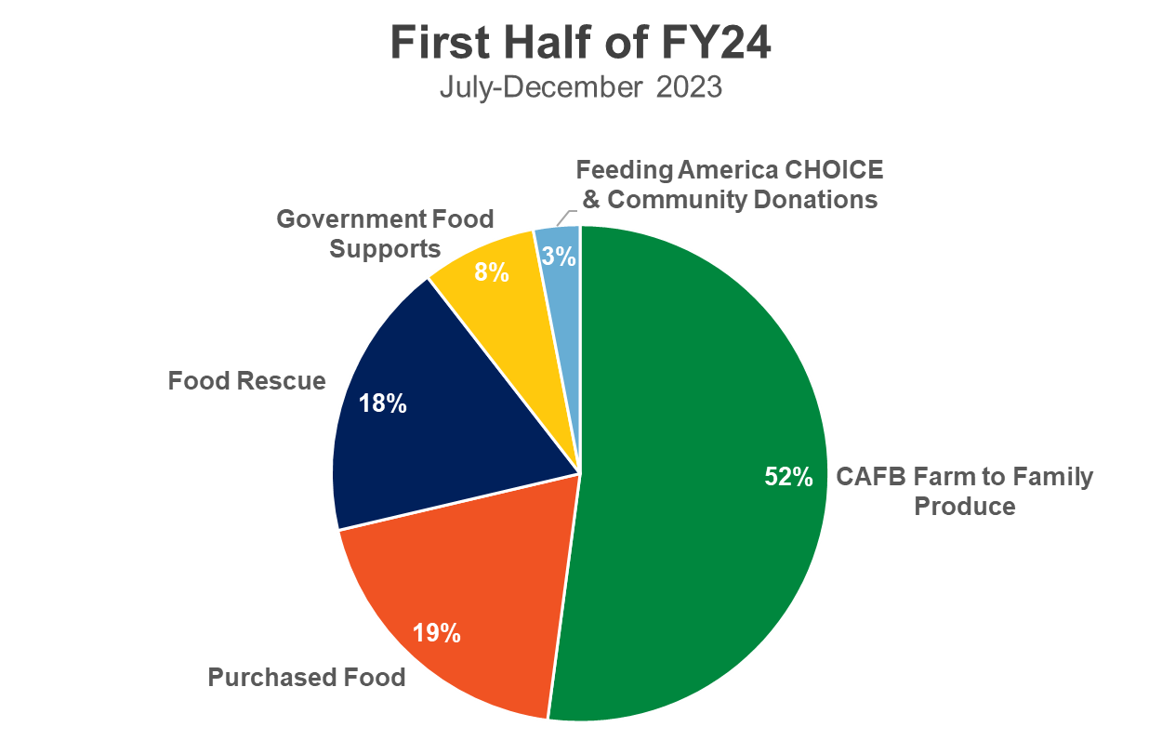
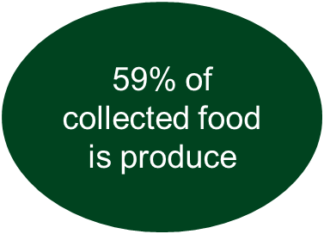
Food by Source Continuing to maximize produce and food rescue while managing purchased food costs
81% donated / 19% purchased

Slide 9
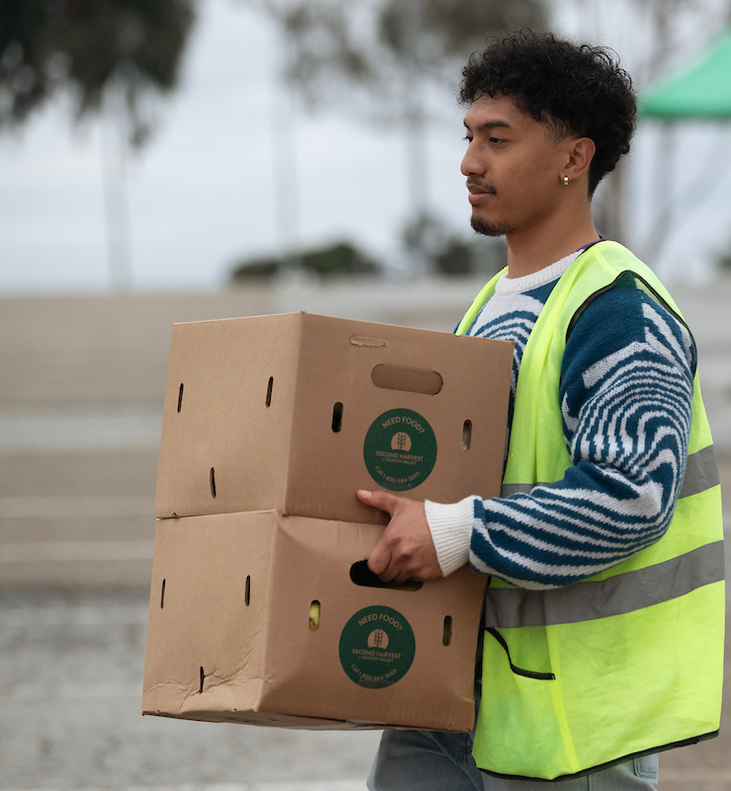
Volunteers Offer Core Service Support
40,000+
Unique Volunteers
283,000
Hours of Service
Volunteer Hours Equivalent to
136
Additional Full-Time Staff

Slide 10
Second Harvest is serving the same number of people as during the height of the pandemic
We are serving 100% more people than we served pre-pandemic
Dramatic increase in need is outpacing resources
Resources are steadily declining
Government funding is returning to pre-pandemic levels (less than 10% of our budget) and private funding is just 60% more than pre-pandemic
This leaves us with a significant budget deficit that is not sustainable
We need our community and government partner support now more than ever to maintain this critical safety net.

Slide 11
Our Mission: End hunger in our community
Strategic vision
We will deepen our relationships with local communities to evolve a system of support that equitably meets the immediate need for food assistance while identifying opportunities to address the root causes of hunger.
Goals
Transition from crisis response to a sustainable way of working
Increase our impact by working more deeply in community
Create a workplace that empowers all of us to do our best
Educate, inspire
and engage our community to take action

Slide 12
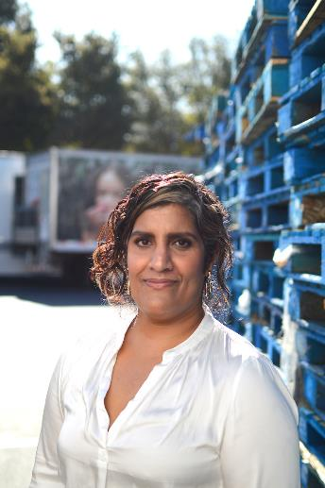
Deepening Community
Maya Murthy
Vice President of Programs & Services

Slide 13
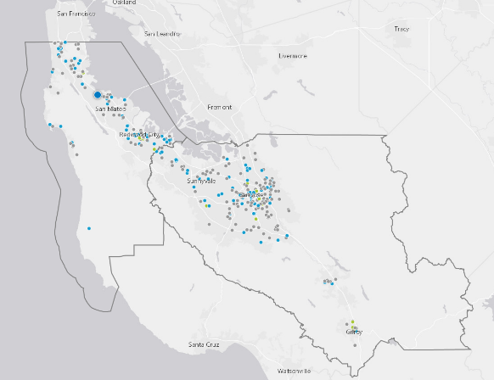
Bringing our Mission to Life
​Second Harvest sources and distributes groceries through about 400 partners and 900 sites across Santa Clara and San Mateo counties. All food is free for partners & clients.
We partner with local, state and federal groups, enabling us to connect people with food resources in their neighborhood and strengthen programs and policies that help build a hunger-free community.

Slide 14
Increase our Impact by Working More Deeply in Community Multi-Year Goal
Purpose:
We know the challenges in our communities will be better addressed if we are working in deep collaboration together
Objectives:
Deepen relationships
Increase our engagement with people experiencing food insecurity
Advocate for root cause solutions beyond food provision and extend the reach of our advocacy
Notes:
We know that the challenges to address essential needs and impact the root cause of food insecurity in our communities will be better addressed if we are working in deep collaboration together with our partners, community leaders, people experiencing food insecurity, and local electeds.
Deepen relationships to better understand how to effectively serve, partner, connect, and work collectively with our community to end food insecurity.
Increase our engagement with people experiencing food insecurity, directly & through partners, to ensure we are working on the most impactful services and advocacy.
Work with our elected officials, our partners, community, supporters and clients to continue our advocacy around food and understand where we can effectively advocate for root cause solutions beyond food provision and how we can extend the reach of our advocacy.

Slide 15
Increase our impact by working more deeply in community Multi-Year Goal
In FY24 pilot a holistic neighborhood approach:
Deepen our understanding of community needs, resources, challenges, and advocacy opportunities
Develop & strengthen existing partnerships and build new relationships
Identify areas of greatest impact on food access and other root cause issues
Determine how to launch this hyper-local neighborhood approach across our wider service area

Slide 16
Policy Principles and Priorities
Tracy Weatherby, Vice President of Strategy & Advocacy

Slide 17
Access to Nutritious Food is a Human Right

Slide 18
Evaluate policies for impact on diversity, equity & inclusion

Slide 19
Community Voice Matters

Slide 20
Issue Areas We Have Focused On
School & Summer Meals
CalFresh/SNAP
Food as Medicine
Creating a More Equitable Food System
Protecting workers in fields, kitchens & grocery stores
Directing resources to farmers, ranchers & communities of color that have been excluded from state and federal programs
Food access for the unhoused
Food Rescue
Support of Food Banks
Voter registration & Get Out the Vote

Slide 21
Addressing the Root Causes of Hunger

Slide 22
Addressing the Root Causes of Hunger
Systemic racism and other inequities
are the root causes of hunger
As part of our mission to end hunger in our community, we will explore how we can support root-cause solutions.
We will learn with humility as we learn about issues outside of food.
We will work in coalition with our community and focus on solutions where we can have the greatest impact.

Slide 23
Root Cause Policy Goals
Identify where we can have impact on root cause issues that help to end hunger in our community
Get educated, work with coalitions, and support key policies.
Identify areas of greatest potential impact over time.
Amplify our work on core food issues through support from other coalition partners and through deeper community engagement.
Learn and iterate.
Constraints:
The Advocacy department is not expected to grow.
We need to maximize impact for resources invested.
Notes:
Tracy to deliver in meeting

Slide 24
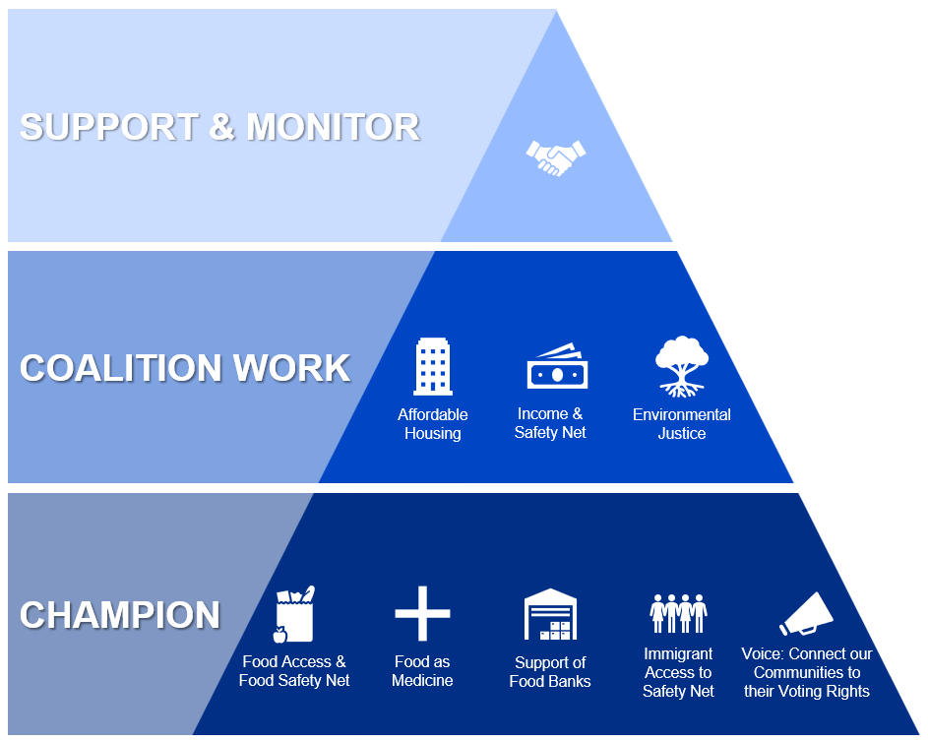
Our
Root Cause Approach

Slide 25
Policy Review Questions
Hunger Impacts: Can this policy help end hunger?
Centering Community: Has this issue emerged in our conversations with clients and partners?
Racial Equity: Does this policy advance racial justice and equity?
Policy Pros & Cons: Are there reasonable solutions to this issue?
Chance of Progress: Can we see a path (shorter-term or longer-term) to success with this issue? Is this part of an ongoing discussion, something that requires long-term education where we could assist, or would we have to start the discussion?
Notes:
Tracy to deliver in meeting

Slide 26
Questions?

Slide 27
School & Summer Meals
Rachel Monaco
Senior Manager, Policy & Advocacy

Slide 28
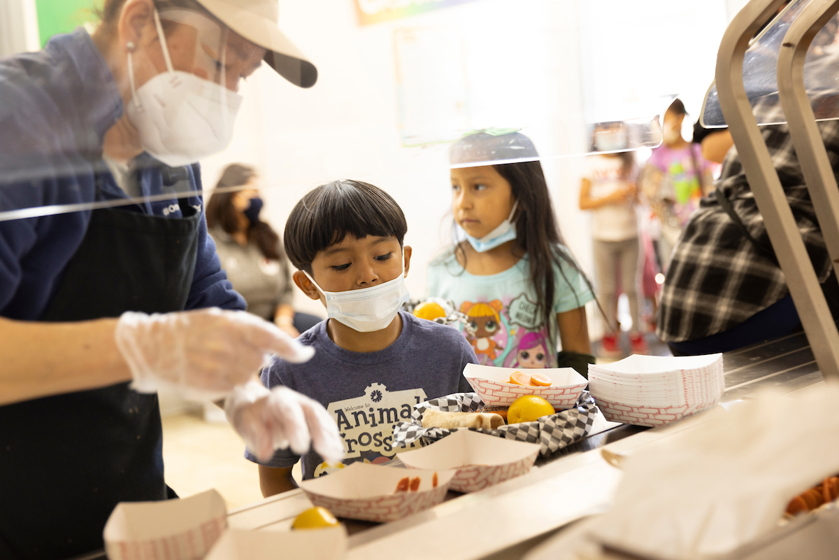
Universal Free School Meals
2022-23 was the first year of CA’s first-in-the-nation universal free school meals program.
Positive outcomes:
Builds equity. More students are eating school meals without stigma or shame.
+12% school meals consumed in CA in SY22-23
Schools began serving breakfast.
More schools cooking from scratch.
State funding for Kitchen Infrastructure and Training (KIT), scratch cooking support, Farm2School programs.
8 states have passed their own free school meals programs.

Slide 29
Building on the Momentum
Local:
Consider school-day schedule adjustments such as Recess before Lunch.
Ensure kids have enough time to eat their meals.
Ensure school nutrition staff are paid a livable wage with benefits.
State:
Protect funding for Universal School Meals.
Continued funding for increased participation projections and KIT.
Federal:
Pass a Child Nutrition Reauthorization Bill which includes Free School Meals for All
Increase Community Eligibility Provision reimbursement multiplier to make it more affordable for states to implement.

Slide 30
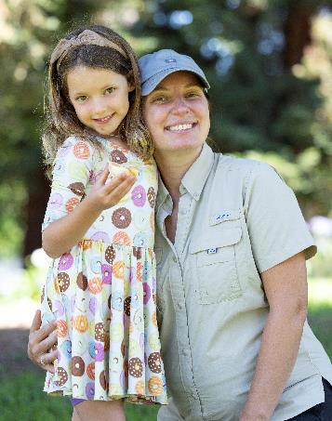
Summer Electronic Benefits Transfer (EBT)
2023 Federal Omnibus Spending Bill established permanent Summer EBT.
Low-income students will receive $120 per child per summer beginning 2024.
30%+ of our student population across our two counties may be eligible.
We will monitor its implementation and advocate for any needed program improvements.

Slide 31
Supplemental Nutrition Assistance Program (SNAP)/CalFresh
Kelly Chew
Director of Services

Slide 32
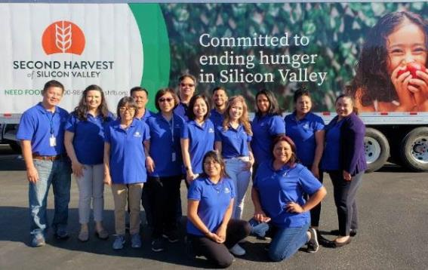
Food Connection
We connect clients to free groceries, sites serving prepared meals, and help them apply for CalFresh or sign up for our home delivery program.
16 bilingual staff – English, Cantonese, Mandarin, Spanish, Tagalog, and Vietnamese
Clients can contact us
Phone: 1-800-984-3663,
Monday – Friday, 8am – 5pm
Fill out form to request a call
Self-service tools:
Online food locator tool
CalFresh online application

Slide 33
FY23 Local Impact of Our Work
9,634 Applicants Prescreened
$5.2M in Annual Benefits
$7.9M in economic activity in SMC and SCC
1,404 Approved CalFresh Applications

Slide 34
Strengthening the Safety Net
Food4All SB245/AB311: Expand access to California Food Assistance Program to low-income people ineligible for CalFresh due to immigration status​.
State budget funded expansion to ages 55+, to be implemented in October 2025.
California Fruit & Vegetable EBT Pilot: Provides a double-up benefit for CalFresh recipients purchasing Californian-grown produce at grocery stores. Pilot operating in Santa Clara County.
Funds projected to run out summer 2024. State Budget request to extend.
Provided estimated $190,000 in benefits in SCC in 2023.
H.R. 3183 – Federal EATS Act: Attending higher education would count the same as work for the purpose of determining eligibility to participate in SNAP.

Slide 35
The Impact of Food Rescue
Joan Sanborn
Senior Manager of Food Sourcing

Slide 36
86+ Million
Pounds of Food Rescued In FY23
3,000+
Olympic Size Swimming Pools of Water
~10,000
Passenger Vehicle Emissions Driven for 1 Year
= 250 Pools
= 1 Thousand Passenger Vehicles

Slide 37
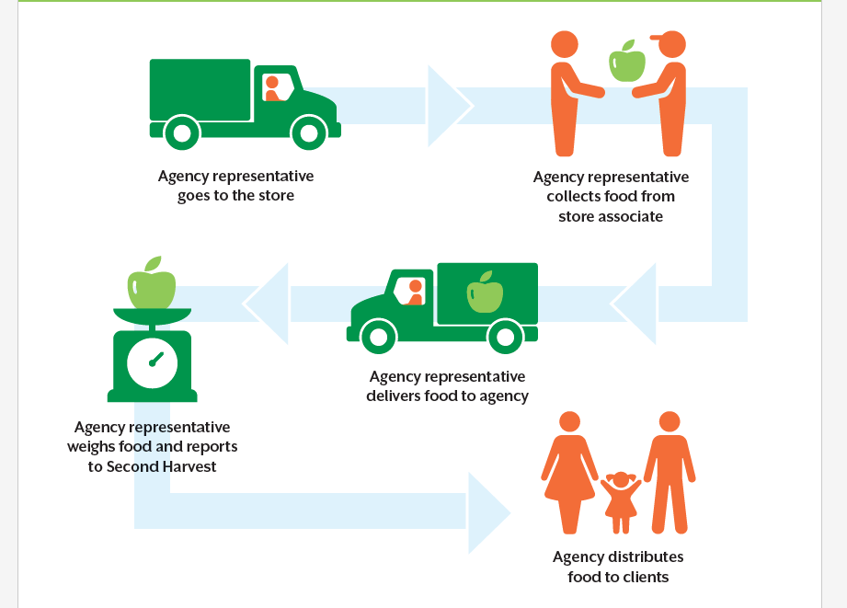
How Second Harvest Rescues Food From Retailers, Manufacturers, Wholesalers
Path 1
Path 2
Second Harvest pairs agencies with retailers, equips and trains agencies to do grocery rescue
Second Harvest picks up large, homogenous loads from wholesalers, manufacturers, and retailers
Food is processed at Second Harvest warehouse for inclusion in agency orders and/or Agency Shopping.
Or
Second Harvest delivers food to agency or the agency picks up in the Shopping area of our warehouse.
Notes:
STAN Speaking Points:
We are the hub of the food rescue system:
Beyond critical transportation, we are providing relationship management, food safety training, infrastructure, and reporting to governmental entities.
Feeding America establishes explicit food rescue relationships with national partners and connects local generators to their regional food bank.
Note that the 93% of Path 1 is increasing and so far in FY24 it’s 96%. (Rescue is up overall this year.)
Path 2 notes:
Amazon fresh – we go 6 days a week to get a tractor trailer
Amazon ultra fresh twice a week & UNFI (Whole Foods Supplier) twice a week
Walmart super centers

Slide 38
SB1383 – Opportunities for Food Recovery
New Partnerships
100+ partner agencies complete 700+ food pickups from 200+ retail locations every week in FY23
Continuing to expand our partner pickup network and providing infrastructure and training
Tier 2 Implementation
Tier 2 generator donation requirements went into effect in 2024 (restaurant meals, event centers, etc)
Providing technical assistance and comprehensive training materials to our partners detailing how to recover and safely redistribute these foods
Sustainability
To support expansion and continuation of Food Rescue in our region, investment is needed in the nonprofits recovering the food to distribute to people in need

Slide 39
Supporting Food Banks
Rachel Monaco
Senior Manager, Policy & Advocacy

Slide 40
Support Food Access
Cities: Evaluate the food access needs of their community and support with space, funding, and infrastructure. Consider the food bank your partner in understanding this issue in your community.
Counties: Collaborate with the food bank & our partners to ensure appropriate access and funding for the food system and charitable food network.
State: Provide ongoing $60M annual investment in CalFood.
Federal
Continue investment in TEFAP through the Farm Bill.
Invest in proven anti-poverty initiatives such as EITC, CTC, SNAP, WIC, SNP, and other nutrition programs.

Slide 41
Questions? Thank you

